Slide 1
Foodshed Analysis
A Food Environment Methodology in Ecuador

Slide 2
A “foodshed analysis” is a method to characterize the local, directional interactions between culture and the production, distribution and marketing of food.

Slide 3
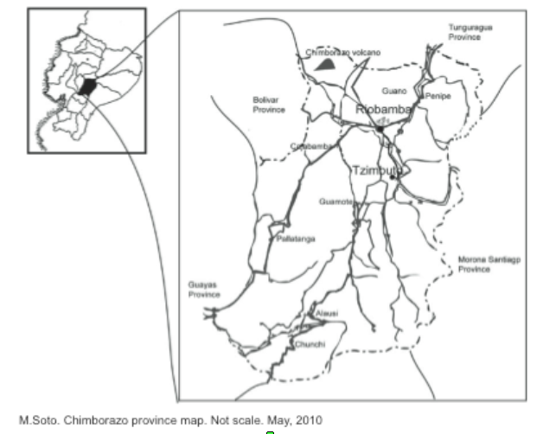
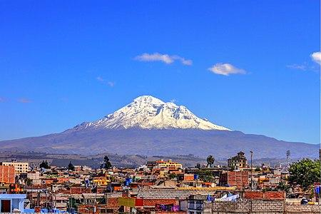

Slide 4
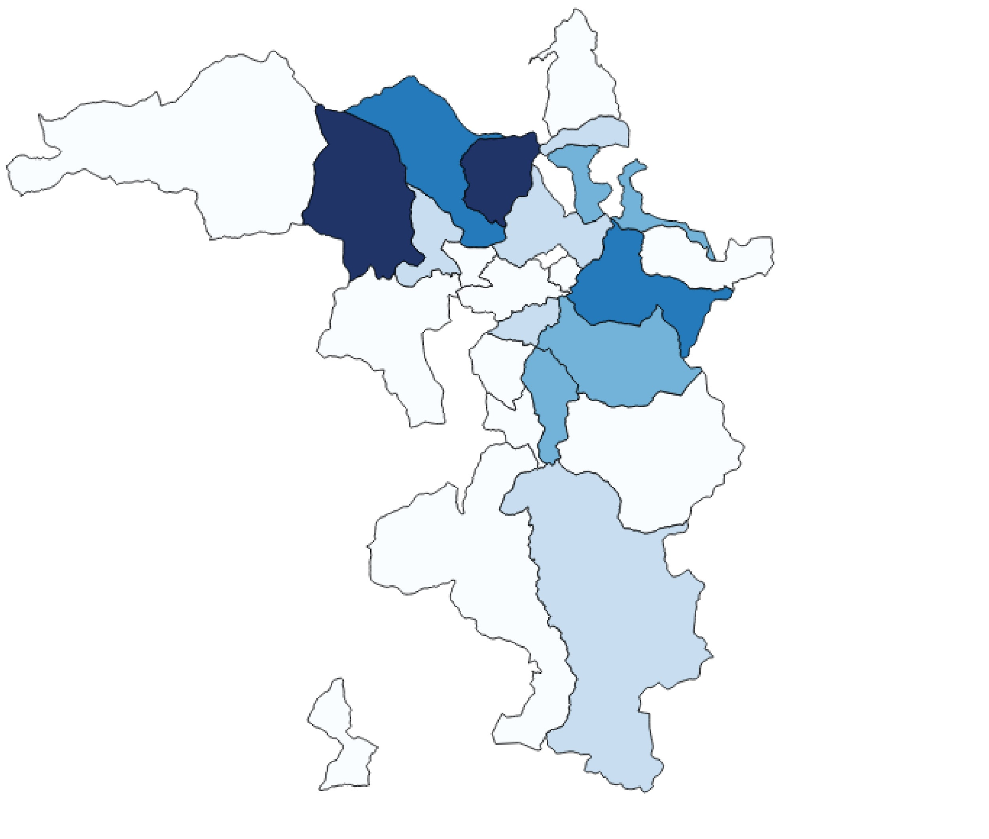
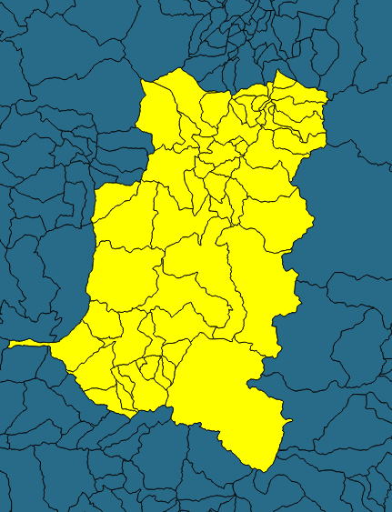
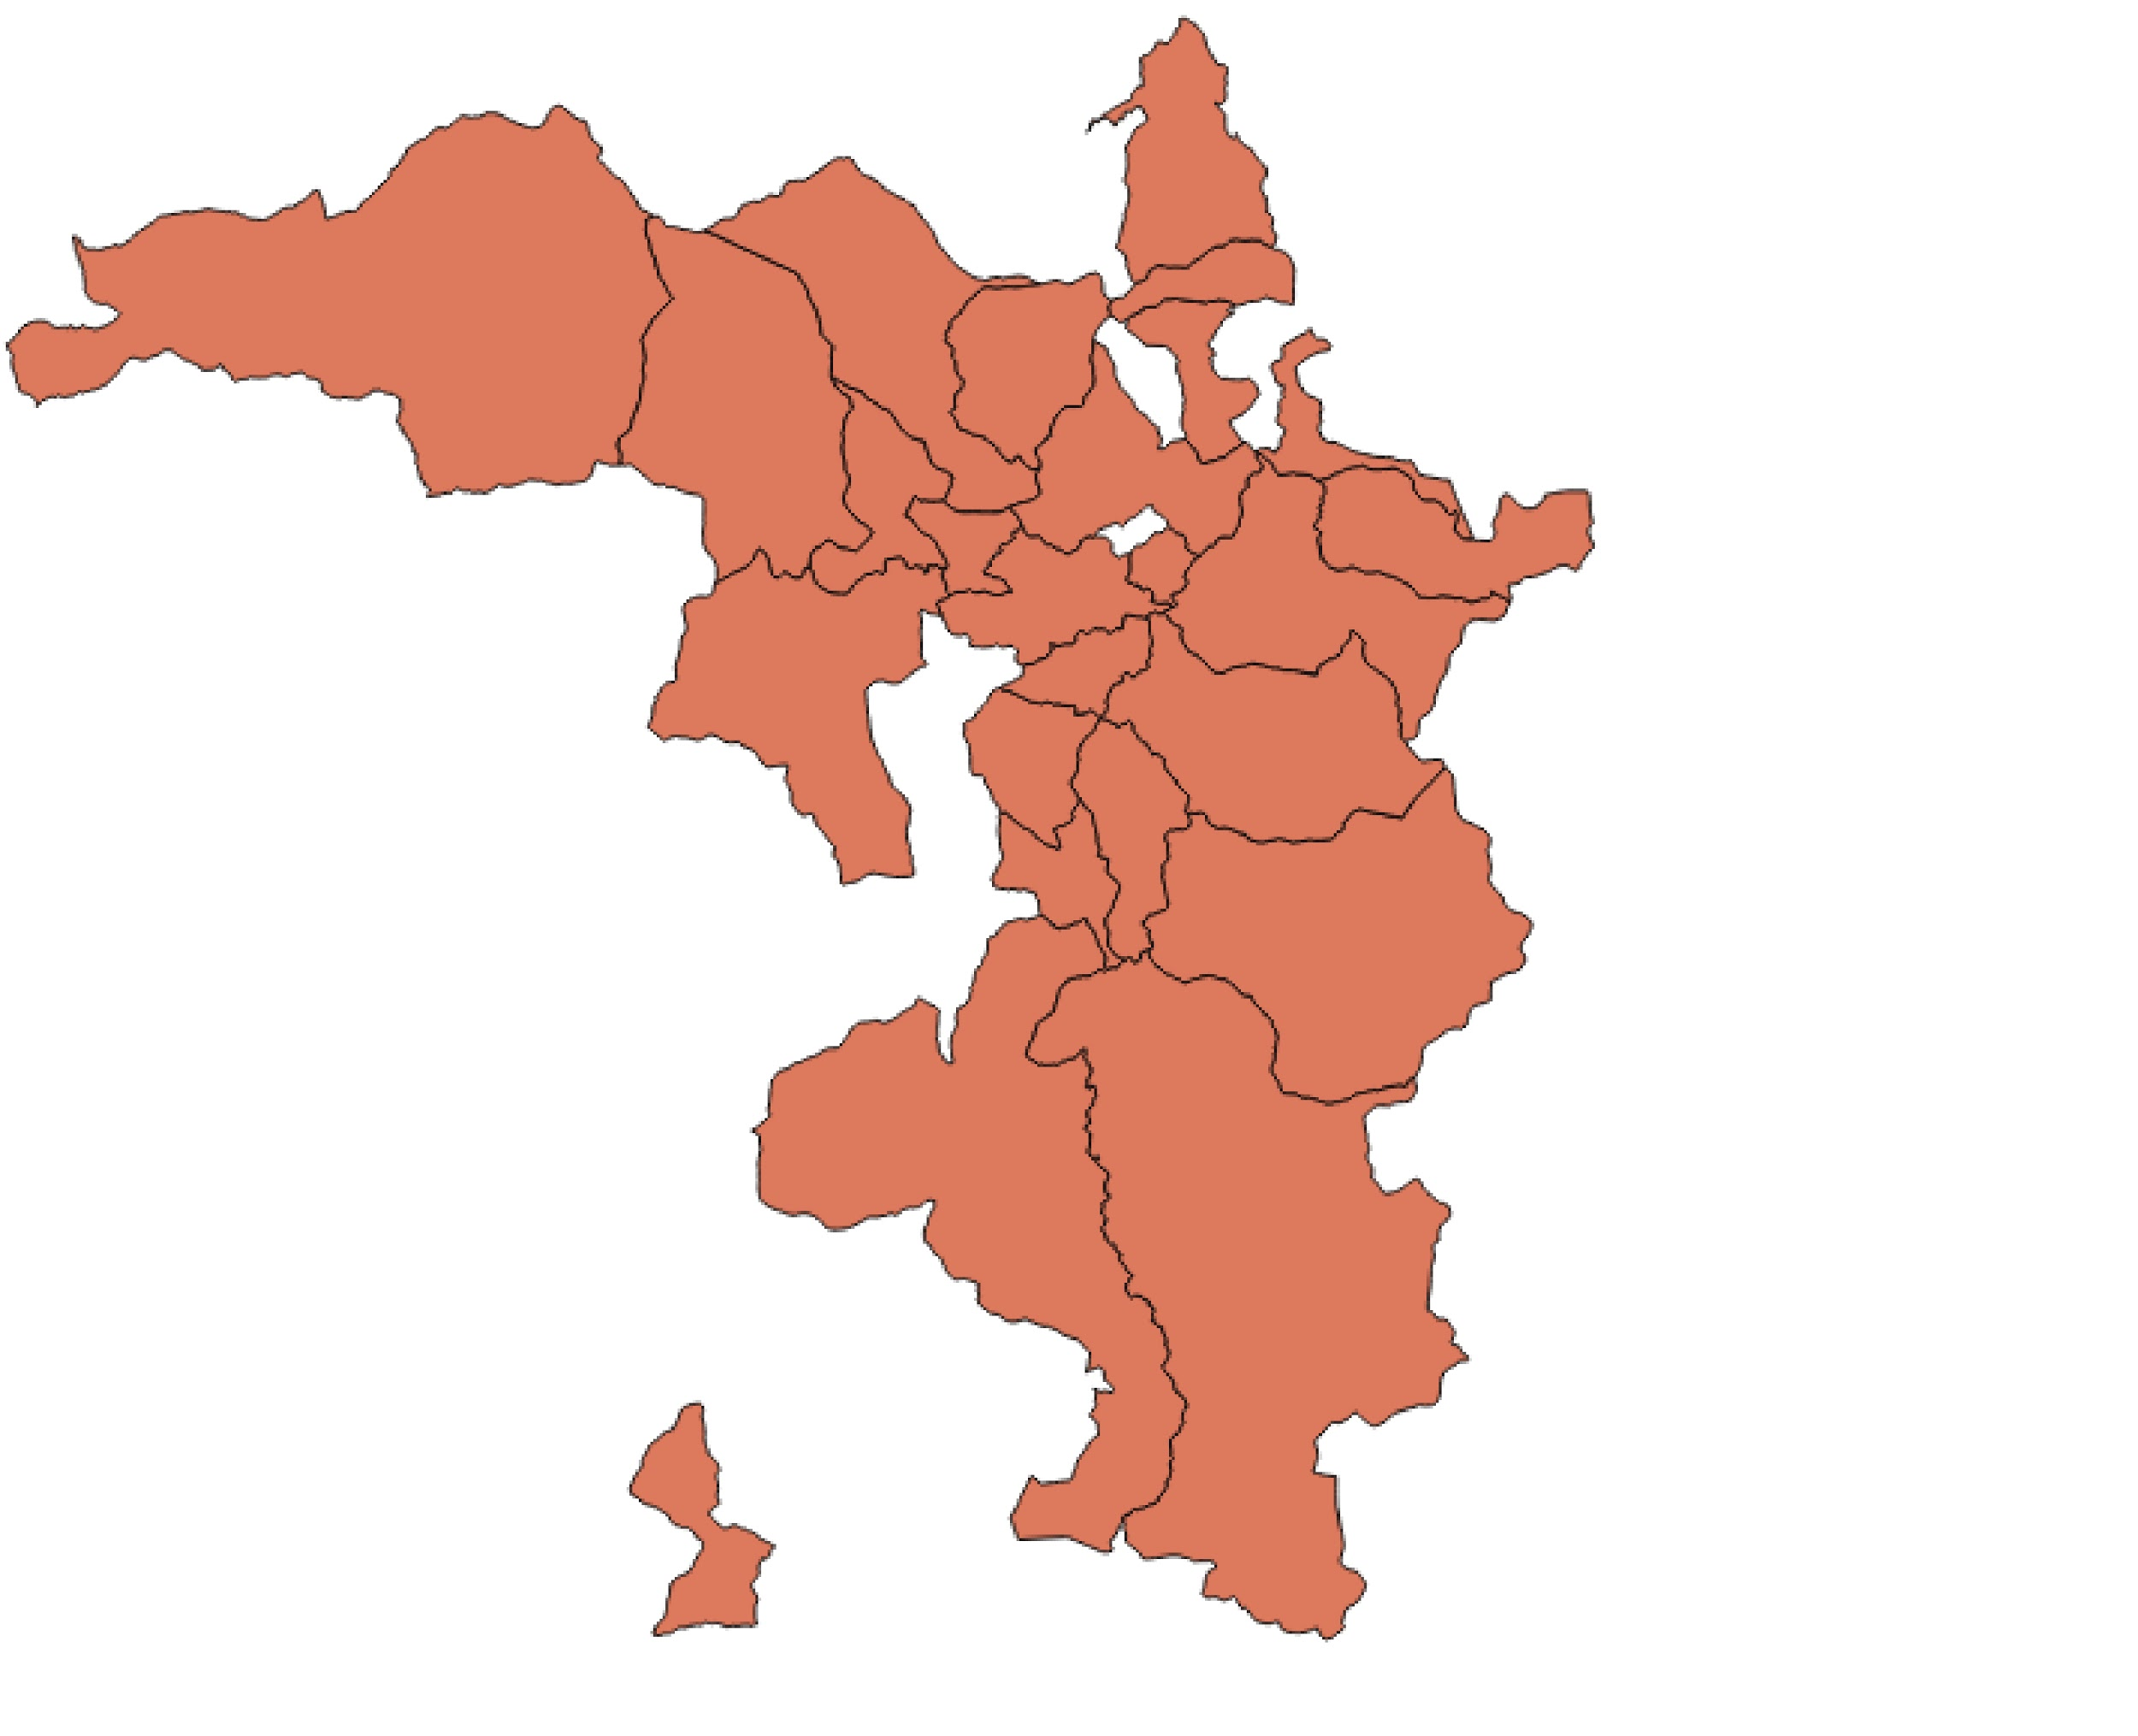
Parishes of Production
Chimborazo, Ecuador
Production Contribution

Slide 5
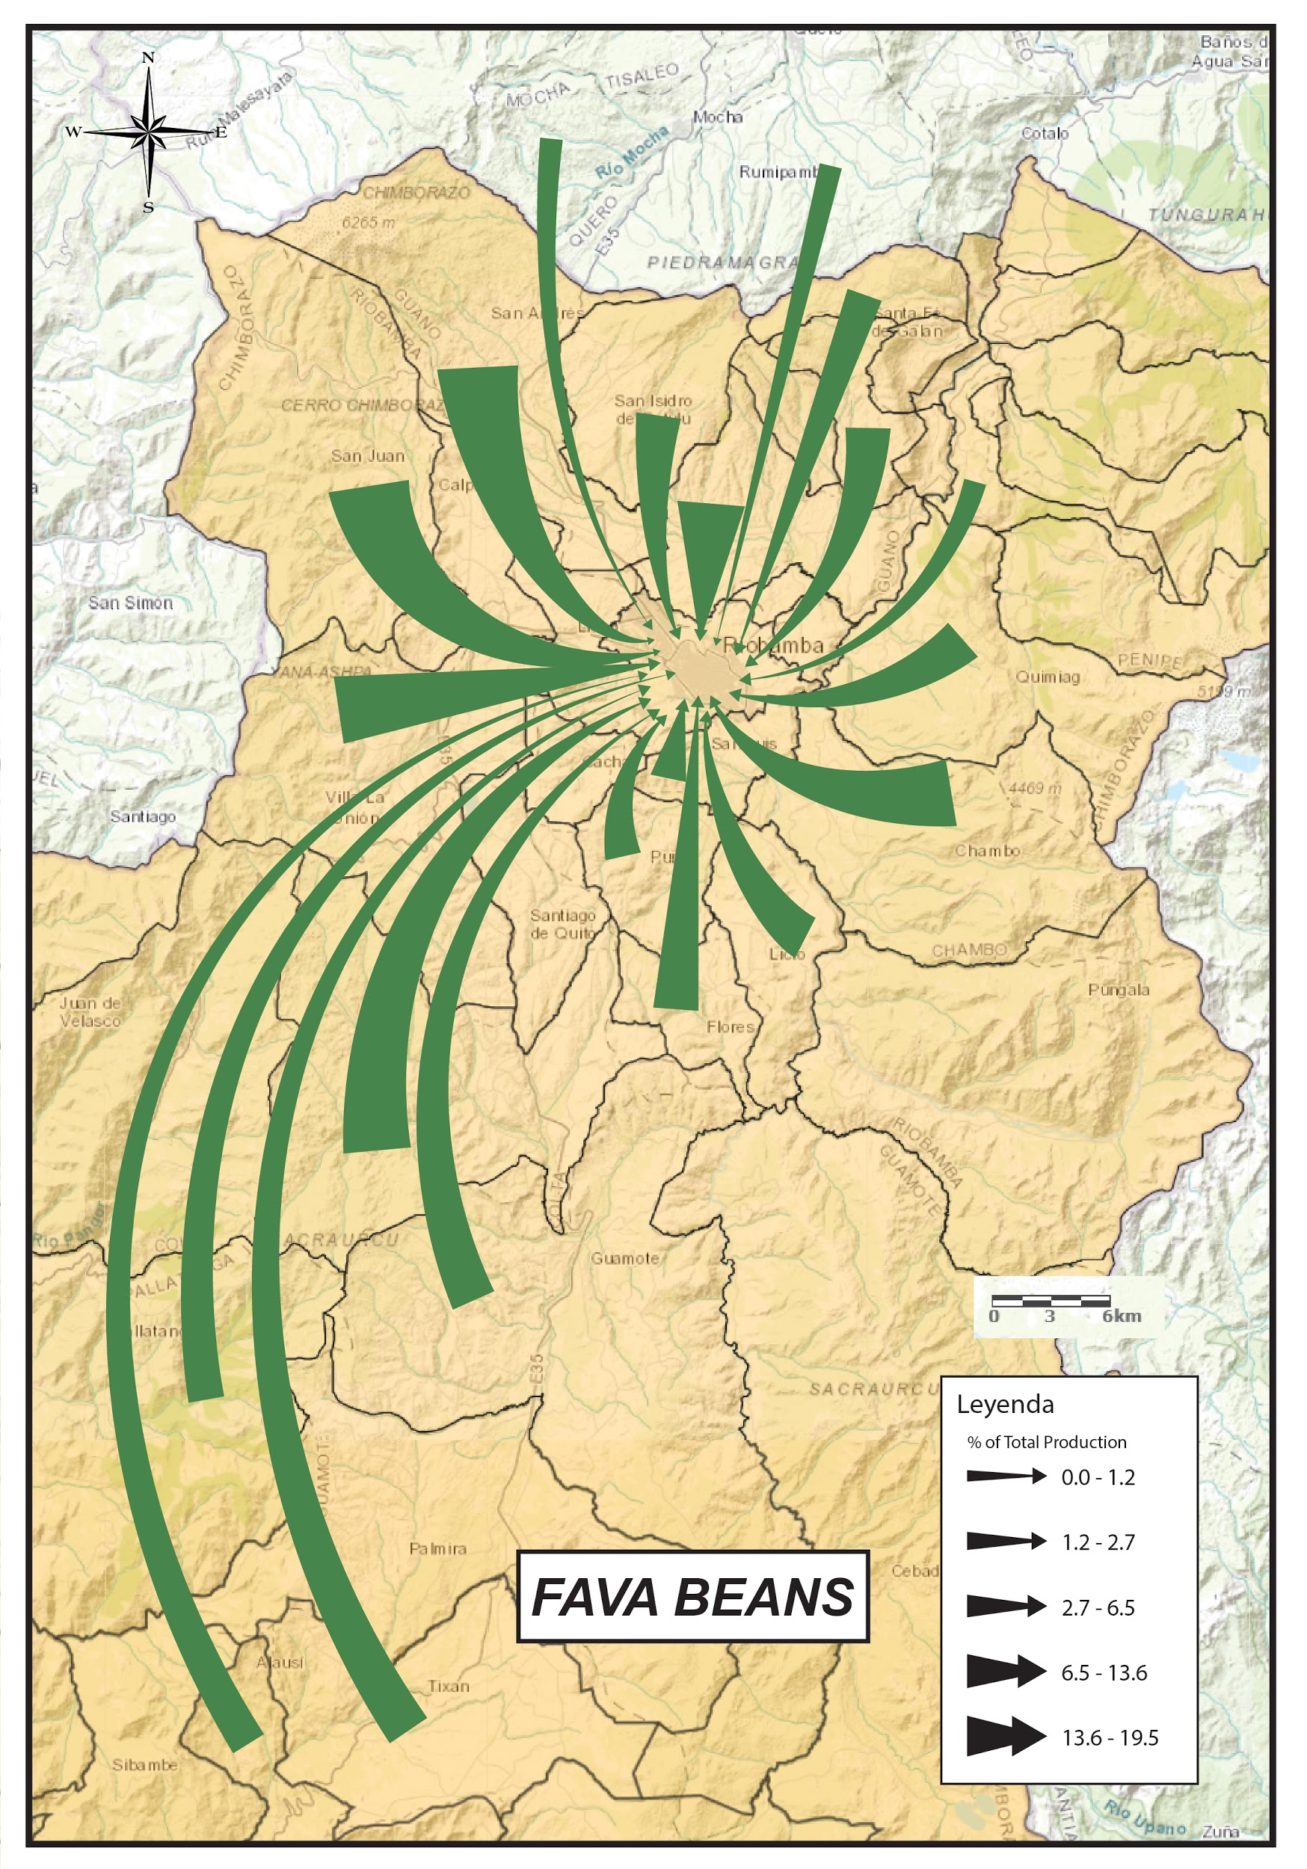
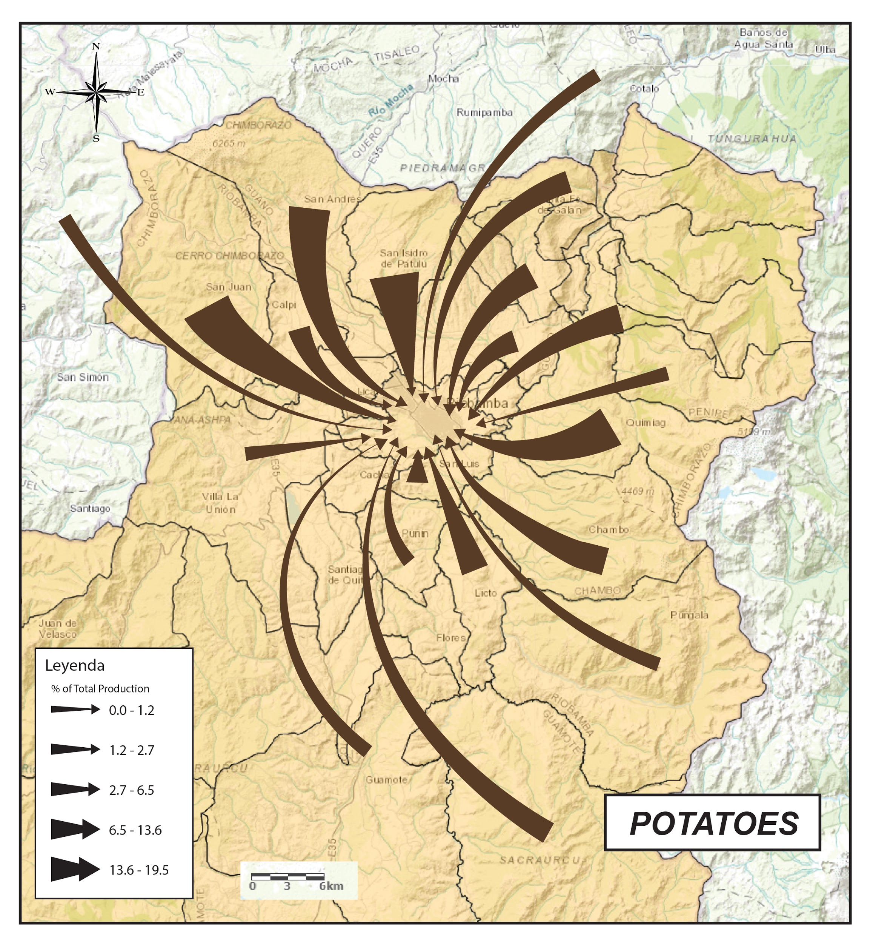

Slide 6
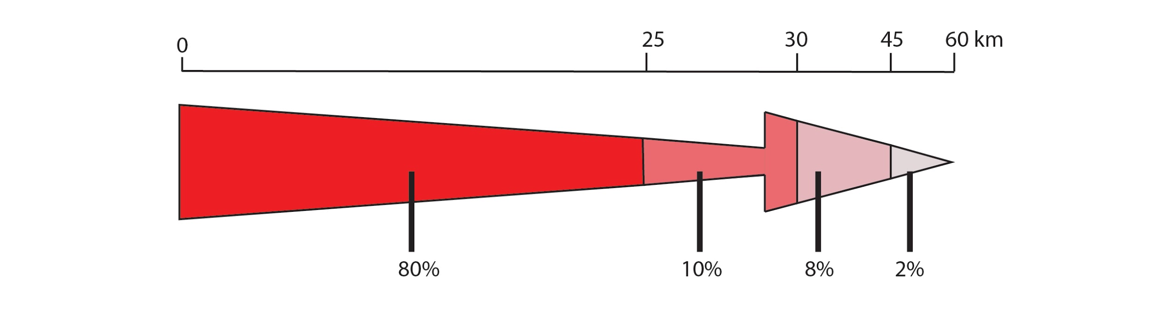
Production Percentage in Distance from City Centre

Slide 8
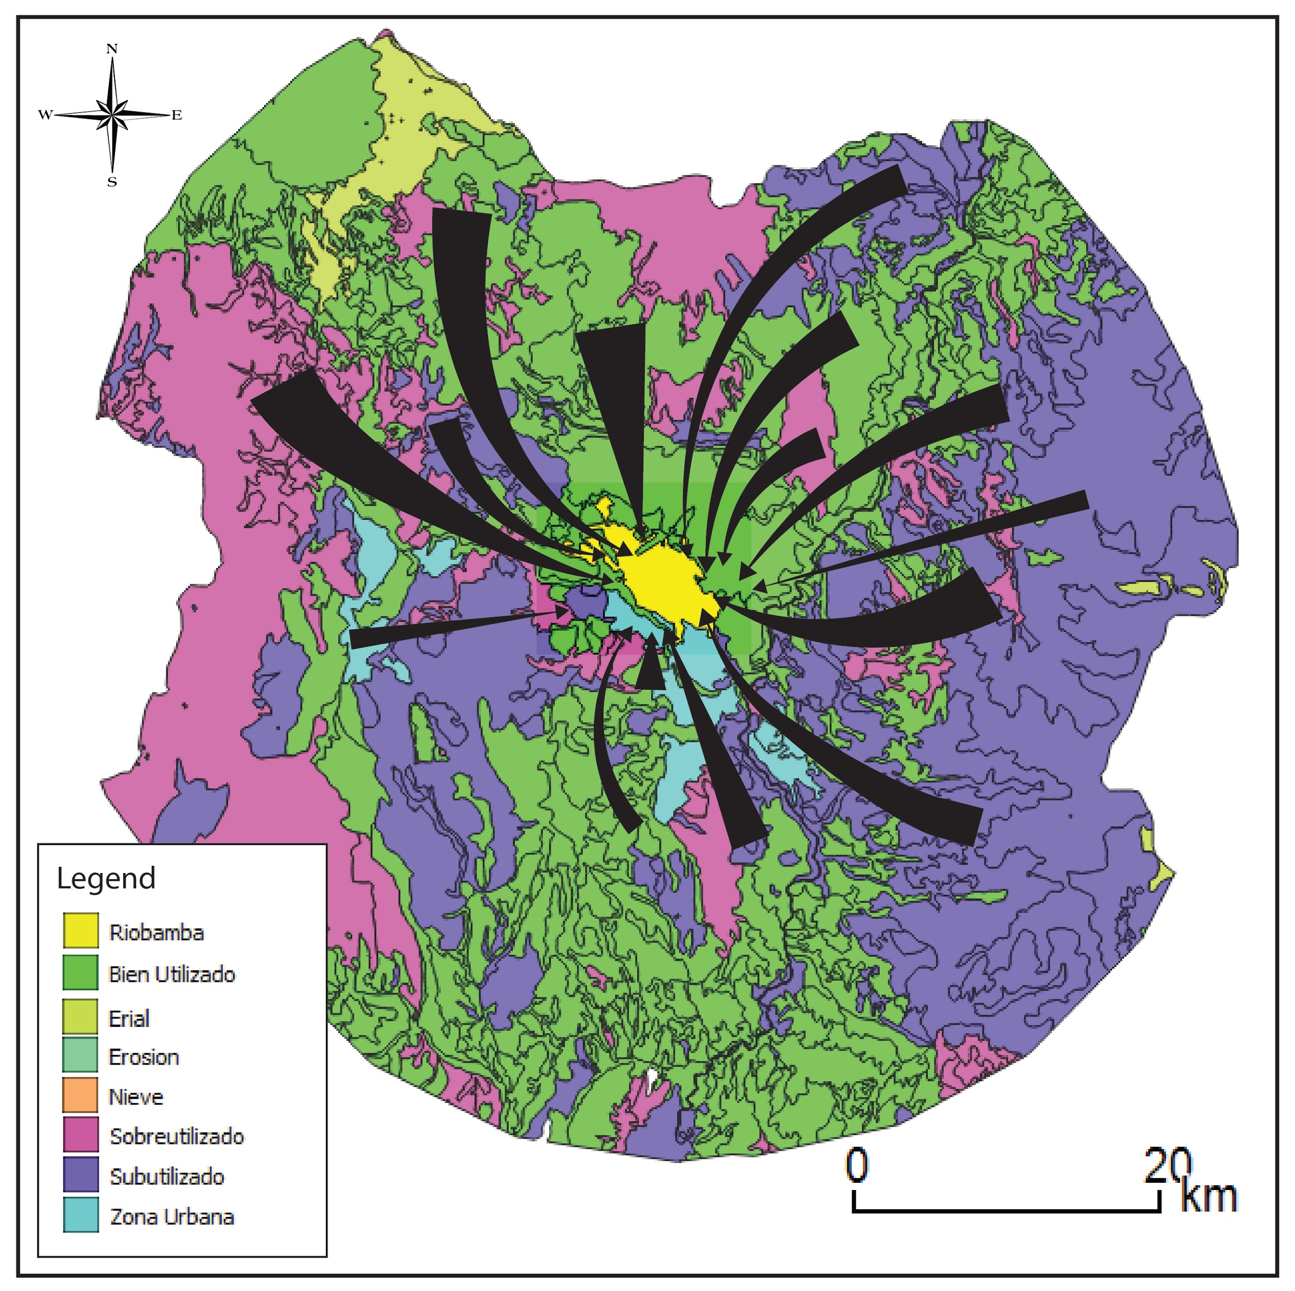

Slide 11
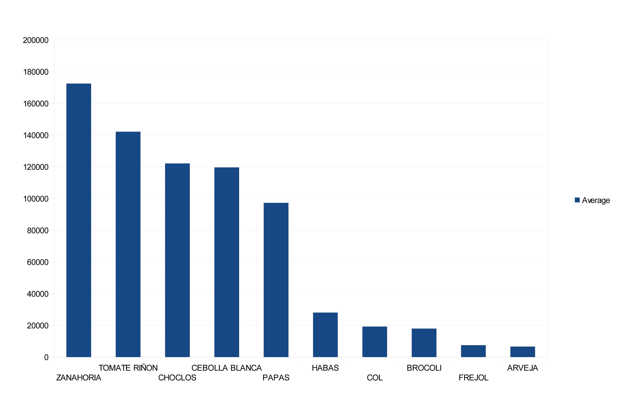
Average Crop Production Surplus

Slide 12
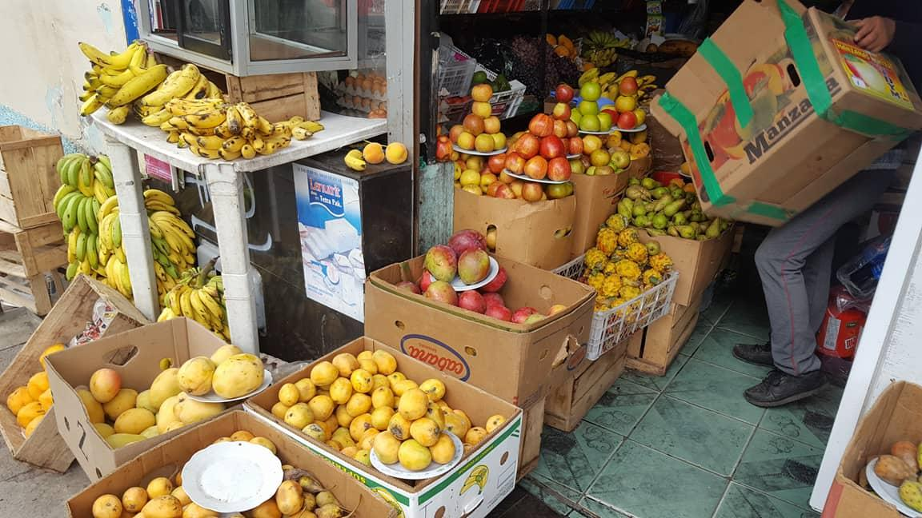
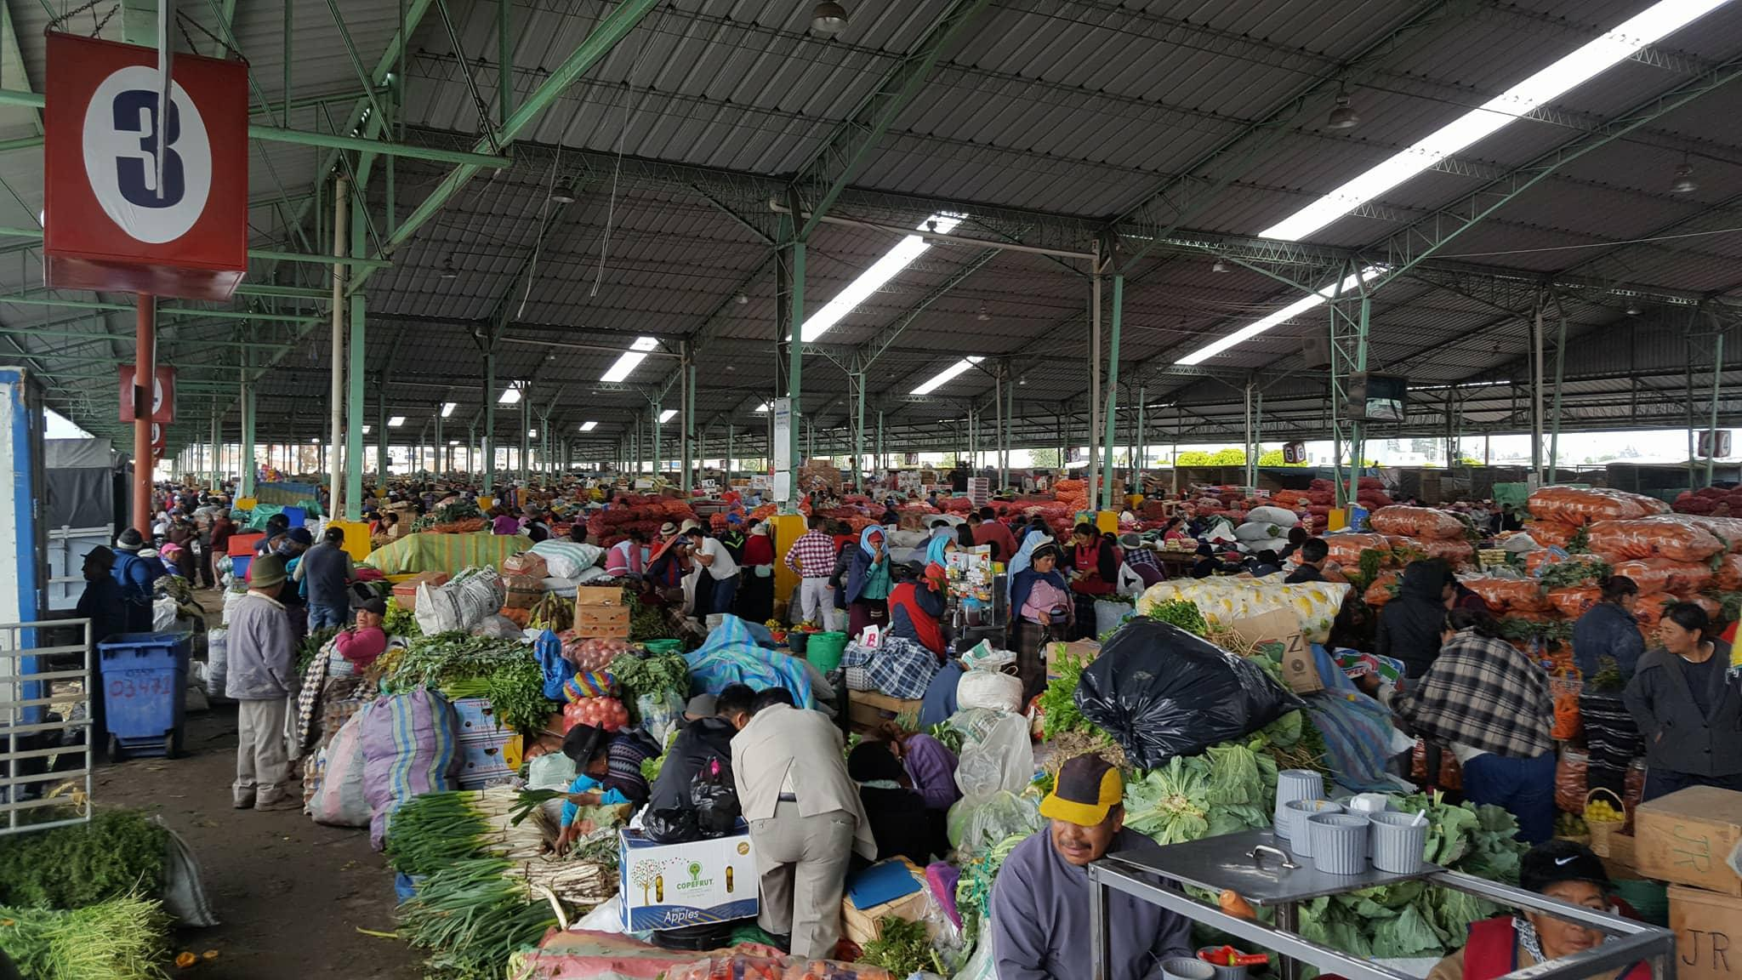

Slide 13
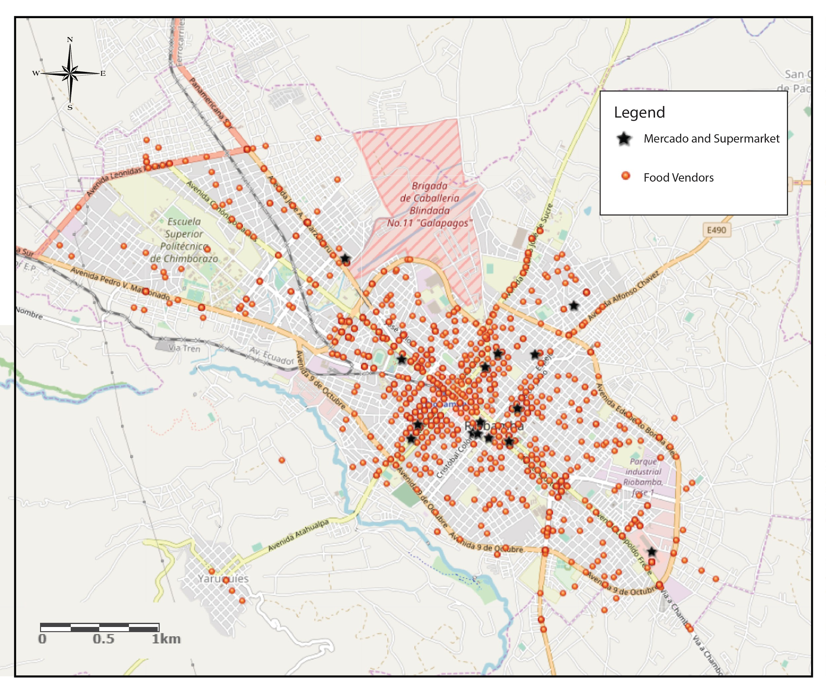
CATEGORIZATION | #
TIENDA COMIDA RAPIDA PICANTERIA, ETC | 1
SUPERMARKET | 2
MERCADO FRUTERIA VERDULARIA | 3
AGROECOLOGICAL SPACE | 4

Slide 14
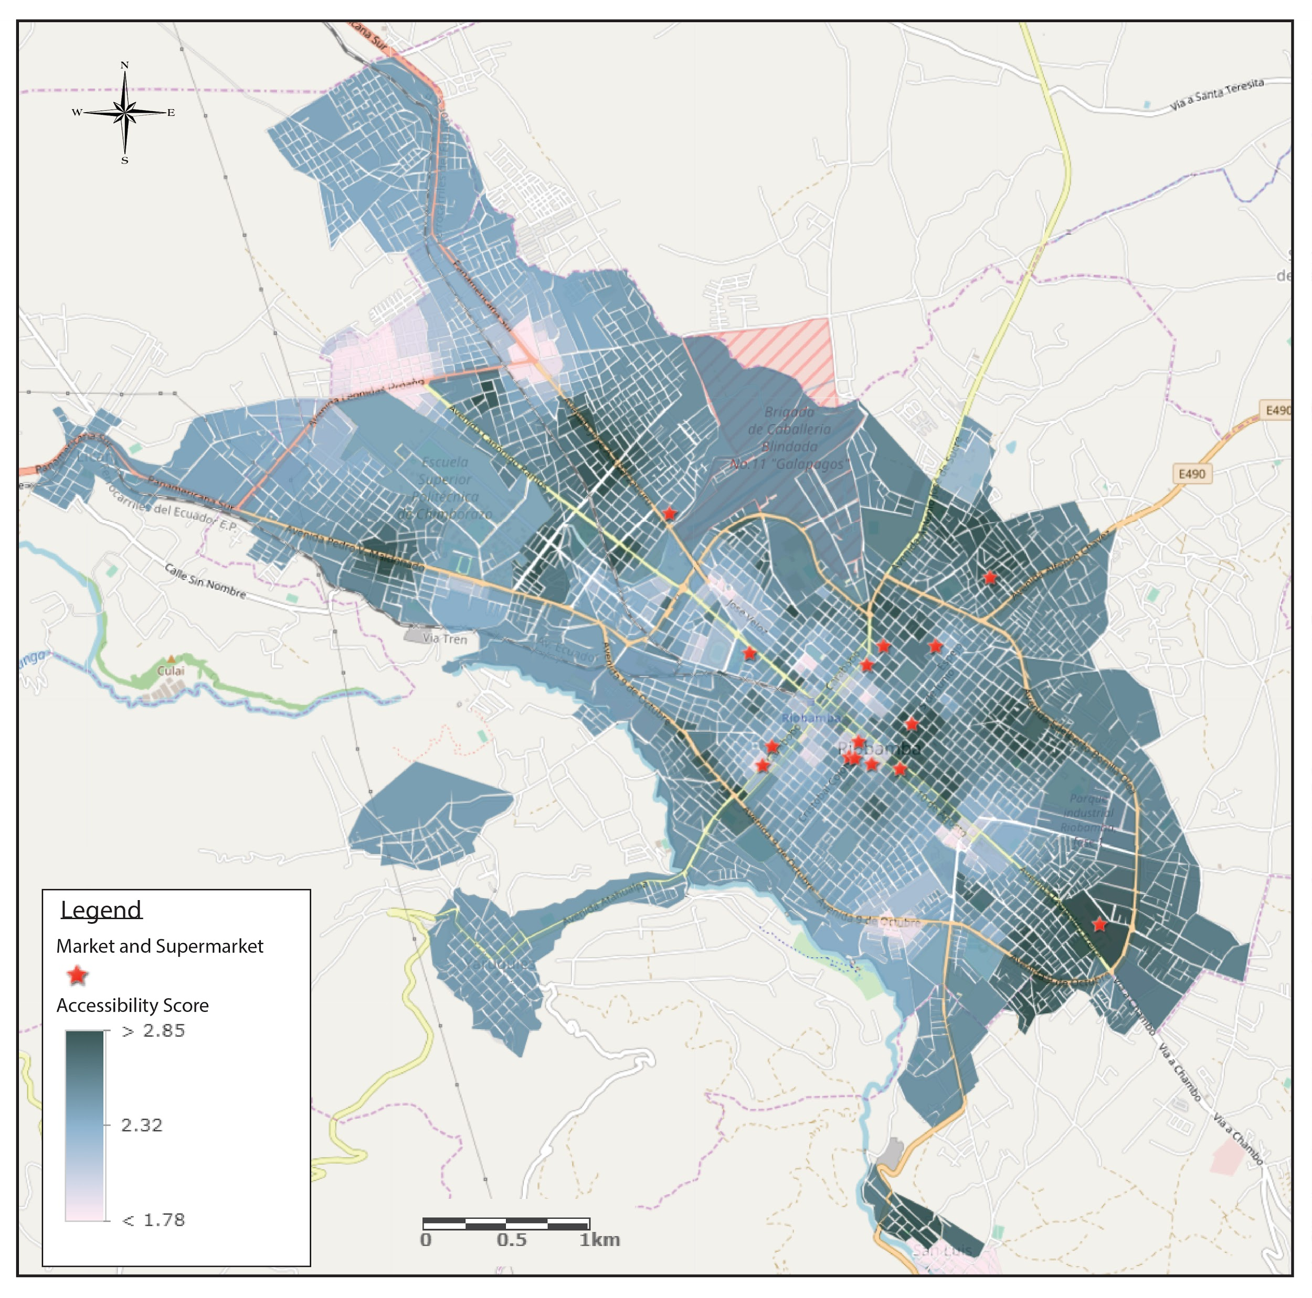
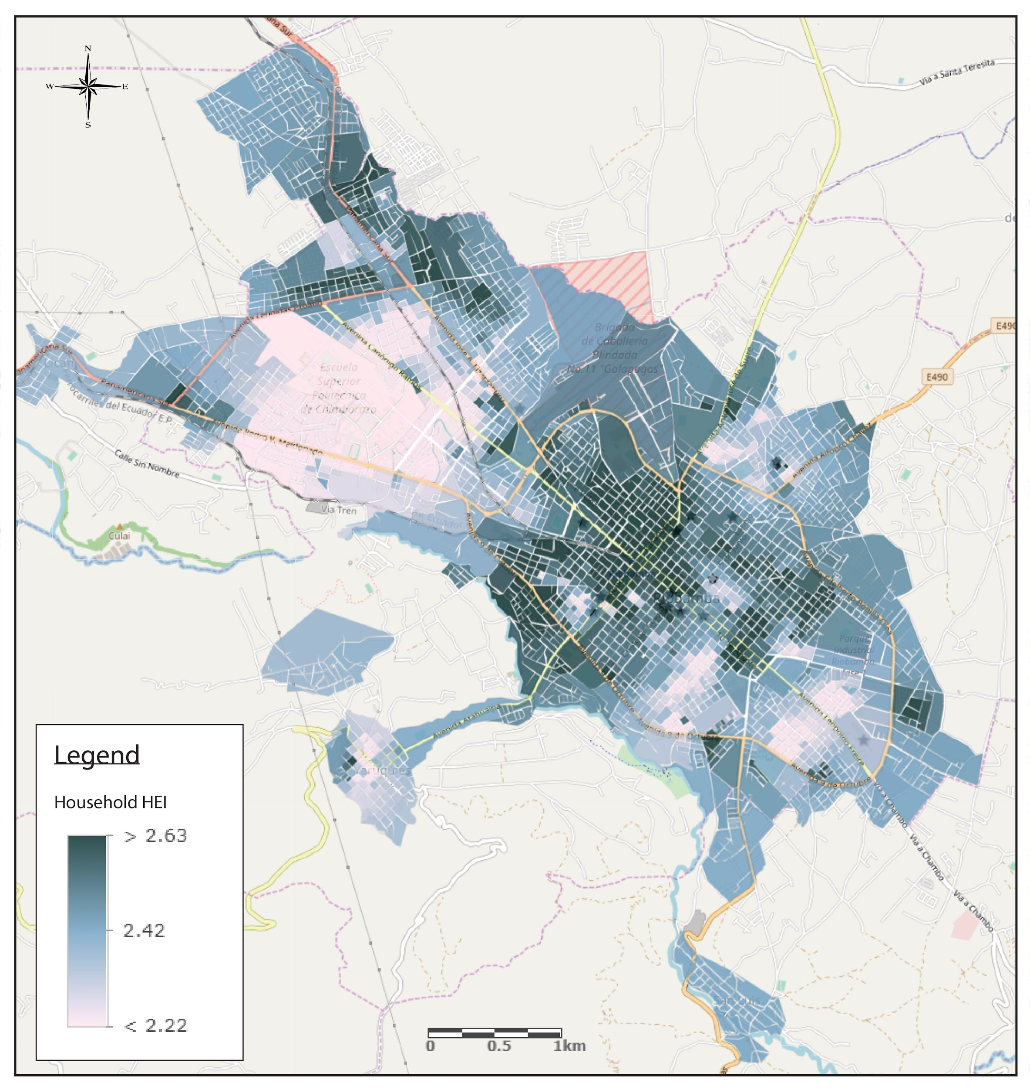
What next

Slide 15
What next

Slide 16
What next

Slide 17
Moving Forward
Accessibility vs Socio-Economic Data
Food Desert Model
Opportunities in City Centre
New Production Zones
Health Mapping

