Slide 1
Papas con alto contenido nutricional:
una alternativa para mejorar la nutrición infantil en las Comunidades Altoandinas del Perú
Raul Ccanto, Maria Scurrah, Walter Amoros, M. Boneirbale

Slide 2
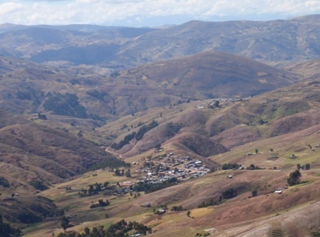
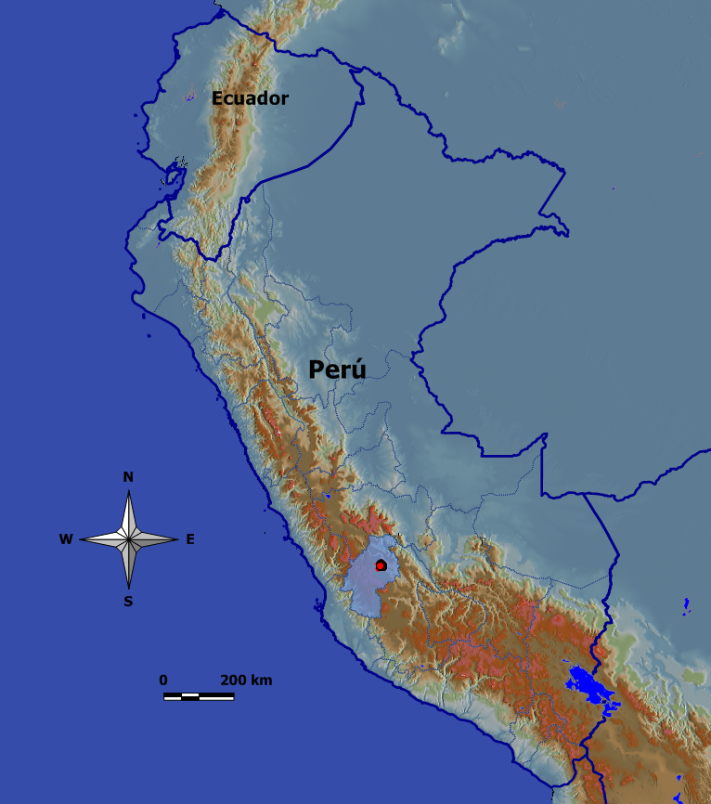
Centro Poblado Ccasapata
11,000 ha., 2100 familias,
10,500 habitantes

Slide 3
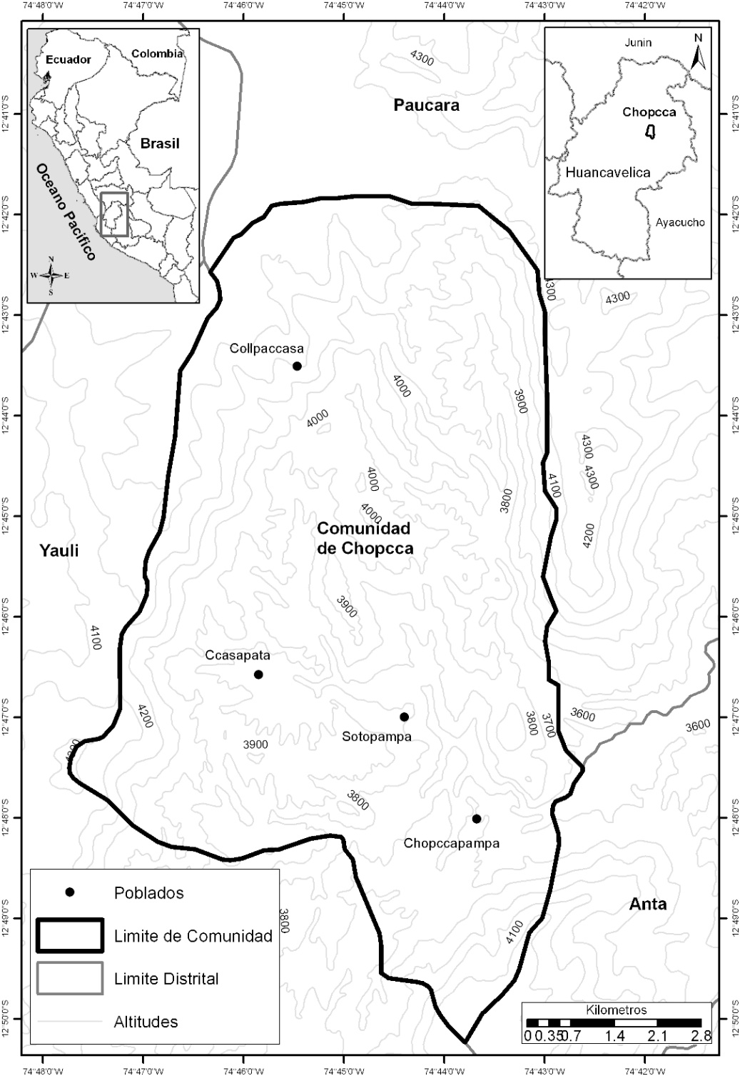
DESNUTRICIÓN CRÓNICA
La desnutrición crónica o atraso en el crecimiento y desarrollo es uno de los principales problemas que afectan la niñez temprana en las comunidades Chopcca.
54.6% de desnutrición crónica, el índice más alto del país (INEI, 2011).
Limites de la Comunidad Chopcca
11,000 ha., 2100 familias,
10,500 habitantes

Slide 4
Desnutrcion Cronica
LINEA DE BASE
La deficiencia de micronutrientes , en especial Fe y Zn fue identificado como uno de los principales causas

Slide 5
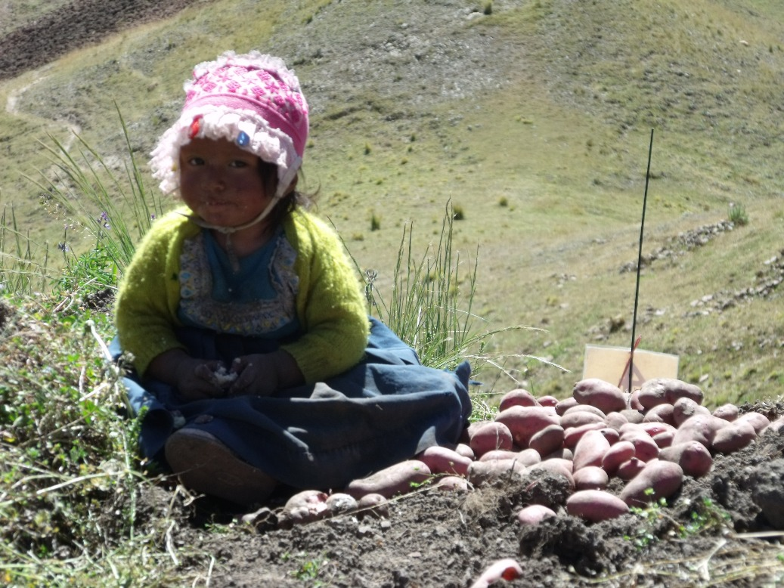
Intervención agrícola sensible a nutrición
Clones con alto contenido nutricional
No requieren cambios de comportamientos alimenticios
beneficios nutricionales
  sin costos adicionales
  estrategia sostenible

Slide 6
Diferencias en consumo en Abundancia y Escasez

Slide 7
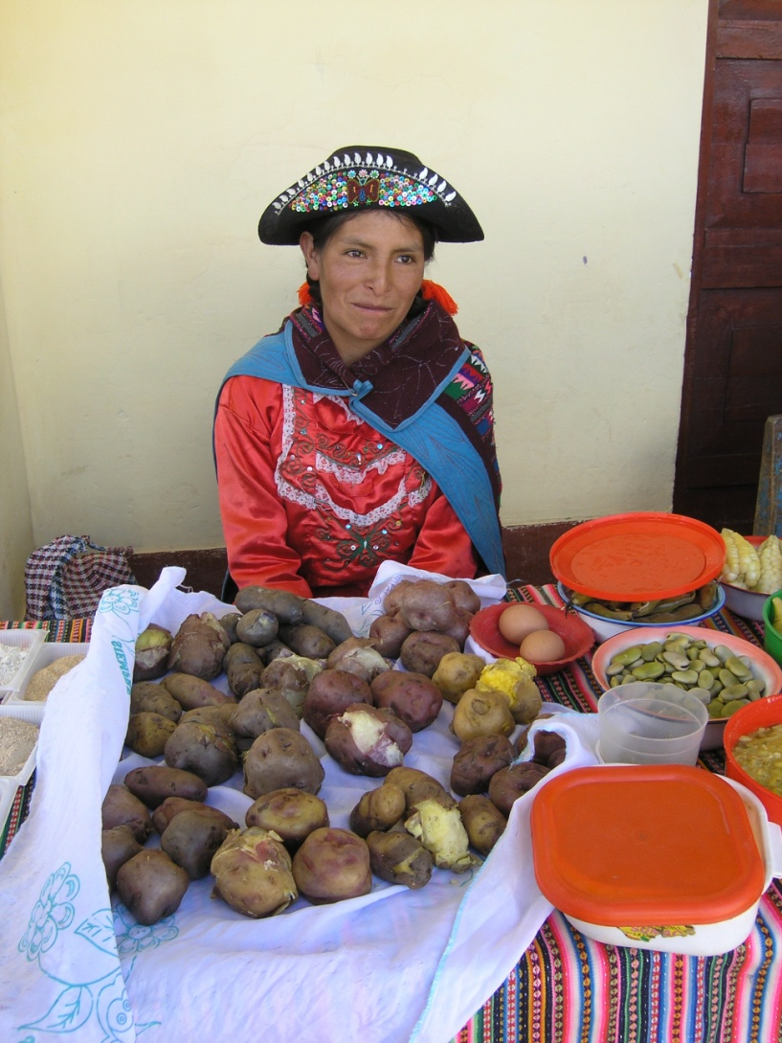
VINCULOS ENTRE AGRICULTURA Y NUTRICION
Desarrollo de alimentos básicos mejorados como fuente rica en micronutrientes.
Complementaria a la diversificación de la dieta, suplementación y fortificación alimentaria.

Slide 8
Variabilidad en recursos genéticos de papa para concentraciones de Fe & Zn
Landrace
Landrace
Landrace
Landrace
Notes:
8
a quality that is particularly welcome in regions where land is scarce

Slide 9
Diversity: Genetic Variability of Potato for Vitamin C Concentration
40
33.2
33.2
82% retention in boiling
%
30
75%
Vit C (mg/100g DW)
20
10
4.2
4.2
0
Natives
(n=626)
Improved
(n=315)

Slide 10
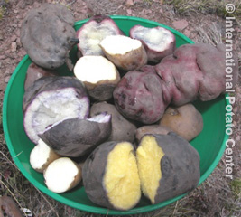
Retención de of Fe & Zn en papa hervida
Fe
No hay reducciones significativas en la concentración de Fe & Zn tras la ebullición
Zn
Notes:
10

Slide 11


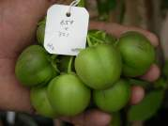





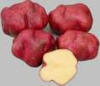



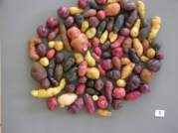

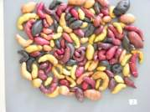
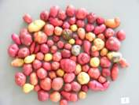
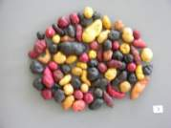
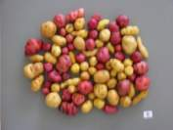
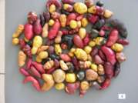
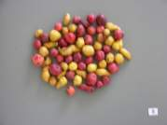
MATING DESING NCD I (CYCLE I)
Grupo I
Grupo II
♂
♂
703825
Gon
703421
Stn
X
X
♀_{s}
♀_{s}
702815
Stn
703291
Phu
703825
Gon
704393
Gon
703168
Gon
703831
Gon
703352
Gon
701165
Phu
303846
303835
303845
303828
303842
303826
303841
303832
Notes:
11

Slide 12

Ranges of Fe in potatoes and projected advance by selection

Slide 13
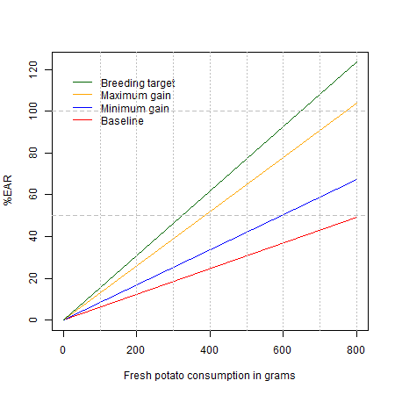
Impacto de la biofortificación en la satisfacción de los requerimientos nutricionales de Fe
Contribución de la papa a los EAR (requerimientos promedio estimados) de Fe para mujeres entre 19 y 50 años.

Slide 14
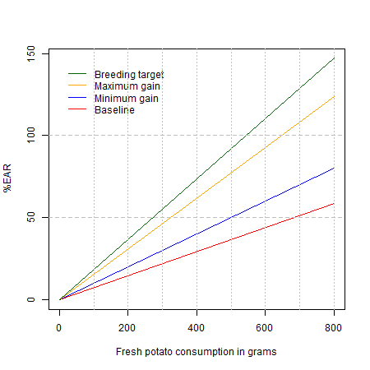
Impacto de la biofortificación en la satisfacción de los requerimientos nutricionales de Zn
Contribución de la papa a los EAR (requerimientos promedio estimados) de Zn para mujeres entre 19 y 50 años.

Slide 15
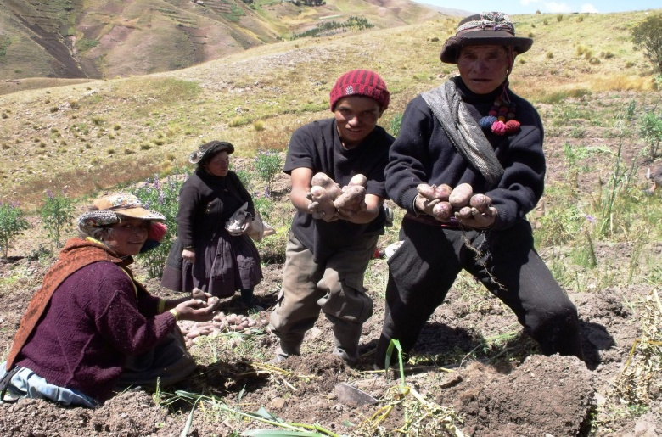
Recomendaciones de Fe y Zn según edad y biodisponibilidad(mg)
Biodisponibilidad Fe | Niños (mg) | Mujeres (mg) | Biodisponibilidad Zn | Niños (mg) | Mujeres (mg)
Muy baja (5%) | 15 | 58.8 | Baja (10-15%) | 11.05 | 13.1
Baja (10%) | 7.5 | 29.4 | Media (30-35%) | 5.55 | 6.5
Media (12%) | 6.25 | 24.5

Slide 16
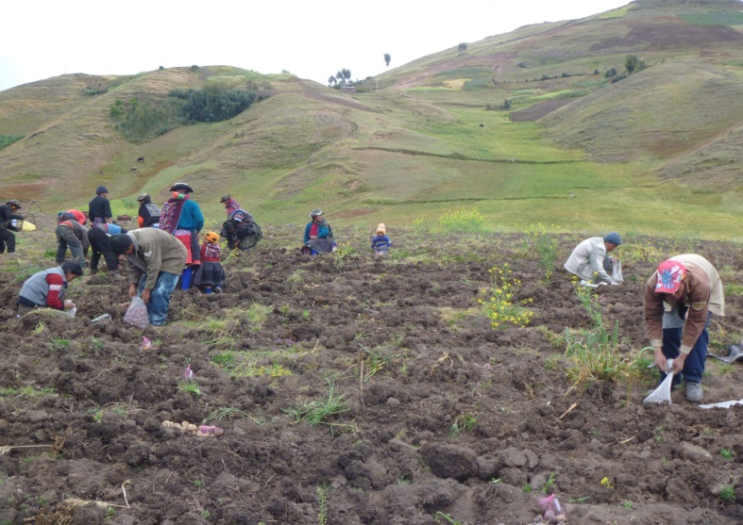
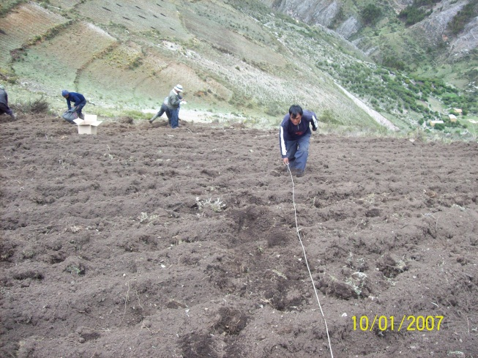
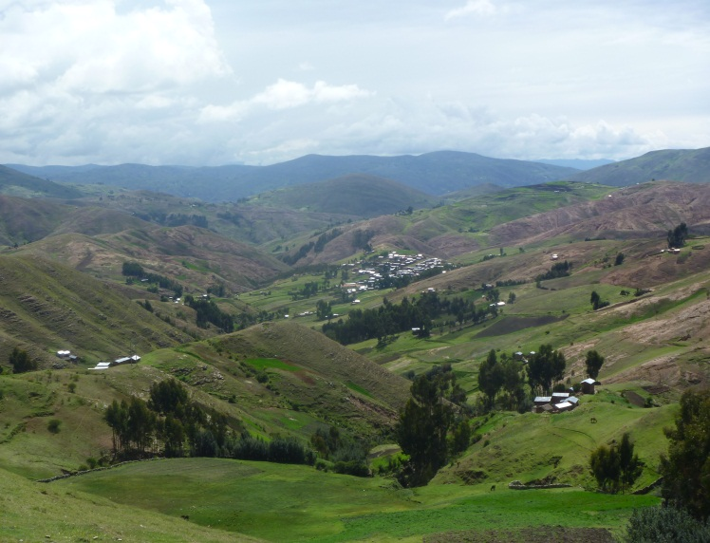
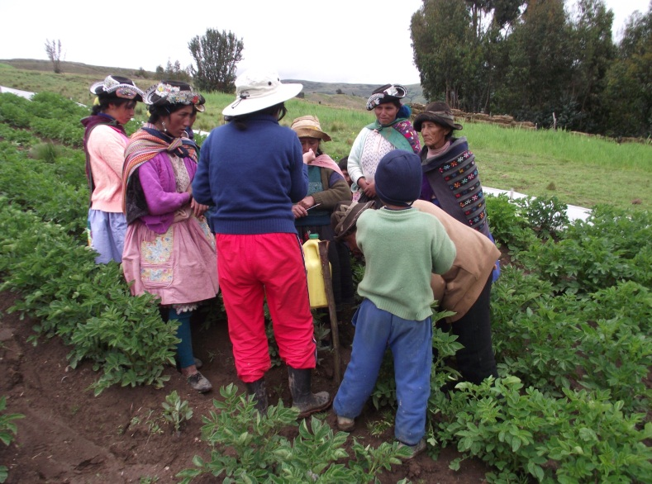
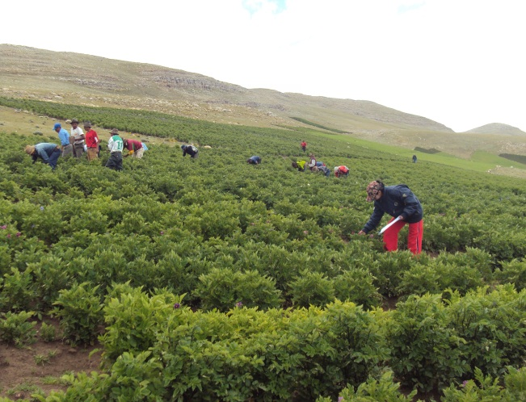
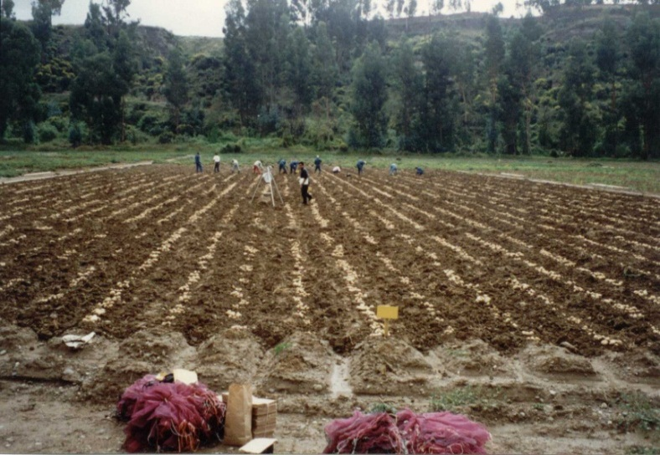
Ensayos multi-ambientes (EMAs) para Evaluar la estabilidad y efectos de GxA
6 ambientes, DBCA, 3 repeticiones en Perú
Collpaccasa
4067 m.s.n.m
Conayca
4178 m.s.n.m
Ccasapata
3765 m.s.n.m
Sotopampa 3754 m.s.n.m
Rangra
3323 m.s.n.m
Huancayo
3265 m.s.n.m

Slide 17
Biplot of G X E Interaction for Iron (mg/100g,FW)
General Mean
0.44
15.16
Most Stable – values higher than mean
Non Stable –values higher than mean
Most Stable_ values lower than mean
Non-stable_ values lower than mean
Notes:
Zinc and iron are important micronutrients for human health for which widespread deficiency occurs in many regions of the world including South America. Breeding efforts for enriching potato tubers with more zinc and iron are in progress in International Potato Center (CIP). Further knowledge on genotype _ environment interaction of these nutrients in the tubers is expected to contribute to better understand the magnitude of this interaction and the potential identification of more stable genotypes for this trait. Analysis of the stability of micronutrient traits will be applied to strategies for biofortification and the dissemination of its products.Twenty-two native varieties representing five taxonomic groups of cultivated potato conserved in the germplasm collection at CIP were evaluated in a multilocation trial in the Highland of Peru to determine genotype _ environment (GE) interactions for nutrient traits. Vitamin C concentration were available for 6 environments, while zinc and iron concentration of tuber for 5 environments.
Material.- Twenty-two native varieties representing five taxonomic groups of cultivated potato conserved in the germplasm collection at CIP were used for this study. Samples of tubers were taken from seed plots grown in randomized complete block designs with three replications of one hills per plot in each of 6 sites of the central Peruvian Andes in 2010: Ccasapata (3765 masl); Sotopampa (3754 masl); Ccollpaccasa (4067 masl); Conayca (4178 masl) these four localities are in the region of Huancavelica, la Victoria (3265 masl) and Rangra (3323 masl) from Region of Junin. Well-matured tubers were harvested to 150 and 180 days.
Statistics method.- Analysis of variance describes only the main effects; it tests the significance of the G E interaction but provides no insight into the particular patterns of genotypes or environments that give rise to the G E interaction.
Multiplicative models for multi-environment trials have been used for studying G E interaction, examining genotypic yield stability and adaptation, and developing methods for clustering sites or cultivars into groups with statistically negligible crossover G E interaction (Crossa and Cornelius, 1997; Crossa et al., 2002).
Multiplicative models have an additive (linear) component (i.e., intercept, main effects of sites and/or genotypes) and a multiplicative (bilinear) component (G E interaction) and, thus, are also named linear–bilinear models.
A type of linear–bilinear model suitable for grouping sites and cultivars without cultivar rank change is the AMMI model (Addite Main Effects and Multiplicative Interactions).
Results.- The contribution to variance for 22 genotypes, 6 environments, and the GxE interaction is found in this table.
For Vitamin C : The large contribution to variance in ANOVA model with 53% of the total sums of squares for content of vitamin in FW was for genotypes. This was almost as twice as the contribution of environments with 32% and a significant GxE interaction contain around of 12% of total variation. Using the AMMI model the GxE interaction was decomposed into five components, the first two components accounted aprox. 79 % of the variability in the model, and therefore, only these two were retained in both cases for Vitamin C.
b) For Zinc: The low contribution to variance in ANOVA model with 24% of the total sums of squares for content of Zinc in FW was for genotypes. The contribution of environments with 42% was two times more than genotypes; and a significant GxE interaction contain around of 17% of total variation. Using the AMMI model, the GxE interaction was decomposed into four components, the first two components accounted aprox. 73 % of the variability in the model, and therefore, only these two were retained in both cases for Zinc.
c) For Iron: The good contribution to variance in ANOVA model with 36% of the total sums of squares for content of Iron in FW was for genotypes. The contribution of environments with 30 % was only a little less than genotypes; and a significant GxE interaction contain around of 19% of total variation. Using the AMMI mode,l the GxE interaction was decomposed into four components, the first two components accounted approximate 65 % of the variability in the model, and therefore, only these two were retained in both cases for Iron.
Many tools and techniques have been suggested for characterizing and grouping environments, with biplot analysis considered the most valuable. Interpretation of performance of a number of genotypes in a broad range of environments is generally affected by large G E interactions (Gauch and Zobel, 1996).
Biplots obtained from graphing the first two components of the multiplicative part of AMMI model are useful for summarizing and approximating patterns of response that exist in the original data (Gabriel, 1971, 1978).
The stable genotypes through sites are within the circle of dotted lines and the genotypes the highlighted within this circle have concentration over general average. (The idea are for the three biplots: Vitamin C, Zinc and Iron).
The non stable genotypes through sites are outside the circle of dotted lines and the genotypes highlighted outside this circle have concentration over general average. (The idea are for the three biplots: Vitamin C, Zinc and Iron)
The environments with colour green have concentration over general average according to biplot.

Slide 18
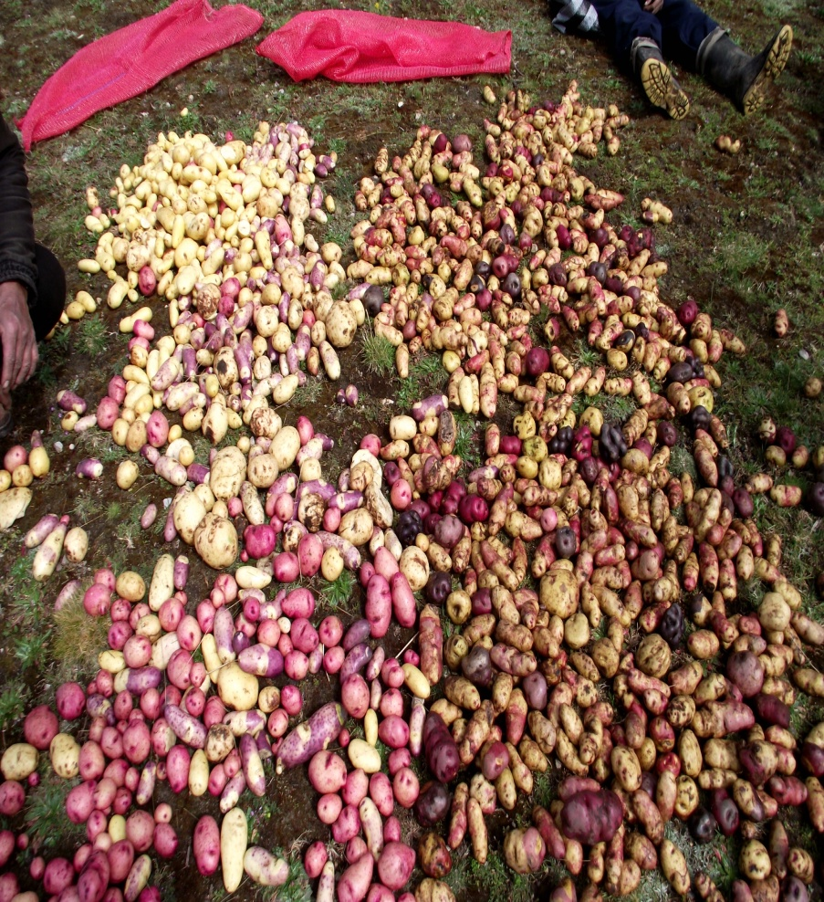
Material obtenido CIP con alto contenido nutricional (tops)
Material diverso (nativas y mejoradas) con alto contenido nutricional ..32
Material del programas resistencia rancha (phythtophtora) …..25
Materia Precoz …….25
Var locales …………
TOTAL………………. 82

Slide 19
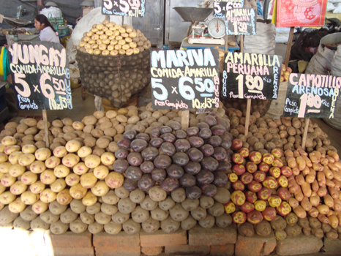
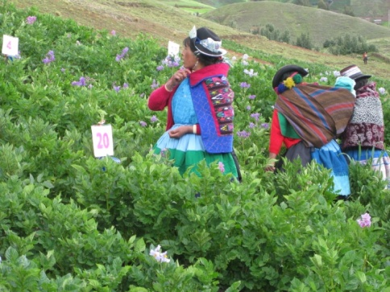
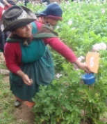
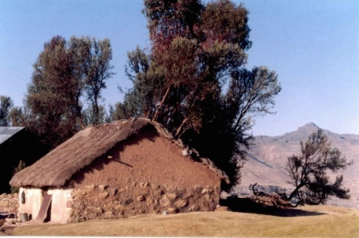
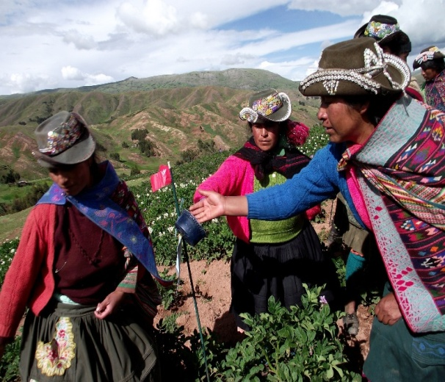
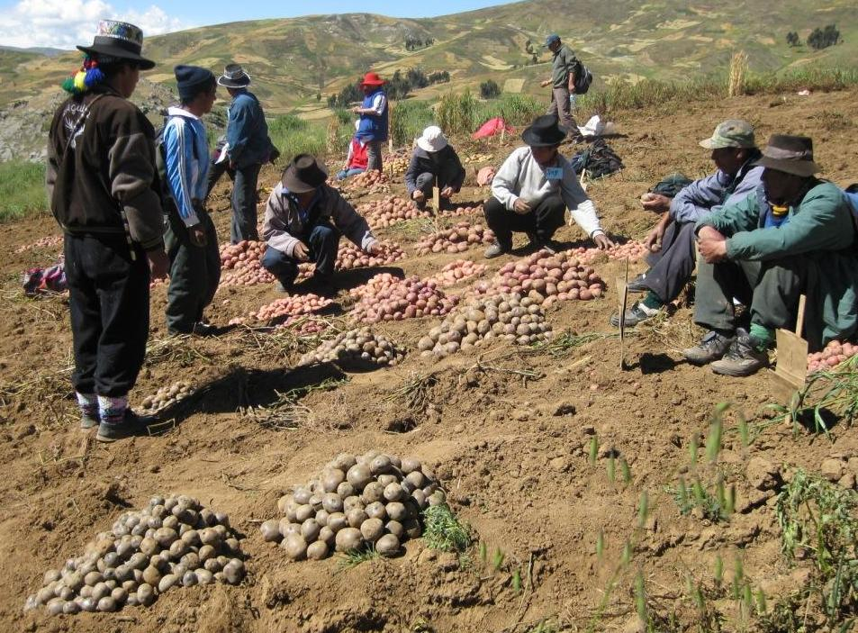
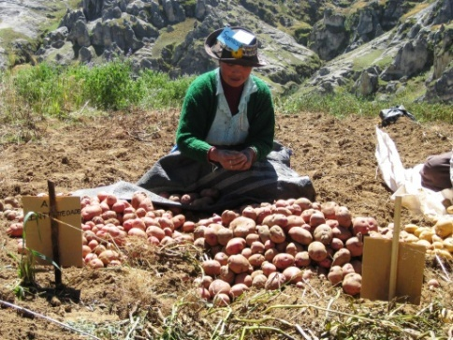
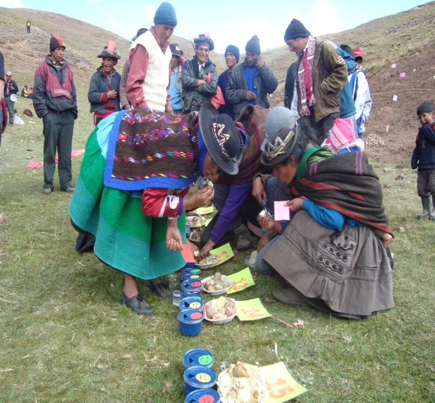
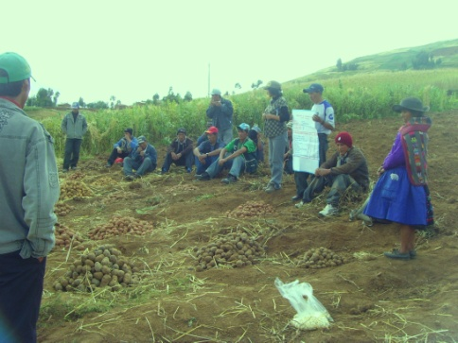
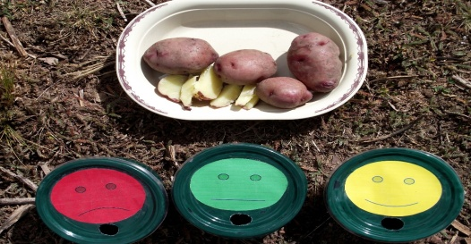
1. Evaluación en floracion
4. Post-cosecha
Seleccion Participativa fases de la seleccion
2. Evaluacion en cosecha
3. Organoléptica .
Diseño Mama & BB

Slide 20
Seleccion Participativa de variedades (PVS): Rankeo de criterios de seleccion (cosecha) 2011
Paso 1.- listado de cirterios de seleccion
Criterios de seleccion | varones | Mujeres | Global
Tubérculos grandes | 25 | 23 | II
Alto contenido nutricional | 17 | 7 | I
Resistencia al gorgojo | 12 | 21 | III
Resistencia a la rancha | 18 | 13 | IV
Alta rendimiento | 12 | 6
Paso 2.- Rankeo de los criterios de seleccion
Notes:
Mejorar el grafico OK : One point of interest is that women put a high priority on high nutriente content, This is probably the result of capacity buidling and explaining that this materiasl was slected for high nutrient content. This may be the first change necessary for consciousness raising .

Slide 21

Club de madres Totora Chopccapampa 2012-2013 evaluación en floración
0rden | Criterios identificados | mujeres
1 | Bastante flor | 10 | III
2 | Papas nutritivas | 25 | III
3 | Tallos gruesos | 36 | !
4 | Tallos altos | 5 | !V
5 | Variedades precozes | 2 | V*
 | TOTAL | 78

Slide 22
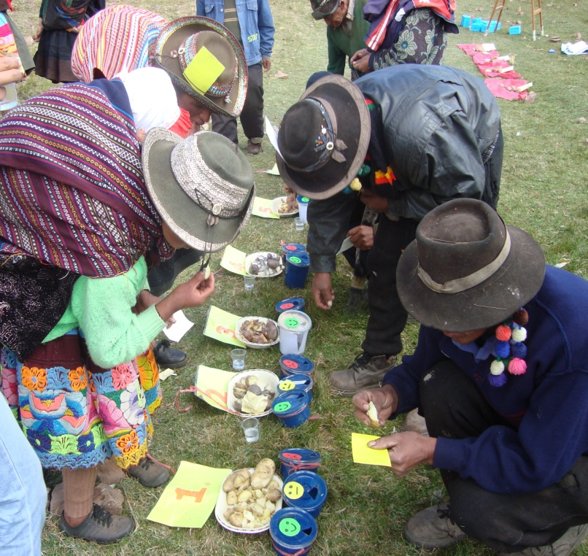
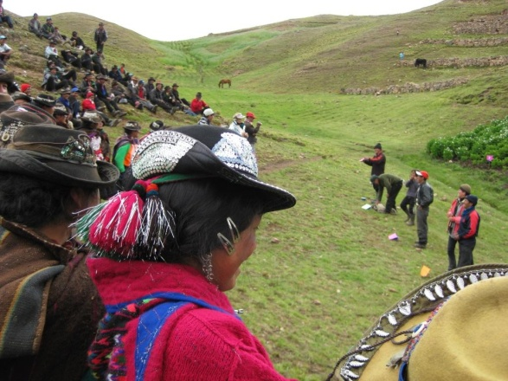
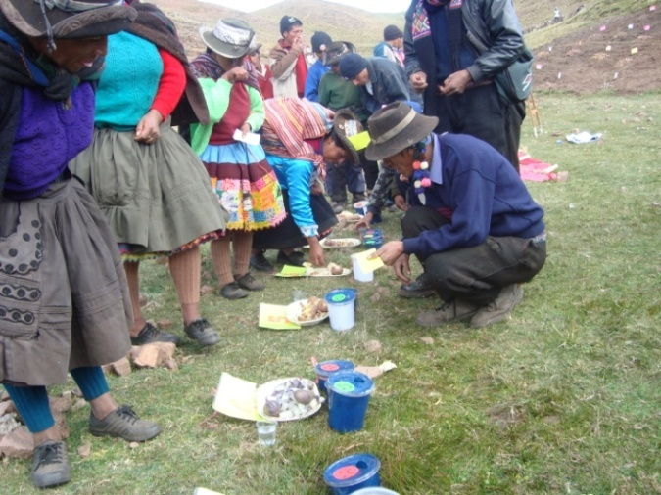
Prueba de degustación en Ccollpaccasa 4200 m.
2011-2012
Notes:
trial location; Ccollpaccasa, 4200 m.a.s.l.. Yields variable. Part to insure all families take these for baby trials.

Slide 23
Selección de material alto en micronutrientes.
Nº | CLUB DE MADRES | Localidad | Nº de participantes | Material | Nº de Clones 10-11 | Nº de Clones 12-13 | No de clones 13-14
1 | Centro | Ccasapata | 7 | Fe Zn y resist. Rancha | 31 | 10 | 2+5
2 | Llunchipampa | Ccasapata | 21 | Fe, Zn, Vit. C | 20 | 4 | 2
 |  |  |  | Precoz Fe, Zn, Vit. C | 16 | 3 | 1+2
3 | Pulpera | Ccasapata | 19 | Fe, Zn, Vit. C | 20 | 3 | 3
4 | Hornopampa | Ccasapata | 23 | Fe, Zn, Vit. C | 20 | 6 | 4
5 | Asociación de productoras Sotopampa | Sotopampa | 14 | Fe, Zn, Vit. C | 24 | 8 | 2
6 | Chachascullo | Sotopampa | 13 | Fe, Zn, Vit. C | 12 | 6 | 2
7 | Centro | Sotopampa | 25 | Fe, Zn, Vit. C | 6 | 6 | 2
8 | Club de madres Totorapampa | Chopccapampa | 26 | Precoz Fe, Zn, Vit. C | 11 | 6 | 2
9 | Club de madres Ccollpaccasa | Ccollpaccasa | 21 | Fe, Zn, Vit. C | 25 | 5 | 4
 | TOTAL |  | 169 |  | 80 | 30 | Rancha 6 Precoz 6 Alto cont 15

Slide 24
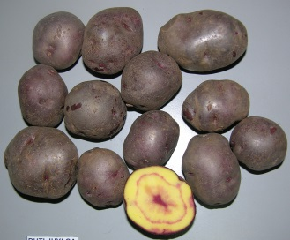
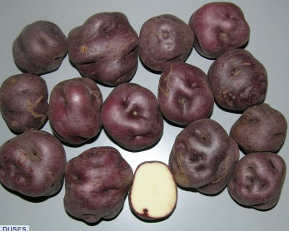
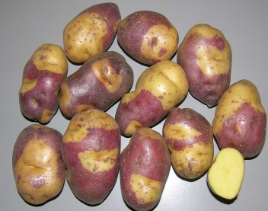
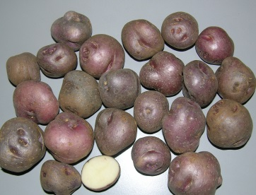
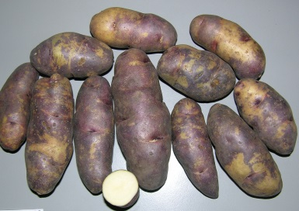
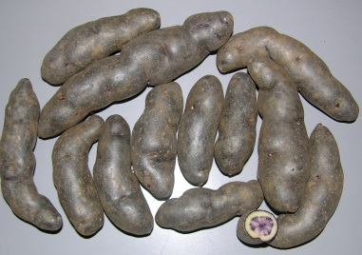
Variedades locales con altos contenidos nutricionales
Variedad local | Fe (mg/100g PF) Promedio (Sd) | Zn (mg/100g PF) Promedio (Sd) | Vit C (mg/100g PF) Promedio (Sd)
Botijuela | 0.496 (.015) | 0.468 (.021) | 9.04 (0.18)
Docis | 0.508 (.010) | 0.393 (.008) | 23.51 (0.35)
Walash | 0.415 (.000) | 0.453 (.029) | 8.73 (0.44)
Poqya | 0.450 (.018) | 0.667 (061) | 9.60 (0.19)
Romano suito | 0.627 (.026) | 0.395 (.002) | 9.44 (.01)
Yana Wengo | 0.457 (049) | 0.382 (.040) | 12.92 (.40)

Slide 25
Clones con alto contenido nutricional y resistencia a rancha selectos
 | Materia Seca | Fe (mg/100g,FW) | zn (mg/100g,FW) | Vitamina C (mg/100g,FW)
Código CIP/Yanapai | Promedio | Proemdio (SD) | Mean | Mean
R5738:394908-13 | 27.21(2.o1) | 0.49 (.01) | 0.72 | 16.38(2.26)
B3C1:391058-175 | 21.53(0.62) | 0.38 (.06) | 0.23 | 28.24 (.79)
B1C5:399092-116 | 19.90 (.65) | 0.45 (.03) | 0.29 | 14.23 (0.52)
B1C5:394904-17 | 24.38 (.52) | 0.52(.04) | 0.54 | 17.61 (.72)
B1C5:395443-109 | . | . | . | .
B1C5:393382-44 | 23.23 (.96) | 0.41 (.07) | 0.54 | 20.87 (2-04)

Slide 26

Clones Precoces con alto contenido nutricional.
CLON | Materia seca | Fe (mg/100g,FW) | zn (mg/100g,FW) | Vitamina C (mg/100g,FW)
Código Yanapai | Promedio | Promedio | Promedio | Promedio
CIP392820.1 | 20.30 | 0.34 | 0.37 | 25.26
CIP380011.12 | 23.83 | 0.43 | 0.34 | 16.93
CIP394904.9 | 24.40 | 0.52 | 0.48 | 20.74
CIP397006.18 | 18.22 | 0.34 | 0.33 | 10.03
CIP397069.5 | 19.39 | 0.33 | 0.36 | 19.68
CIP395434.1 | 23.59 | . | . | 18.475

Slide 27
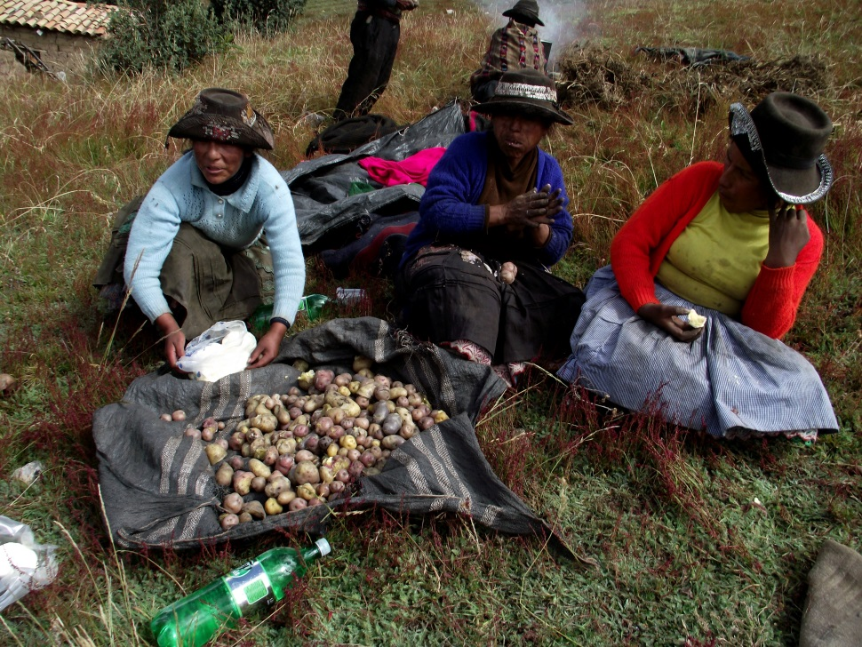
Cosecha 2014 entrega de semilla fin de proeycto.
Entrega de 20 kg de semilla cada familia
m
Mujeres comiendo mezcla de papa con alto contenido nutricional en una cosecha

Slide 28
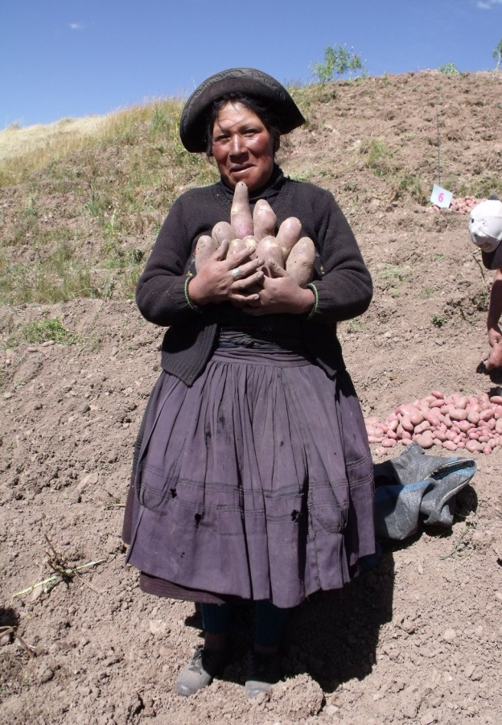
Material selecto multiplicado y entregado en Sotopampa Centro y libre.
N° | Localidad | Organización | Código_Clon | Materia seca | Fe(mg/100gPF) | Zn (mg/100gPF) | VITC (mg/100gPF)
LB | Sotopampa | Centro | B1C5.393382.44 | 23.23 | Medio | alto | medio
Alto CN | Sotopampa | Centro | 700234 | 23.8 | ALTO | MEDIO | Medio
Alto CN | Sotopampa | Centro | Amarilla Tumbay701862 | 28.7 |  |  | medio
Precoz | Sotopampa | Centro | 394904.9 | 24.40 | ALTO | ALTO | Medio
Precoz | Sotopampa | Centro | 397069.5 | 19.39 | bajo | medium | Medium
LB | Sotopampa | Libre | B1C5.395443.109
LB | Sotopampa | Libre | B3C1.391058.175 | 21.53 | Medio | bajo | ALTO
Alto CN | Sotopampa | Libre | B1C5048.116
Alto CN | Sotopampa | Libre | 397060.19 | 21.8 | medio | ALTO | ALTO
Alto CN | Sotopampa | Libre | Ceccorani 706134 | 33.6 | ALTO | medio | bajo
Alto CN | Sotopampa | Libre | 395443.1 | 22.0 | medio | ALTO | ALTO

Slide 29
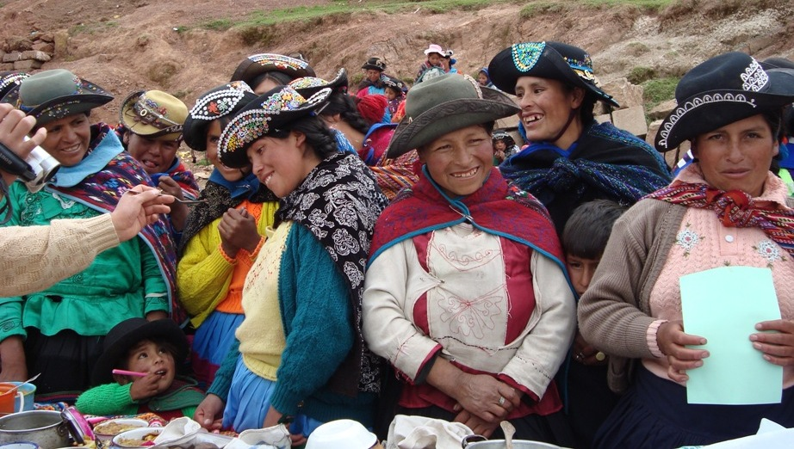
Sotopampa, Chachascullo
N° | Localidad | Organización | Código_Clon | cod CIP | prom | Fe (mg/100gPF) |  | Zn (mg/100gPF) |  | VITC (mg/100gPF)
Alto CN | Sotopampa | Chachascullo | 703268 | Bolona | 26.7 | 0.48 | medio | 0.30 | bajo | 16.20 | medio
Alto CN | Sotopampa | Chachascullo | 703426 | Wakapa Ñawin | 23.3 | 0.40 | medio | 0.3 | medio | 18.60 | Medio
Alto CN | Sotopampa | Chachascullo | 703488 | Challina | 23.5 | 0.44 | Medio | 0.42 | Medo | 10.70 | bajo
Alto CN | Sotopampa | Chachascullo | 703625 | Amayllo | 23.7 | . | . |  | . | 9.40 | bajo
Alto CN | Sotopampa | Chachascullo | 392740.4 | 92.065 | 21.5 | 0.35 | medio | 0.6 | alto | 23.40 | alto

Slide 30
Clones selectos y multiplicados en 3 barrios de Ccasapata
N° | Localidad | Organización | Código_Clon | cod CIP | materia seca(promedio) | Fe (mg/100gPF) | Zn (mg/100gPF) | VITC (mg/100gPF)
LB | Ccasapata | Llunchipampa | B1C5.395443.109
Alto CN | Ccasapata | Llunchipampa | 705495 | Puca Cambru | 28.1 | ALTO | bajo | Low
Precoz | Ccasapata | Llunchipampa | 395434.1 | cip | 23.59 | . | . | medio
Precoz | Ccasapata | Llunchipampa | 397069.5 | cip | 19.39 | bajo | medio | medio
LB | Ccasapata | Centro | B1C5.399092.116 | B1C5:399092-116 | 19.90 | Medio | bajo | bajo
LB | Ccasapata | Centro | 394908.13 | R5738:394908-13 | 27.21 | Medio | alto | medio
Alto CN | Ccasapata | Hrnopamopa | 705495 | Puca Cambru | 28.1 | ALTO | bajo | Low
Alto CN | Ccasapata | Hornopampa | 705975 | Clavel Huaita | 25.7 | ALTO | bajo | medio
Alto CN | Ccasapata | Hornopampa | 706134 | Cceccorani | 33.6 | ALTO | medio | bajo
Alto CN | Ccasapata | Hornopampa | B1C5048.116

Slide 31
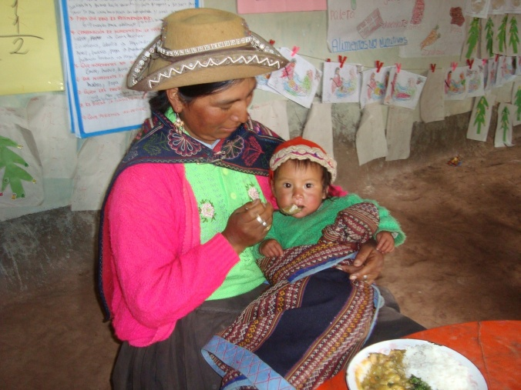
Selección, multiplicacion y entrega Izcumachay, Pulpera,Ccasapata
N° | Localidad | Organización | Código_Clon | materia seca(promedio) | Fe (mg/100gPF) | Zn (mg/100gPF) | VITC (mg/100gPF)
Alto CN | Ccasapata | Izcumachay | 394908.13 | 27.21 | Medio | alto | medio
LB | Ccasapata | Izcumachay | B1C5.399092.116 | 19.90 | Medio | bajo | bajo
LB | Ccasapata | Izcumachay | B1C5035.22
Alto CN | Ccasapata | Pulpera | Soco Huacoto 702363 | 22.8 | medio | bajo | bajo
Precoz | Ccasapata | Pulpera | 397069.5 | 19.39 | bajo | medio | Medium
Precoz | Ccasapata | Pulpera | 380011.12 | 23.83 | medio | medio | Medium
Precoz | Ccasapata | Pulpera | 394904.9

Slide 32
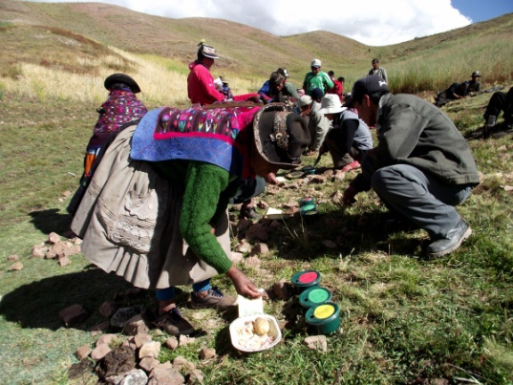
Selección, multiplicación, entrega de clones en Chopccapampa y Ccollcpacasa
N° | Localidad | Organización | Código_Clon | prom | Fe (mg/100gPF) |  | Zn (mg/100gPF) |  | VITC (mg/100gPF)
Alto CN | Ccollpaccasa | Santa Teresita | B1C5046.19 | 21.8 | 0.35 | medio | 0.59 | ALTO | 21.50 | Alto
LB | Ccollpaccasa | Santa Teresita | B1C5048.116
Alto CN | Ccollpaccasa | Santa Teresita | S3.066
Chopccapampa
Precoz | Chopccapampa | Totora | 397006.18 | 18.22 | 0.34 | bajo | 0-33 | medio | 10.33 | Medio
Precoz | Chopccapampa | Totora | 392820.1 | 20.30 | 0.34 | bajo | 0.37 | medio | 25.26 | Alto

Slide 33
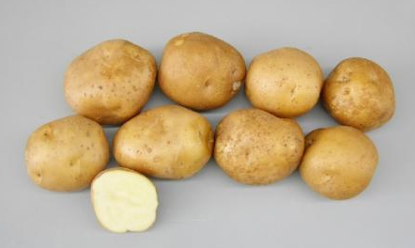

Dos clones resistentes a rancha
Nueva Variedad de Papa en el Perú
Clon CIP 399052.3 “Papa Bola”
Gastelo,M.; Bastos, C.; Ccanto, R.; Scurrah, M.; Diaz, L.; Bonierbale, M.
Color de piel | crema
Color de pulpa | Crema
Forma de tuberculo | Redondo (oblongo)
contendio de FE | 13 mg/100g pf
Contendio de Zn | 8.11 mg/100 g pf
Contendio de Vit C | 65.44 mg 100 g ps

Slide 34


