Slide 1
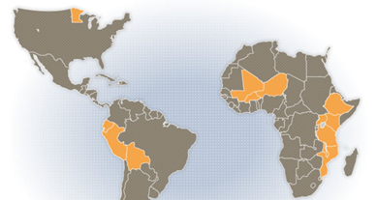
La Fundación McKnight y CCRP
10ma Reunión Anual de la CdP Andes
El Pasado, Presente y Futuro de un Programa de Desarrollo Agrícola Basado en Investigación
Cochabamba, Bolivia, 14 al 18 de julio, 2014
Notes:
JANE
Now that we are all together in person, I would like to take a moment to celebrate the approved Gates grant of 25 million over the next five years.
This is a fitting time to reflect on the impacts of the program over the last five years. Becky and I are going to share a sampling of these impacts with you.
We also have Richard here to share his thoughts and answer your question at the end of the presentation.

Slide 2
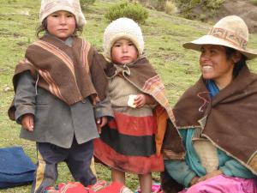
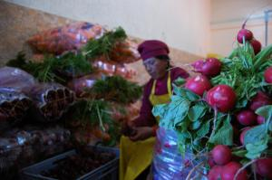
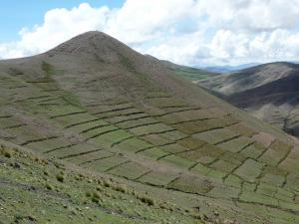

People, Place, and Possibility /
La gente, el lugar y la posibilidad
We attend, unite, and empower through
grantmaking, collaboration, and policy work
Notes:
Kate
Between fall 2011 and spring 2012, McKnight’s board and staff engaged in deep exploration to consider major trends and patterns in our external context, and to develop a shared sense of what the shifting landscape means for our work. We explored a series of questions in the context of both program and operational strategies — what we do, as well as how we do it. In the end, we arrived at a Strategic Framework that embraces McKnight’s unique approach and history of commitments, while emphasizing the need for flexibility to learn and adapt to future challenges and opportunities.
In this diagram:
INTERNAL is at bottom, EXTERNAL is at top, INTERCHANGE between the two is in the middle.
At the bottom (right beside our logo) are our mission and values. This is who we are. Operations or programs, our approach begins with these. [Elaborate more?]
At the top are “People, Place, and Possibility.” These are our partners and those we serve. This level is the world we operate in and the communities we support. [Elaborate more?]
The banners in the middle of the slide are two important, explicit strategies we employ in our outreach to our grantees and partners: Adaptive Leadership and Credible Influence. [Elaborate more?]
The arrows on the ends represent a constant, two-way flow of information to leverage our work and inform our strategies: Knowledge Sharing and Understanding Context. [Elaborate more?]
The Strategic Framework is grounded in proactive responsiveness and adaptive leadership, balancing our long-term commitments with flexibility to take advantage of unexpected opportunities. It articulates our board and staff’s shared understanding about the values, mission, and approach that will guide the Foundation in the coming years. It is meant to provide coherence across the organization while honoring the diversity of program goals and structures. We consider this a dynamic guide, and intend to update it as needed to ensure relevance to current contexts.

Slide 3
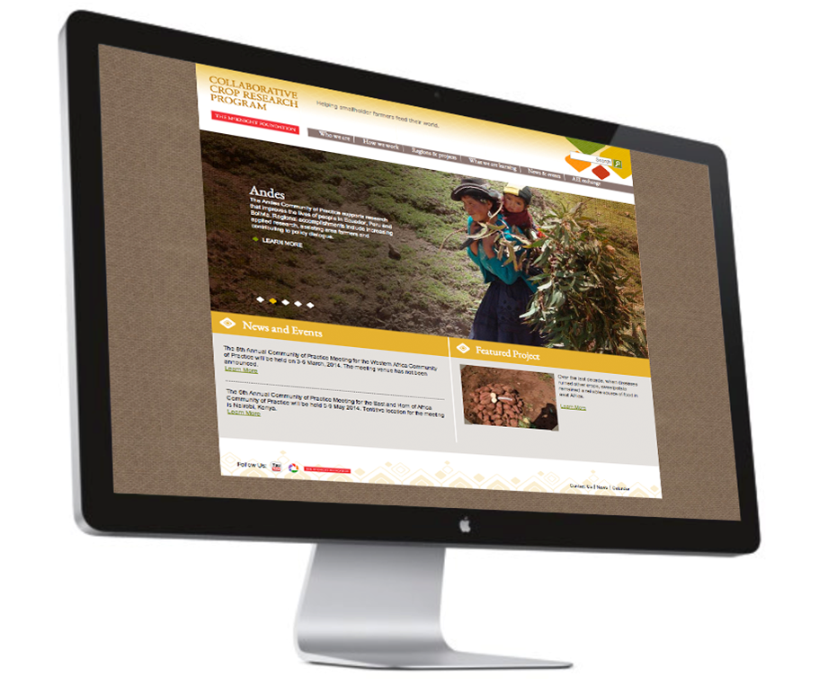
  Plant Biology Program – 1983-1992
  CCRP 1993 –presente
  Temas
  Investigación agropecuaria para los agricultores
  Fortalecimiento de capacidades - personas e instituciones
  Sostenibilidad
http://www.ccrp.org
Notes:
JANE:
I would like to start with a brief history of the CCRP. I want to begin by recognizing the inspiration of Mac and Pat Binger, who wanted to help farmers feed their families back in the early 1980s– this program has grown to make an important and unique contribution in the field of global ag R+D.
The program started in 1983 as the plant biology program. In 1993 it formalized into the CCRP. We have had essentially four key iterative phases.
Presently we are completing the first five year Gates grant, and now are poised to begin another five years. In both of those phases McKnight and Gates each contribute roughly 5 million each, with them contributing more in this current phase and with us contributing more than 50% in the next five years.
At present, the CCRP holds 120 grants, in 70 collaborative research projects, in 12 countries, through 4 COPs
**************************************************************************************************************
CCRP 3 – 4.7 and 5 mil (gates)
The CCRP IV with Gates…MF provides $5.9 million per year, Gates provides $5M (5.1) in 2014.
Overall CCRP budget (grants and administrative funds) is 56% McKnight funding and 44% Gates funding over the course of the next 5 years.
Globally – Investments in Ag R+D are growing, but in 2006 study estimated a 9.6 B gap in needed investments in Ag R+D…(18.5 B needed to address needs)
Private donors about .5% at that time.
Public sector dollars have increased over the past 5 years – to XXXX amount, but more is still needed.

Slide 4
CCRP
Investigación Colaborativa en IAE
para fortalecer las capacidades de los pequeños agricultores, los institutos de investigación y organizaciones de desarrollo
empoderar a sus comunidades de
producir alimentos nutritivos, a nivel local y sostenible
Notes:
JANE –
The core of CCRP -
The CCRP funds collaborative and participatory focused on agro-ecological solutions – technologies and approaches. The program provides technical support to strengthen the capacities of farmers, research institutes and development organizations to empower communities to grow nutrition food, locally and sustainably.

Slide 5
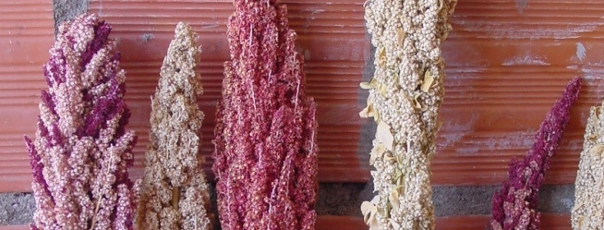
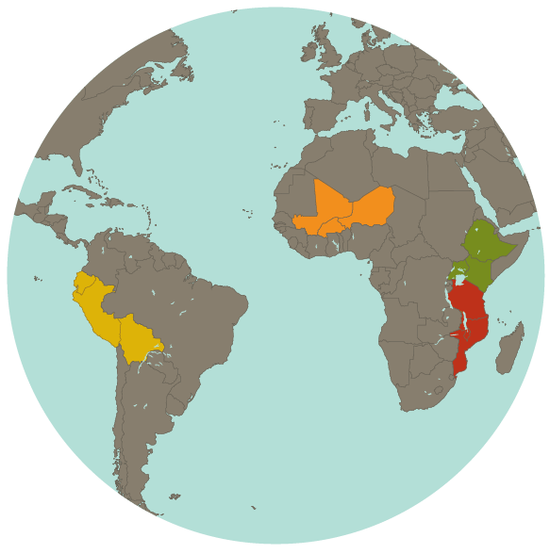
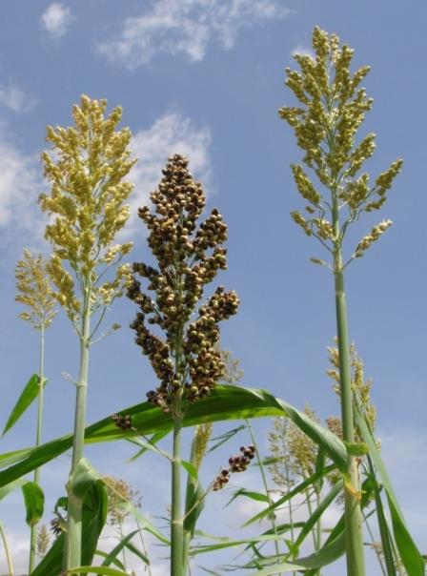
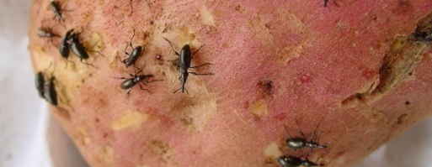
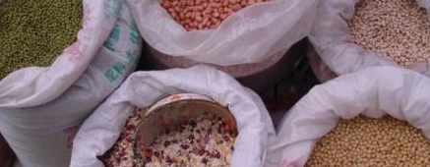
CCRP Comunidades de Practica (CoP)
High Andean
Cropping systems
West Africa:
Millet- and sorghum-
based cropping systems
East and Horn of Africa:
Crop Improvement
Southern Africa:
Integrating legumes in cereal-based systems
Notes:
JANE:
CCRP’s geographical focus, as mentioned prior, is in 12 countries.
We went to the hungriest places on the planet – over 10 years ago… places with (Richard here at this time?)
Minimal infrastructure
Degraded agricultural resources
Places first affected by climate change –
Isolated – mountainous – sometimes landlocked
Where people were very hungry – and relying on mostly starchy diets, lacking in protein and micronutrient sufficient diets
Frequently, the CCRP locations suffered social / cultural / political stresses and conflicts

Slide 6
Impact/Impacto
  ADAPTATION/ADAPTACIÓN
Of AEI technologies by and for resource-constrained farmers
Making global ideas work locally
INSPIRATION/INSPIRACIÓN
Bringing global attention to local discoveries
Quality research & democratic innovation
LINKAGES & COLLABORATION/ VÍNCULOS Y COLABORACIÓN
Within and across sectors and fields
POLICY/POLÍTICA
Evidence, relationships, local knowledge
Notes:
We will be looking at our impacts through these four lenses –
Adaptation of AEI technologies and process by farmers
Inspiration
Linkages and Collaboration
Policy

Slide 7
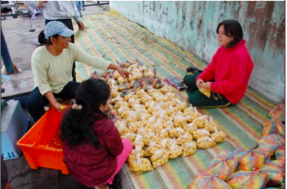
Consumers as Co-producers /
Los consumidores como coproductores
Andes: Developing local agroecological markets where organized urban consumers buy directly from rural farmer associations
Better prices & quality for consumers, better incomes for farmers
Notes:
BECKY: Local markets, where farmers interact directly with consumers and vice versa, become place not just for transactions but for conversations about nutrition, environmental sustainability, etc
Grantee: Ekorural
2 community markets in Ecuador,
90% of participating farmers (N=30) report that their production practices have changed: they have a greater quantity of products (89%), introduced vegetables (77%), plan better (22%), use associated planting (22%), eat their own food instead of buying (18%), less use of chemicals (11%)
In one market, consumers pay wholesale price (which is 50% less than retail) for much better quality
FO made additional $3,000 among 25 farmers for selling to local CSA (Market project)

Slide 8
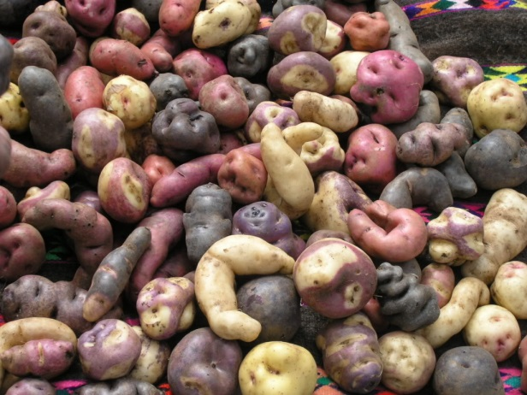
Impact through Adaptation:
Pest & Disease Management
Genetic resistance, bio-pesticides, beneficial organisms, pheromones, farm design
Andes: New bio-pesticide Bacu-Turin has 99% efficiency in controlling the three species of potato moths that attack potato seed in storage
East & Horn of Africa: On-farm management strategies for banana plants controlled bacterial wilt disease by up to 95% in Kenya and over 80% in Uganda.
Notes:
BECKY: Bacu-Turin is being produced in semi-industrial quantities (HOW MUCH…HOW FAST GROWING?)
Farmers usually combat potato moths using chemical insecticides. Are an expense for farmers and can be damaging to human health, especially when treated seeds are stored inside the house in reach of children.
Grantees: INIAP, PUCE (university), IRD (French institute)
Bacterial wilt is a devastating disease of banana and enset. It has been possible to effectively control the disease on experimental plots and in some benchmark sites where participatory work is being done with farming communities. But disease management isn’t always effective or stable – sometimes the problem comes right back. With key input from the RT/IMEP, the BXW project team developed the LEARNING AND EXPERIMENTATION APPROACHES FOR FARMERS approach. They’re working with farmer groups to develop management strategies that work well for farmers.

Slide 9
Collaborative roles in CCRP
Int’l.
NGOs
Local
NGOs
CGIAR
Local univs
Int’l univs
NARS
N=120 grants
by grantee type
Notes:
We fund and connect diverse institutions along the R+D value chain, with NARS being our biggest group of grantees

Slide 10
Policy: Influencing and being influenced
CGIAR
Global Alliance for the Future of Food
Agree: Research, Education and Extension Convening
Global Alliance for Ecological Agriculture; TCA
CGBD – why agriculture matters to nature conservation
SDSN – Sustainable Development Goal for agriculture
African Union
Chicago Global Council
USAID - FtF
Others – From the Floor
Notes:
We are all interacting with the external context, these are a few that we know of…what others do we have? Jane to add some slides here…..AND just mention the credible influence of the group…throughout the presentation or the week.
Deepening and Widening concern sustainbility, the,, CCRP’s “credible influence”
AgREE, SDSN
Many others interactions of our group
Richard’s definition of policy

Slide 11
Grantmaking targets for 2014-2018
Mali, Burkina Faso, Uganda, Ethiopia, and Tanzania
Primary focus on common bean, cowpea, groundnut, chickpea, with secondary focus on other legumes
Increase legume grantmaking to 50% of overall portfolio
60 post-graduate training opportunities (50% related to legumes) with at least half of all funded projects including either a MSc or PhD student. At minimum 1/3 of trainees will be women.
Functioning FRNs in each region

Slide 12
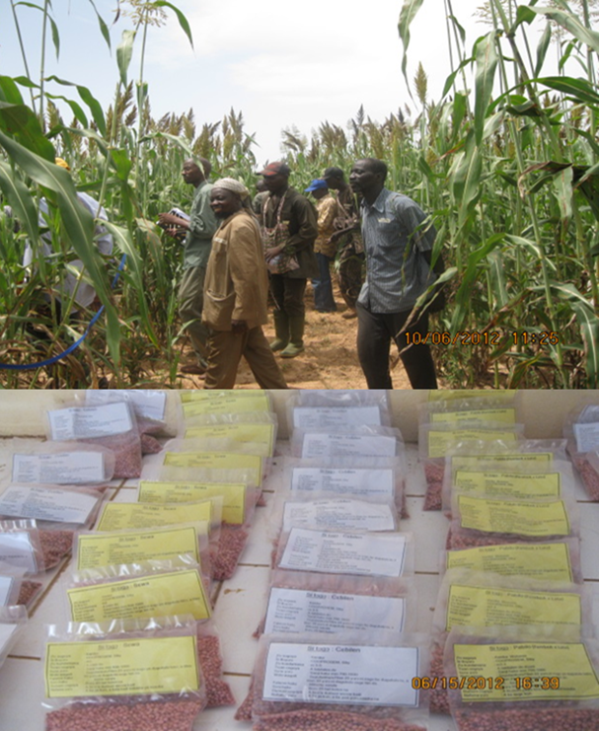
Source: Eva Weltzien

Slide 13
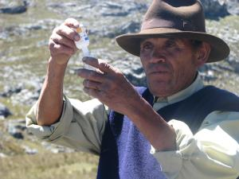
Apoyando a la Intensificación Agroecológico
--Redes de Investigación de los Agricultores (RIAs)
--IAE Intercambio (AEIx)
Photo: Doris Chavez

Slide 14
Base de evidencia de IAE
Mejores medias de vida
Compartir; inspirar; conectar los puntos
IAE
Mejor nutrición
Implementar, adaptar, innovar
Intensificación agroecológico
Mas sostenibilidad, menos daño al medio ambiente
Cadenas de valor; llegar al mercados

Slide 15
Generar la base de evidencia de IAE
IAE
Compartir los principios, evidencia y casos
Intensificación agroecológico

Slide 16
Redes de Investigación de los Agricultores (RIA)
Una innovación social
Una manera de vincular los procesos de innovación social y técnica
Un tipo de enfoque de investigación participativa
Una clase de prueba multi-entorno

Slide 17
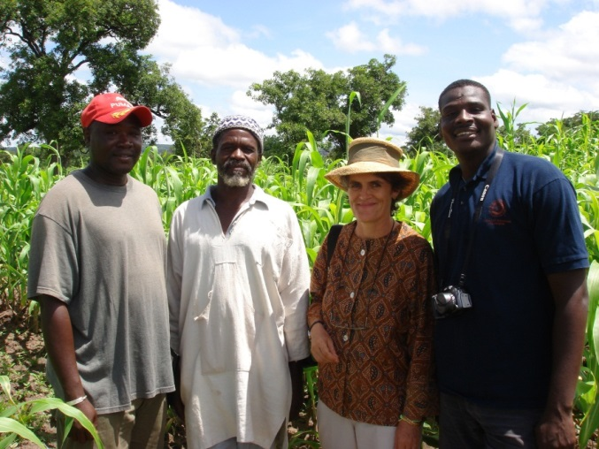
? Porque desarollar las RIAs?
Limitaciones del modelo de I + D
  Opciones interactúan con contextos (OXC)
  Instituciones de investigación, de extensión – somos limitadas
  Necesidad base de evidencia para IAE
Oportunidades
  La innovación social como base para la innovación técnica
  Nuevas posibilidades con de las TIC

Slide 18
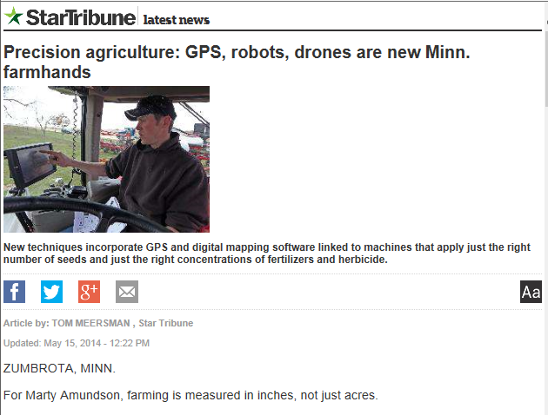
Recomendaciones globales v. ag de precisión
Si vale la pena la gestión de cada metro de otra manera, ¿por qué manejar un país como si fuera uniforme?

Slide 19
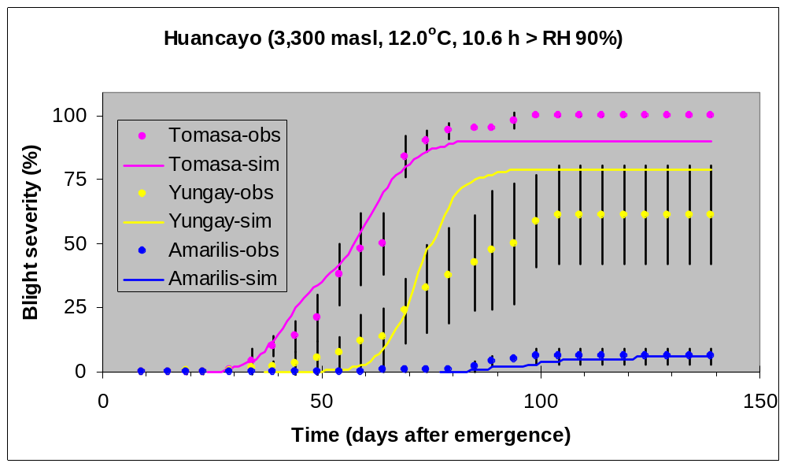
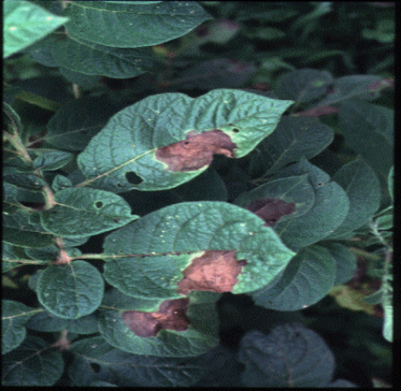
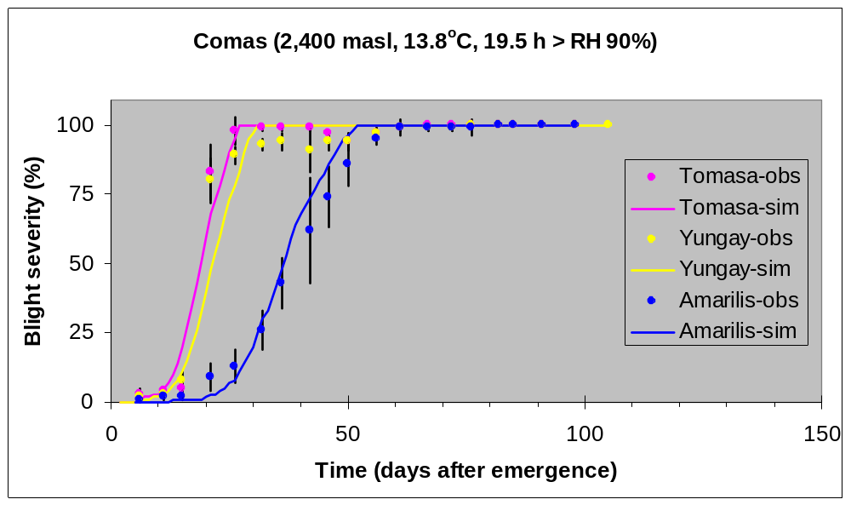
Desempeño de la resistencia es muy dependiente del tiempo
J. Andrade-Piedra,
CIP & Cornell

Slide 20
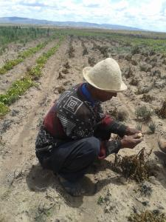
Contextos tienen sus dimensiones
Sociales
  Productores varían en sus recursos, tierras, prioridades, intereses, grado de integración con mercados…
Biofisicos
  Fincas varían en sus suelos, plagas, agua, etc.
→ RIAs pueden considerar sus diferencias en su diseno y analysis de datos
Photo: Irene Roca

Slide 21
Ingredientes para un RIA
Capital social : Organizaciones
innovadores, intermediarios
expertos en facilitacion
FRN
Capital technico :
Opciones viables que puedan satisfacer una necessidad u oportunidad
Capital methodologico
Diseno experimental; participacion, analysis participativa

Slide 22
Ensayos satélite v. central
Ensayo en grupo
Ensayos individuales
Probar opciones (arriesgados?)
Rechazar malas opciones
Ampliar semillas
Aprendan juntos
La acción colectiva
Prueba opciones seleccionadas bajo condiciones propias
Contribuir a la comprensión del desempeño en entornos

Slide 23

Vamos a trabajar en la visualización de datos!
Calendarios de los cultivos
Fecha de la siembra
Rendimiento

Slide 24
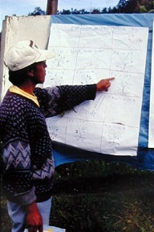
Aprendizaje y investigación
Los mismos principios se aplican a los agricultores como a otros científicos
Necesidad de combinar el aprendizaje con la investigación
La calidad importa
Muchos de los datos necesarios para establecer conclusiones confiables
Método es esencial

Slide 25
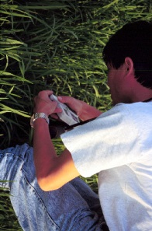
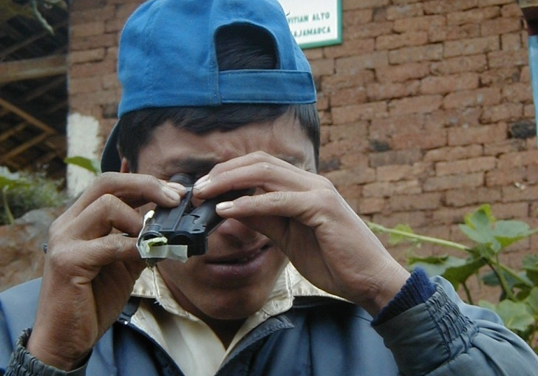
Revelar lo que es invisible pero importante
No se ve
  Microbios
  Micotoxinas
  Clima del futuro
  Propiedades del suelo
→ Hacer visible
  Spectroscopia
  Etc.
Pregunta: Puedan las herramientas / conocimiento promover la acción?
Notes:
Bentley: Farmers are better at managing stuff they can see. What farmers don’t know can’t help them. What we can’t see can hurt us.

Slide 26
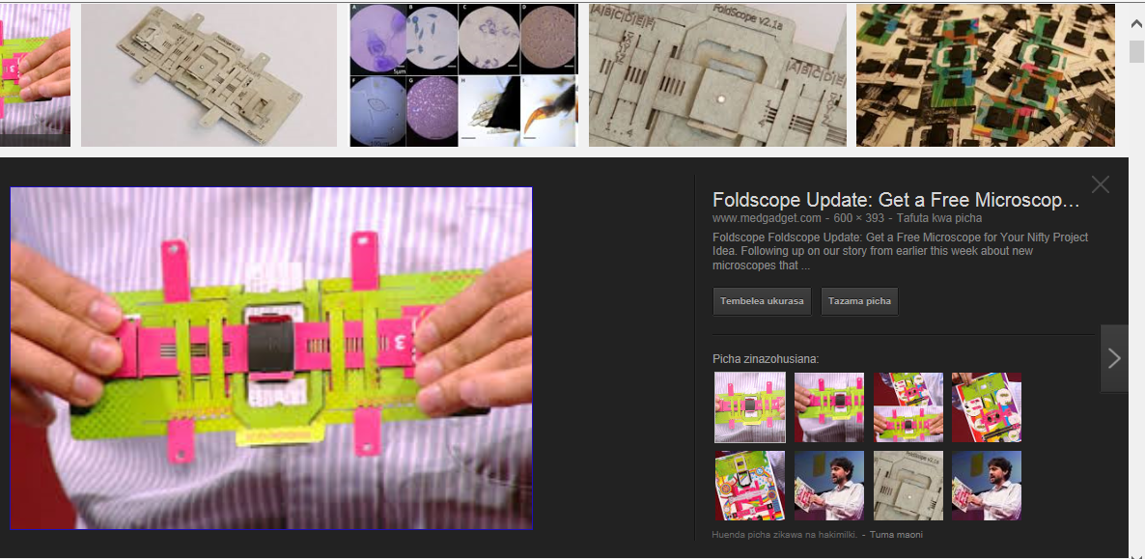
Foldscope: 2,000x a costo de US$0.50

Slide 27
Generar la base de evidencia de IAE
IAE
Compartir los principios, evidencia y casos
Intensificación agroecológico

Slide 28
Intensificación Agroecológico (IEI)
Mejorar el desempeño de los sistemas de cultivo
a través de la integración de los principios ecológicos
en la gestión de la granja y del sistema
Apoyar ...
Productividad bajo las limitaciones de recursos
Sostenibilidad, choques resiliencia v, la capacidad de adaptación
Al facilitar ...
Diversificación
Opciones flexibles para diversos contextos
La innovación social para la adaptación local y la adopción
Notes:
AEI draws upon certain principles and practices, as outlined on this slide. Particularly in the context of resource-constrained smallholder farming in the developing world, it recognizes and aims to work within farmers’ resource limitations. Through functional diversification and careful matching of options to contexts, AEI aims to reduce risk and improve resilience and productivity.

Slide 29
Hay dos tipos de principios IAE
IAE
IAE
Principios agroecologicos
~ Verdades utiles
Principios para la intensificacion
~ Normas éticas
Conocimientos agroecológicos apoyados por evidencia científica
- El manejo de plagas
- La diversidad funcional
El ciclo de nutrientes
- Integración de cultivos, árboles, ganado? ...
¿Cómo apoyar a un mejor rendimiento del sistema en el respeto de la gente, su cultura y la autodeterminación
Participación
Las decisiones mutuas
La conciencia de género
No aumentar los riesgos
...
Notes:
Break down and animate it better

Slide 30
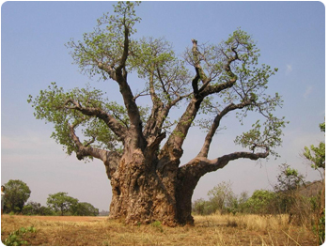
Principios de manejo de las plagas
Barreras: Reducir el acceso al cultivo
Matarlo: Biopesticideas
Comerlo: Enemigos naturales
Mesclas: reducir la densidad del huesped; barreras
Repele la plaga: Use cultivos intercalados, u asociados
Mejoramiento: Reducir la vulnerabilidad
Administrar el microambiente: espaciamiento etc → menos favorables para la plaga / patógeno
Manejar la evolucion: Reducir la presion para los cambios negativos
IPM
Roots: knowledge of pest biology / ecology
Notes:
Put up a baobab fruit picture

Slide 31
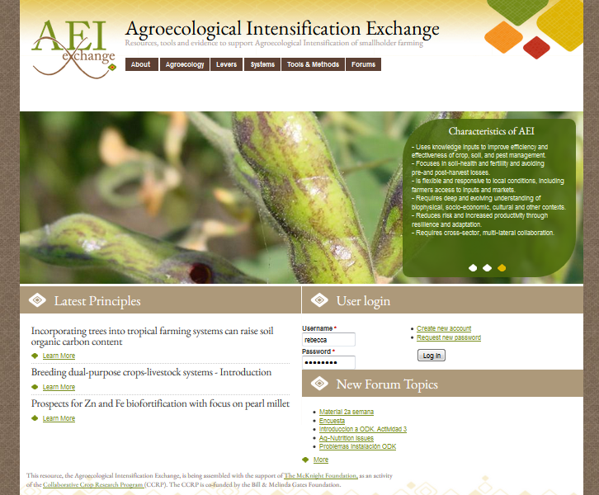

Slide 32
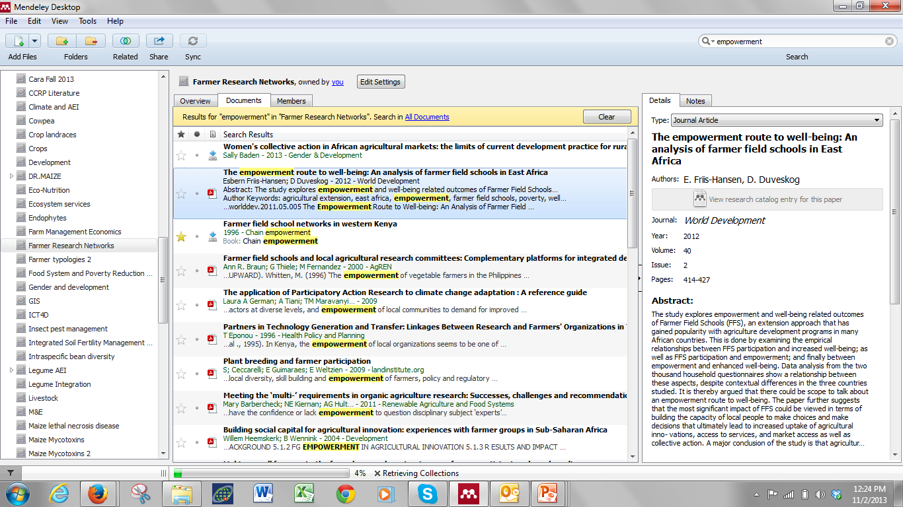
Biblioteca de publicaciones sobre IAE

Slide 33
