Slide 1


16th Annual Meeting
Andes Community of Practice
Jane Maland Cady
Rebecca Nelson
Walter Abrego
6 de Julio, 2020 - Virtual
Notes:
Greetings from Minnesota! On behalf of the McKnight Foundation I would to welcome you to the 16th Cop Meeting. A Big thank Andes Regional Team and Planning team for all their efforts in this new experiemental format. It is so wonderful to be with you all virtually.
Over the next hour I will be joined by three others-
Rebecca Nelson – SD and co-director of CCRP
Walter Abrego - PGA
Ruth Richardson. – ED GA
Our plan is to
-updates from McKnight, including our work with DEI
-Share some CCRP program wide updates and priorities
-The last half of the hour will be spent with Ruth Richardson, Executive Director of the GAFF. The GA is a funders Alliance that McKNight has been actively engaged with since inception. Some of you in this region will also have familiarity with it as various CoP members have participated in convenings and other activities of the Alliance. The GA is supported by the x-cutting grant area within CCRP and we see this collaboration as a vital way to animate and activite local, national, regional and global exchange and collective action. So welcome all.
CONFIRM - Can these guys introduce themselves here and be on screen?

Slide 2

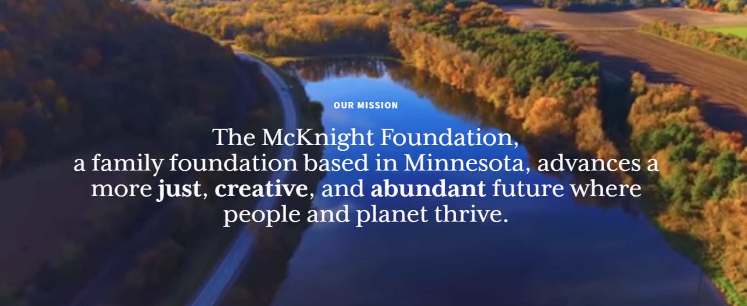

Notes:
I think it is important to highlight some several key strategic decisions at McKnight to set the context for our conversation and the week.
In November of 2018, that the board approved a new mission statement… declaring that we seek to “create a just, creative, and abundant future where people and planet thrive.”
Many of you have seen this, yet it so critically drives our work and is so relevant for this time…..Let me repeat – a creative, Just, and abundant future where people and the planet thrive.
I see this very much alive in the work of the Andes CoP and look forward to the discussions you will be having in the upcoming two weeks.

Slide 3
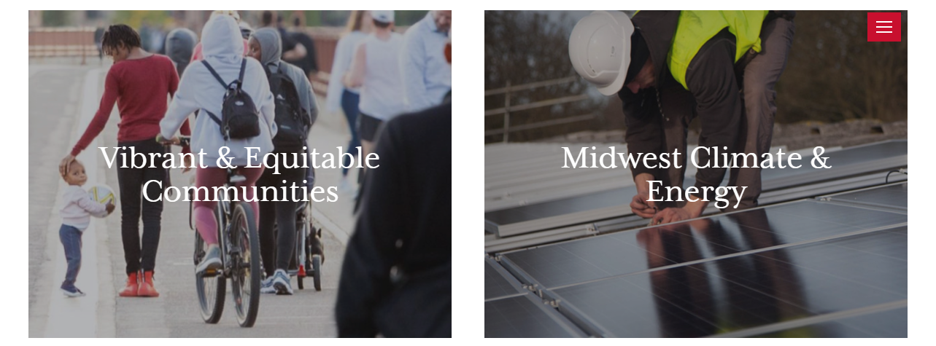
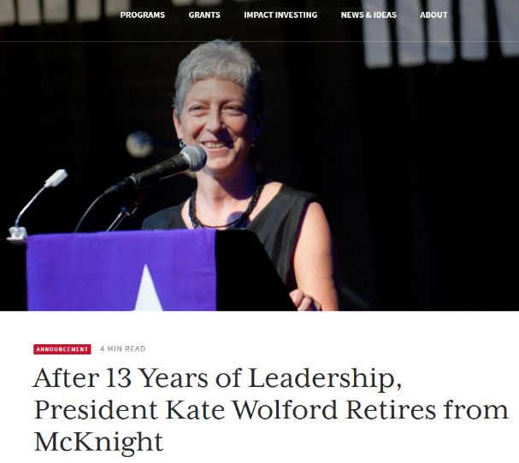
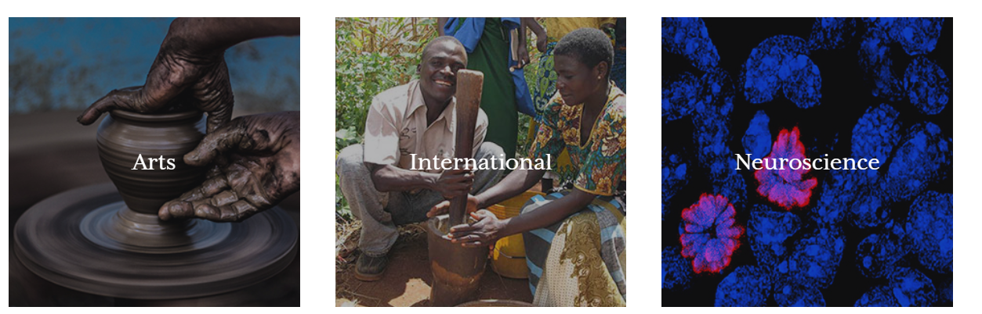
70
projects¹
Notes:
Since that time, the foundation has been conducting a strategic refresh, which resulted in programmatic focus and operational adjustments. We moved from 8 to 5 program areas - the majority of the work continues to focus on our home state of MN
Also in 2019 our president of 13 years announced her retirement. We are currently looking for a new president and so appreciated what Kate brought to the foundation

Slide 4
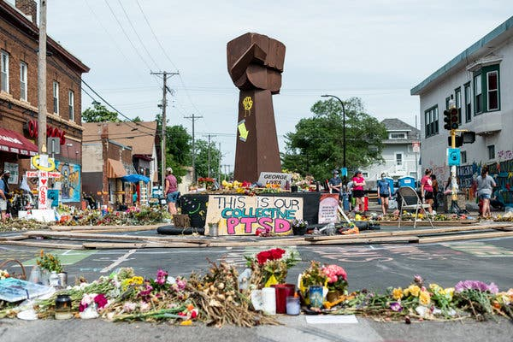
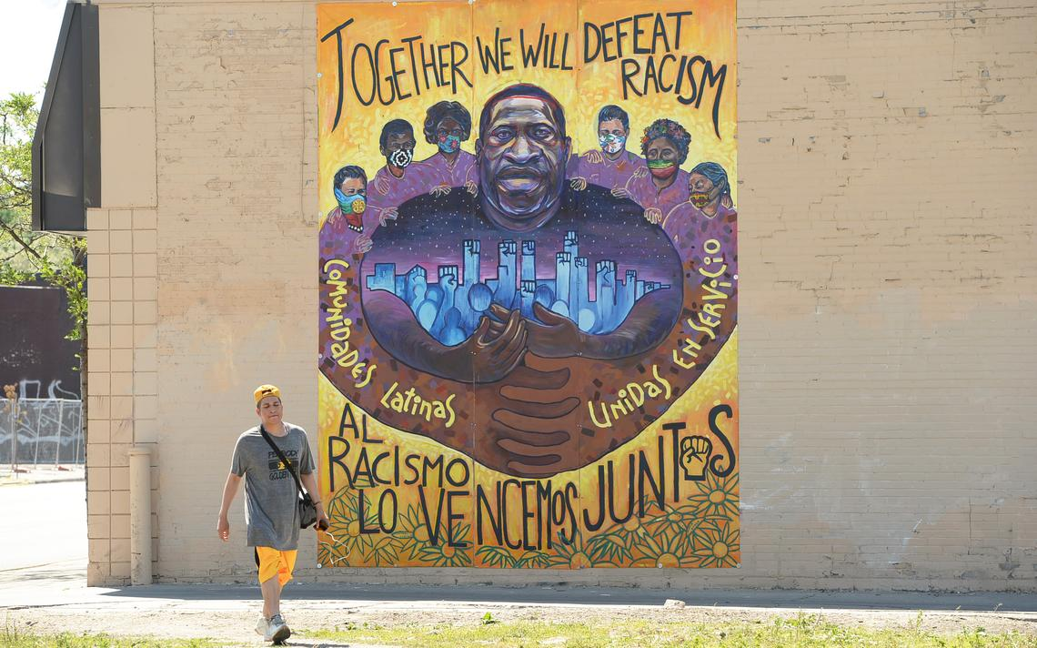
Diversity: We appreciate and leverage our differences, and we involve and reflect the communities we serve.
Equity: We align our policies, practices, and resources so that people of all races, cultures, and socioeconomic statuses have genuine opportunities to thrive.
Inclusion: We create an environment in which everyone feels valued and respected
George Floyd Memorial Site - Minneapolis, Minnesota, USA – June 2020
Notes:
Slightly over two years ago -we made a commitment public commitment to Diversity, Equity and Inclusion that drives work across the foundation, in MN the Midwest of the USA, and in the Andes and Africa regions where we work in CCRP,
We value diversity – social and biophsycial. We strive to work with the diverse communities where we work
We strive to align policies practices and resources so that that all people have genuine opportunity to thrive,
Create an environment where everyone feels valued and respected.
We know that equity issues – in MN a key differentiator is race. Black, indigenous, and other people of color have not had the same opportunities as the predominate white population. In addition, socio-economic status, geography, gender and education are a few other factors that influence inequality in our home state.
These photos are taken at the site of the George Floyd Murder and in the neighborhood.

Slide 5
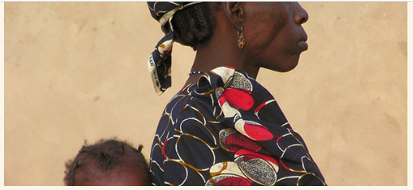
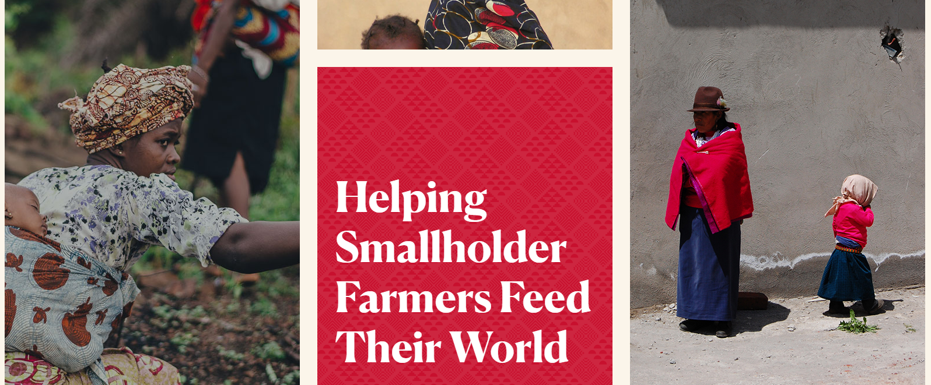
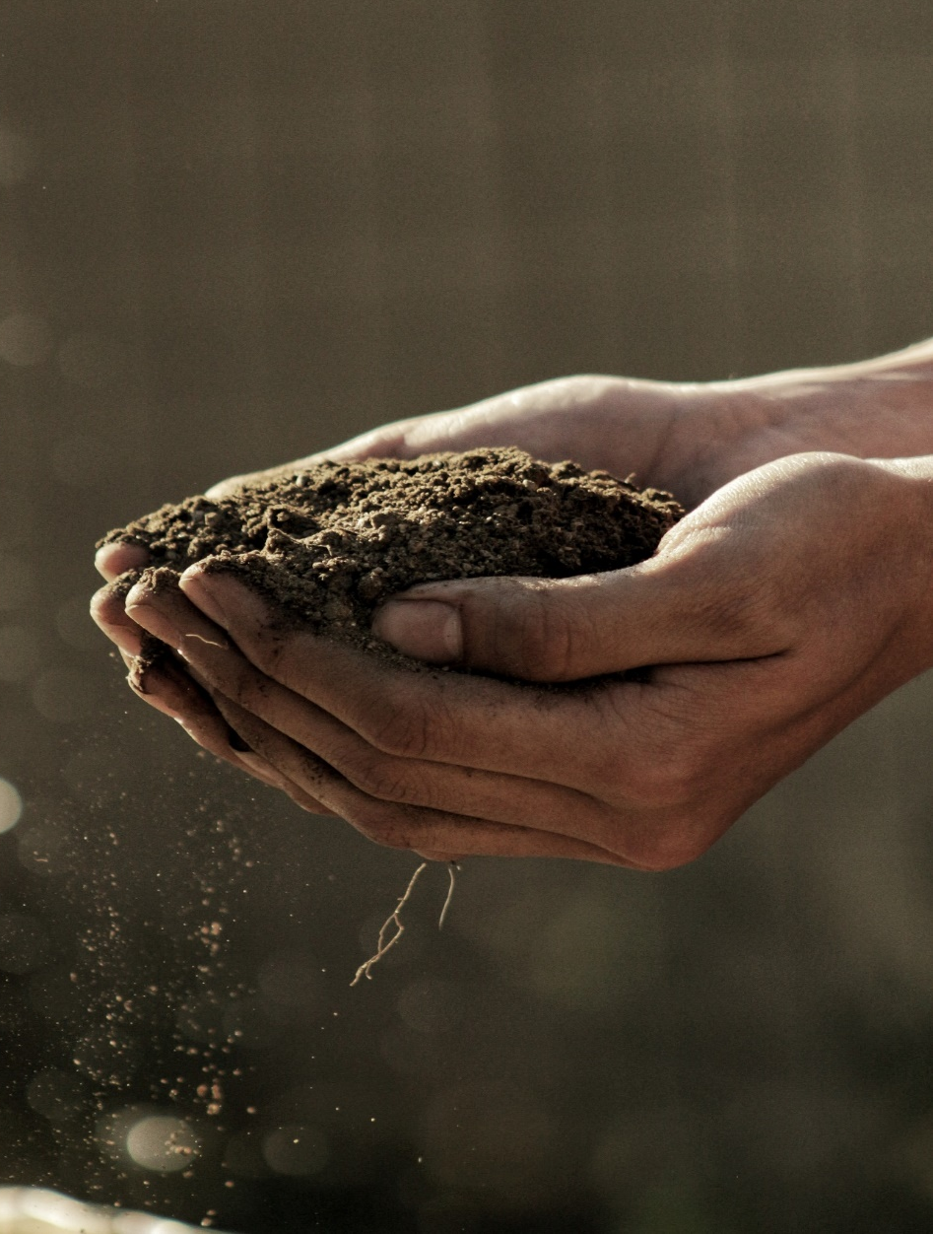
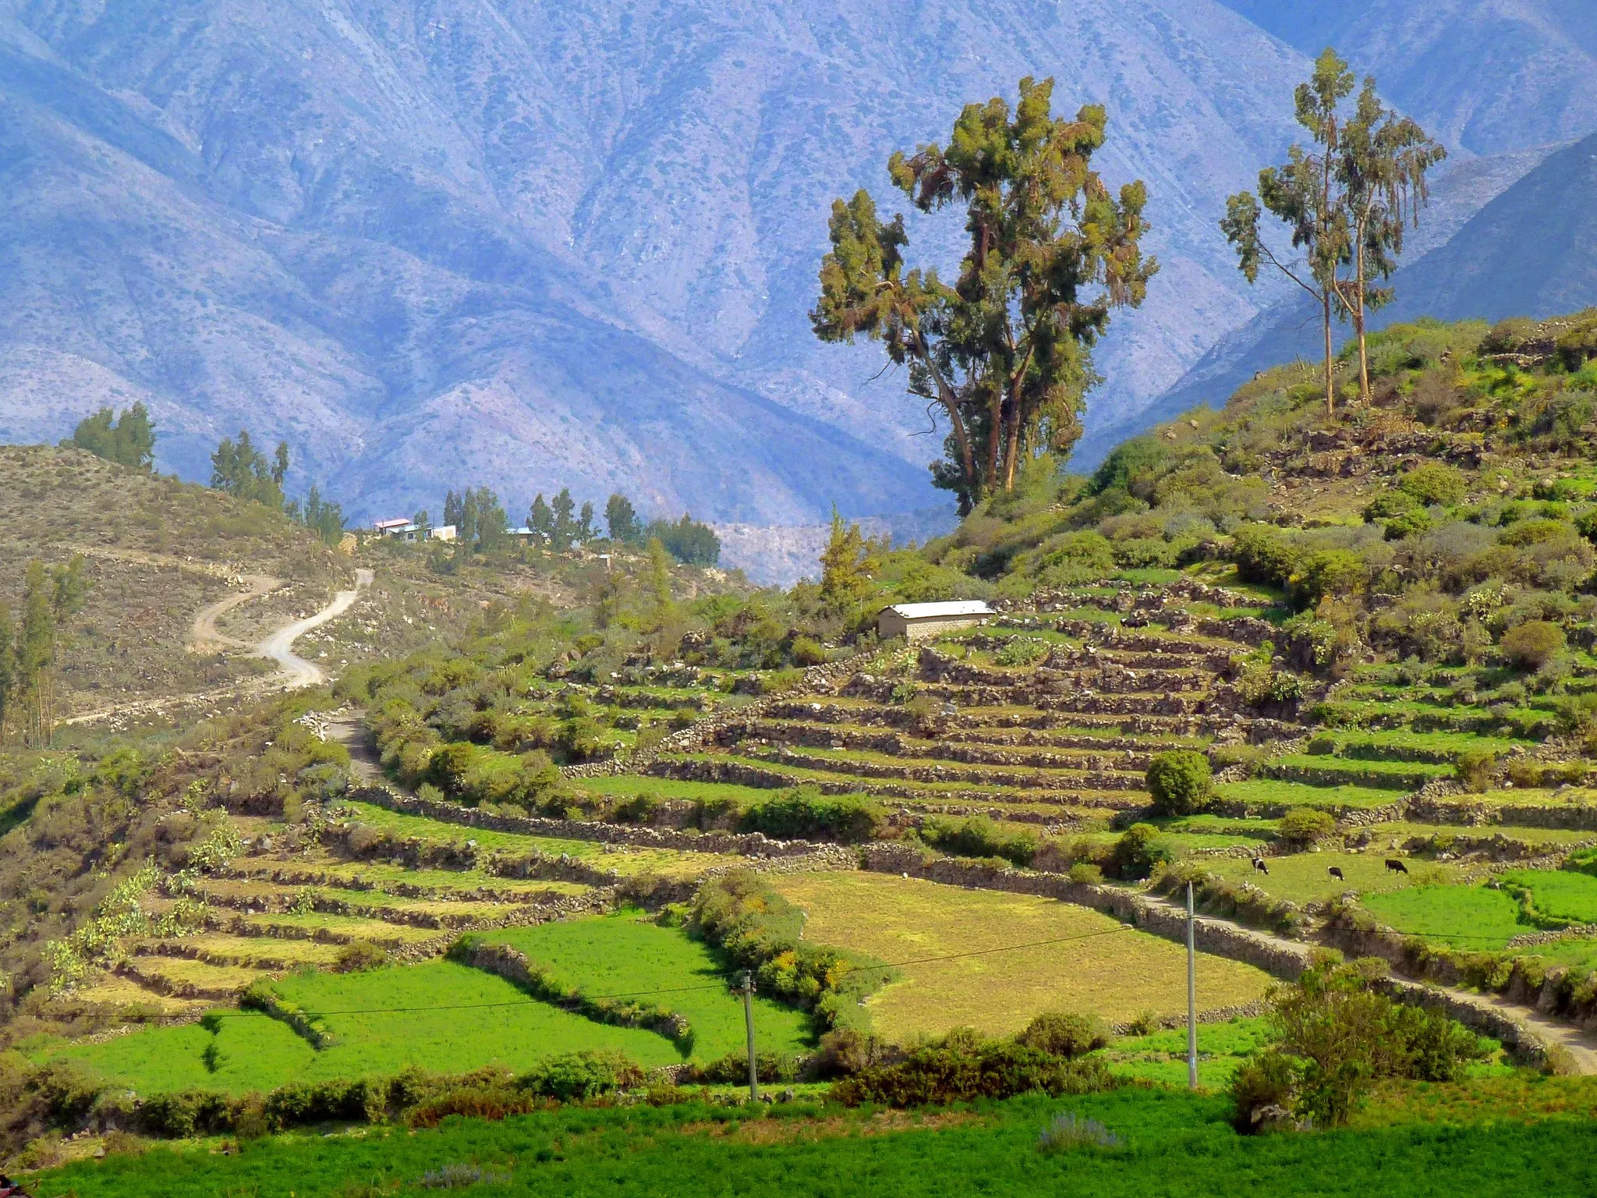
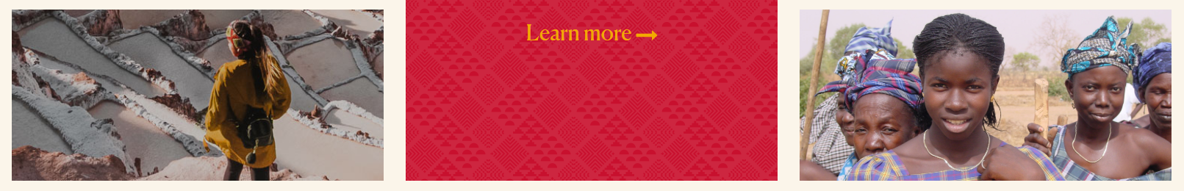
Notes:
Within the International programs at McKnight and within CCRP – we strive to address issues of equity and inclusion that are context relevant. We know for example that we much remain vigilant of the subtle and not so subtle ways that Global North/Global South issues spurred by the legacy of colonialism create unequal opportunities. We recognize other differences that matter, such as gender, how scientific, indigenous, and local knowledge is valued , education and geography.
Baked into the CCRP is a commitment to equity and access – at a high level -
Our mission is to ensure a world where everyone has access to nutritious food produced sustainably by local people.
We strive to reduce hunger and advance equity by
increasing agroecological-centered research and practice and
Advancing social and institutional capacities that support collaboration between researchers and farming and food-system communities.
We couple research funding with capacity strengthening (or co-learning) and convene people and communities—across disciplines, backgrounds, and experience—to share information, build bridges, expand networks, and inspire action.
We are here to learn and listen form the Andes CoP – exploring what this means for you how this might impact the work of CCRP.
With that – I wanted to invite Walter Abrego, my colleague from the Mcknight Foundation to say a few words about his experience with DEI at the foundation.

Slide 6
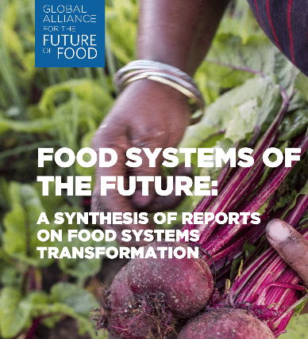

Food Systems and Climate
Exploding Debates and Perspectives
IPCC,
FOLU,
EAT
LANCET
IPES
FAO
WBCSD………
Notes:
Thank you walter –
Beore turning to CCRP, I must first acknowledge this pivotal moment on our planet.
Across the globe, we hear the many voices that are speaking out against social injustice and demanding change—some of that recently spurred by a hateful act in Minneapolis, the city I call home. All of this while we we are feeling the impacts of Covid-19 and recognizing the looming threats of climate change.
Couple with this -There is no denying that the world’s food systems and our very planet are at a critical point.
It is increasingly clear that the way we grow, process, package, transport, eat, research, teach about, and dispose of food directly contributes to these global challenges.
There is a growing momentum towards agroecological and regenerative solutions with transformative potential to draw down carbon, build inclusive economies and feed people with diverse and healthy foods.
The time is now for programs like CCRP to contribute to food system transformation.
We have the opportunity here over the next two weeks to really think about how to seize this moment. How can the Andes CoP – as part of a rsearch program focused on ecological solutions in ag and food systems, committed to equity and inclusion make a difference in this critical time?

Slide 7
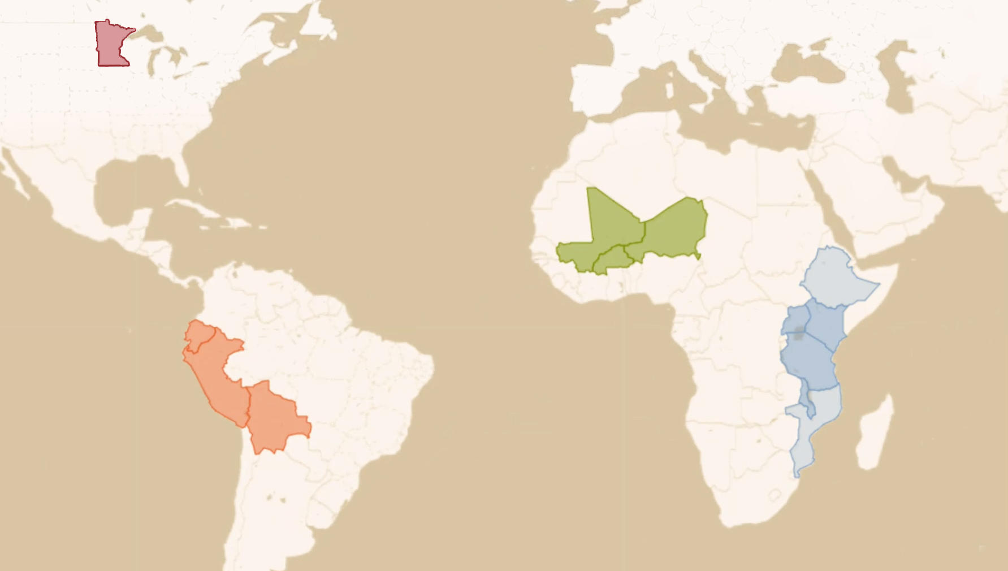

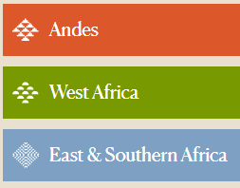
Where We Work
Burkina Faso
Mali
Niger
Uganda
Kenya
Malawi
Tanzania
Peru
Ecuador
Bolivia
Notes:
I wanted to share a few updates from CCRP since the CoP last met.
As I reminder, these are the countries where we focus our work. We now have 3 CoPs and the Andes is the oldest at 16 years.

Slide 8
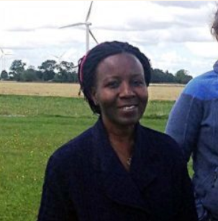
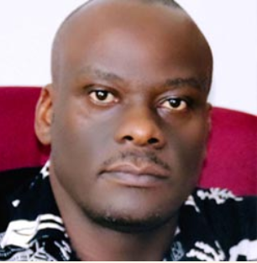
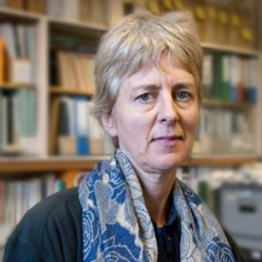
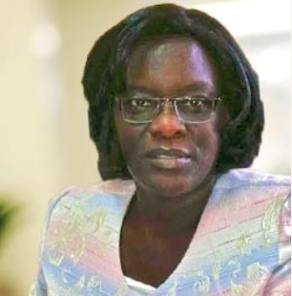
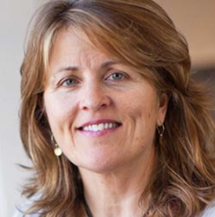
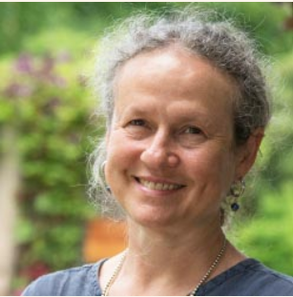
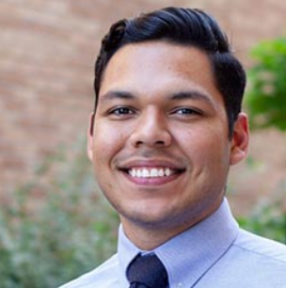
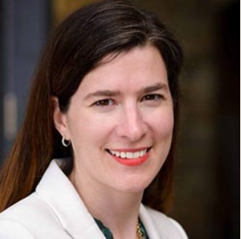
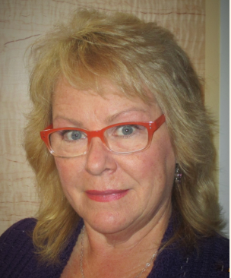
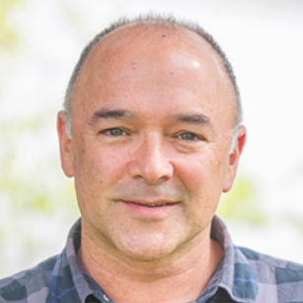
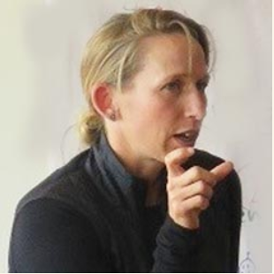
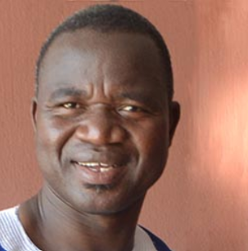
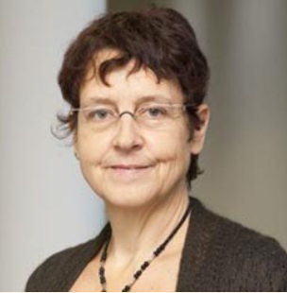
CCRP Staff & Consultant Core Leadership Team
(Full team not pictured)
Notes:
In our program, we have an expanded team so that we can do place-based work with cultural competent and experienced members, who work closely with grantees on the ground. Pictured are most of our core consultants from the regional CoPs. Also joined by 2 facilitators, iTeam, RMS, and some key grantees, partners, and guests….such as our dear Carlos Barahona.

Slide 9
CCRP by the Numbers
$7.08M
CCRP grantmaking
70
projects¹
$1.9M
CCRP non-grant assistance
80
CCRP projects
Notes:
We grant out 7.08 million and provide convening and capacity strengthening support in 80 projects, roughly ¼ of this supports the Andes CoP

Slide 10
Our principles
Principles of Collaboration
Inclusion
Genuine collaboration
Principles of Ag Systems
Agroecology
Contextualization
Principles of Research
Farmer-researcher co-creation
Research for AE impact
Principles of Program
Values coherence
Systemic coherence
70
projects¹
Notes:
The program takes a systems-based approach to effect this change, using shared core principles that guide how work is implemented.

Slide 11
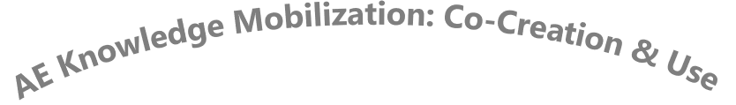
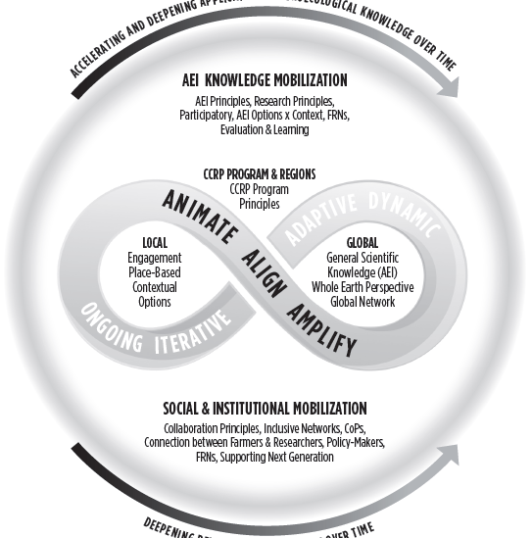
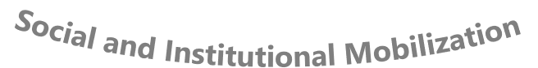
Ecological pest/ disease management
Agrobio-
diversity
Soil health
Farmer-
centered research
institutional & policy change towards AEI
Enhanced food systems
Notes:
We are guided by our theory of change aims to move towards ecological/regenerative agriculture and food systems that are woven together with equitable vibrant rural areas.
We do this through two interrelated work streams 1) co-creation and use of agroecological knowledge and 2) social and institutional change.
More specifically we focus this work on 6 key intervention points –
2-15 % of budgets go to support this – we are what we measure.

Slide 12
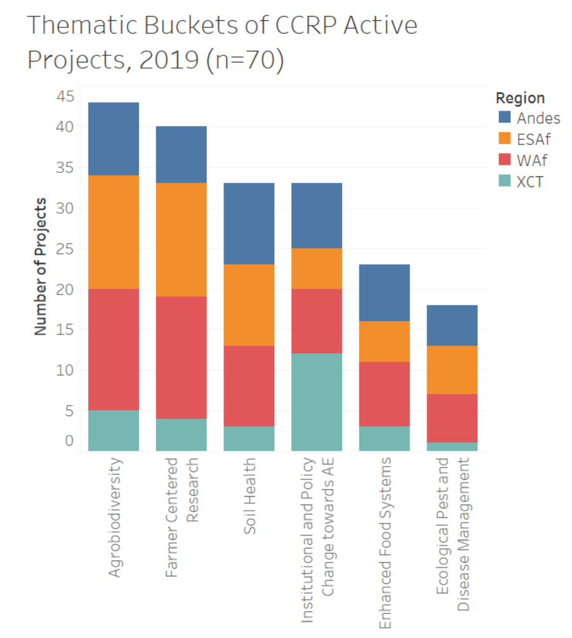
Grantmaking: what are we doing?
Thanks, Claire!
Notes:
This graph shows a break down of these six intervention points CoP and x-cutting grantmaking. A few highlights include -
All do some work in each area – with supporting agrobiodiversity and farmer centered research which is expressed through FRNs in the program. Our x-cutting grantmaking has a larger focus on the institutiona and policy change to support the expansion of ecological approaches on the ground.

Slide 13
How we work: Collaboration
Had a local NGO or farmer org partner
Had a national government, university or research partner
68%
69%
80
projects
70
projects¹
Had an international NGO, university, or research partner
53%
Notes:
Jane: Collaboration is key to our work - it is here where we prioritize the integration of various forms of knowledge – farmer, indigenous, scientific, national, international,.– for example of the 80 projects – comment on slide.

Slide 14
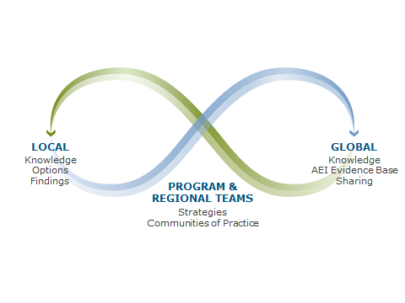
Notes:
I want to close by reminder you of how we think about the work we do.
We often visualize the work of CCRP with an infinity symbol, which represents dynamic and continuous flow and balance.
Our work, grounded in agroecological research and practice, relies on the flow of knowledge between indigenous communities, smallholder farmers, biophysical and social science researchers, development organizations, and others locally, nationally and globally .
It utilizes the flow between plants and animals and other natural synergies in soils, microflora, and crops.
And it results in the flow of diverse income streams and local and regional economies, which sustain healthy, thriving communities that demonstrate more resilience to environmental shocks.
I wanted thank you all for your time and pass this off to Rebecca for her updates.

Slide 15
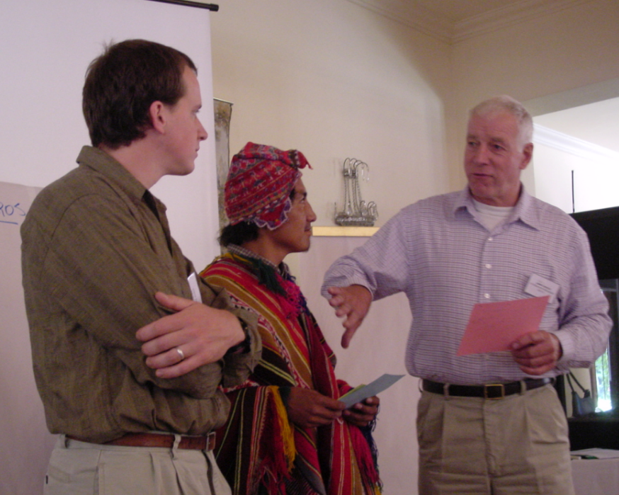
¡Bienvenidxs!
CdP16-Andes
6 de Julio 2020
CdP-0, Cochabamba, 2003

Slide 16
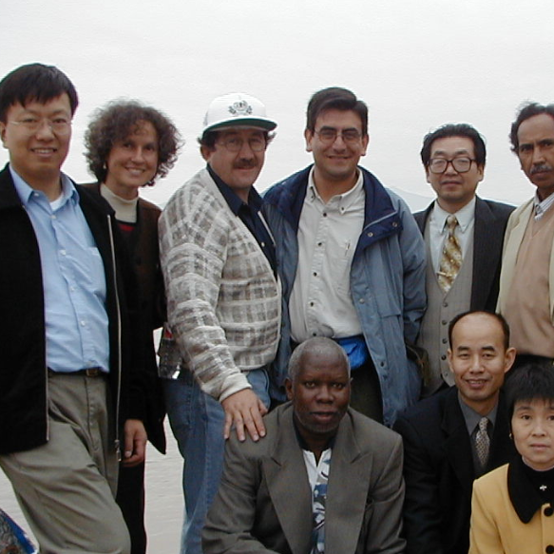
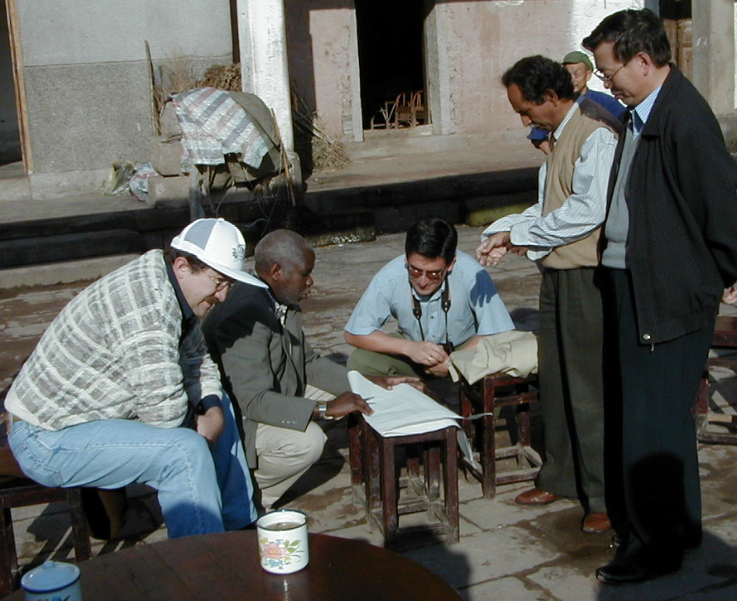
Recordando a
Antonio Gandarillas

Slide 17

AE Movilización del conocimiento: co-creación y uso
MIP
Manejo ecológico
de plagas / enfermedades
Agrobio-
diversidad
Salud del suelo
Movilización Social e Institucional
Investigación centrada en el agricultor
Cambio institucional y de políticas hacia AE
Sistemas alimentarios mejorados
Notes:
Thanks, KV – this looks nice. But could you please to visually connect this to the previous (ToC) slide (faded-out circle; arrows)?

Slide 18
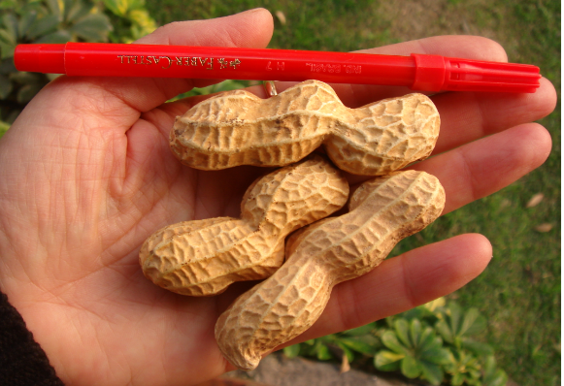
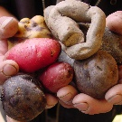
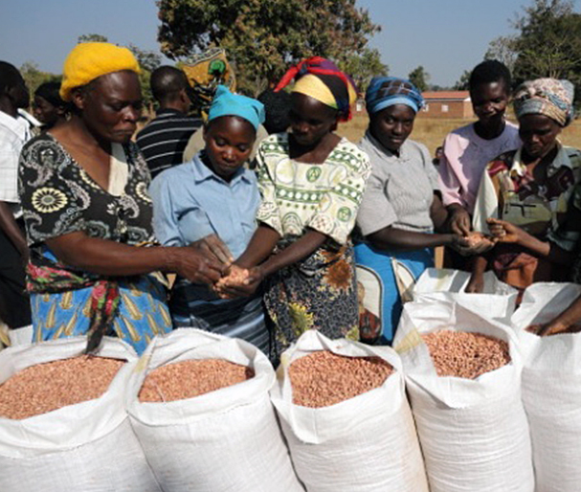
Agrobiodiversidad
Diversity
Mejoramiento
Sistemas de semillas
  Cultivos leguminosos: frijol común, maní, caupí, paloma, soja, maní Bambara, lablab, lupino, Desmodium
  Cultivos de cereales: sorgo, mijo perla, mijo dedo, fonio, tef
  Other: papa; quinua, amaranto
Notes:
Large-scale evidence from Bioversity, …?

Slide 19
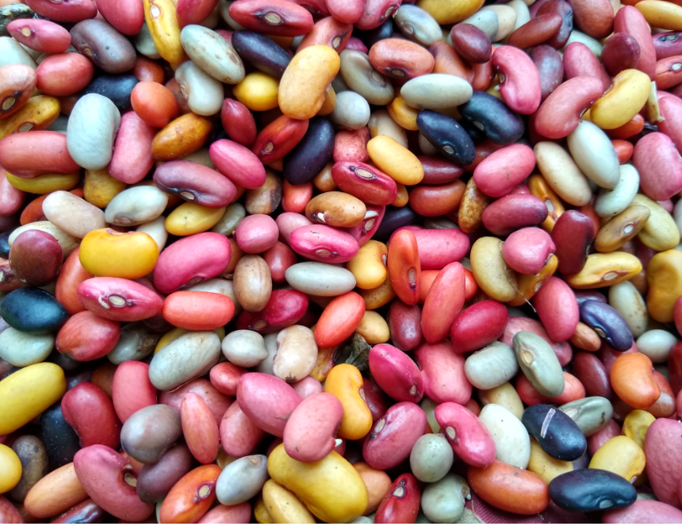
Biodiversidad de leguminosas en Etiopía
La mayoría de los agricultores están plantando variedades tradicionales de leguminosas, incluso en áreas de gran producción donde hay variedades "mejoradas".
La diversidad varietal de leguminosas se conserva dentro de las comunidades, no por hogares individuales. Los agricultores cultivan 1-2 variedades, pero saben qué vecinos están plantando.
Los mercados locales son sitios clave para el intercambio de semillas y conocimiento.
Morgan Ruelle
Notes:
Most farmers are planting traditional varieties of legumes, even in areas of major production where ‘improved’ varieties are available.
Varietal diversity of legumes is conserved within communities, not by individual households. Most households plant only one (sometimes two) varieties of a given crop per year, even when there are many more within the community. When asked, farmers accurately report their neighbors are planting, so they know where to turn when they need a different set of traits.
Local markets are key sites for seed and knowledge exchange. Many farmers report that the original source of the varieties they are using is from their local market. Farmers living far from markets – including those who need to walk several hours – still attend their local market frequently, usually every week.

Slide 20
Desarrollo de germoplasma
Haciendo
Apoyo a programas de mejoramiento para diversos cultivos.
Aprendiendo
Cambiando
Un ejemplo de África occidental
La “mejoramiento” puede aumentar o reducir la diversidad
Notes:
Add what, so what, now what

Slide 21
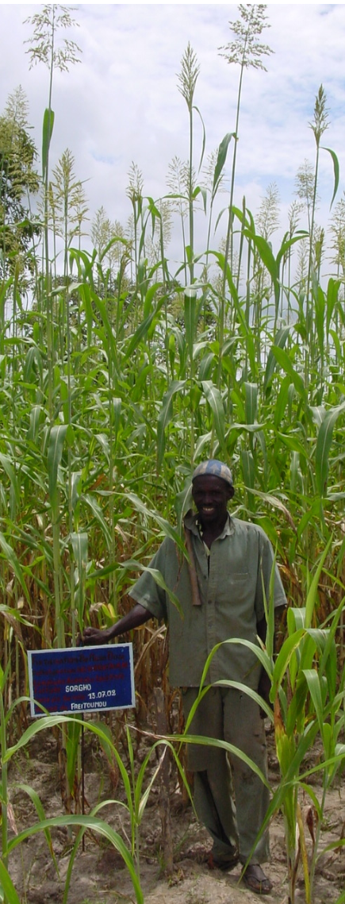
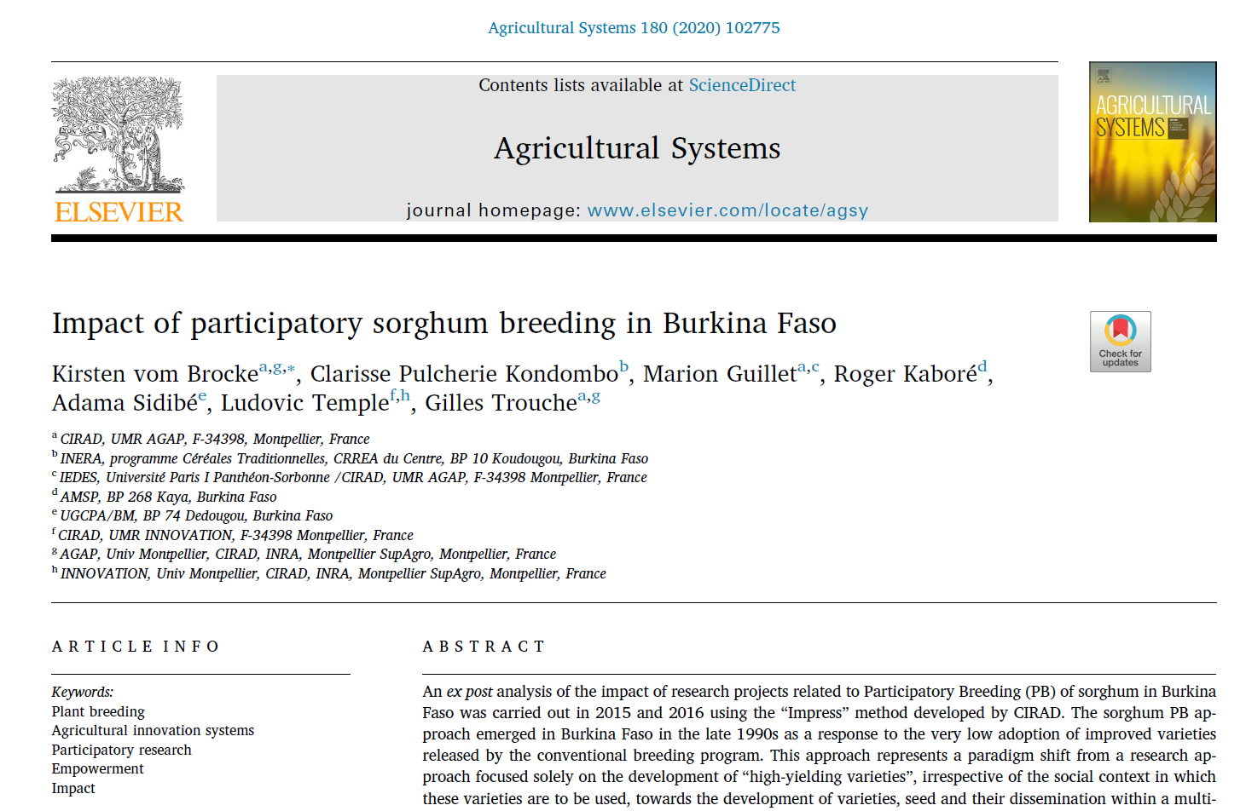
Impacto: lento y serio

Slide 22
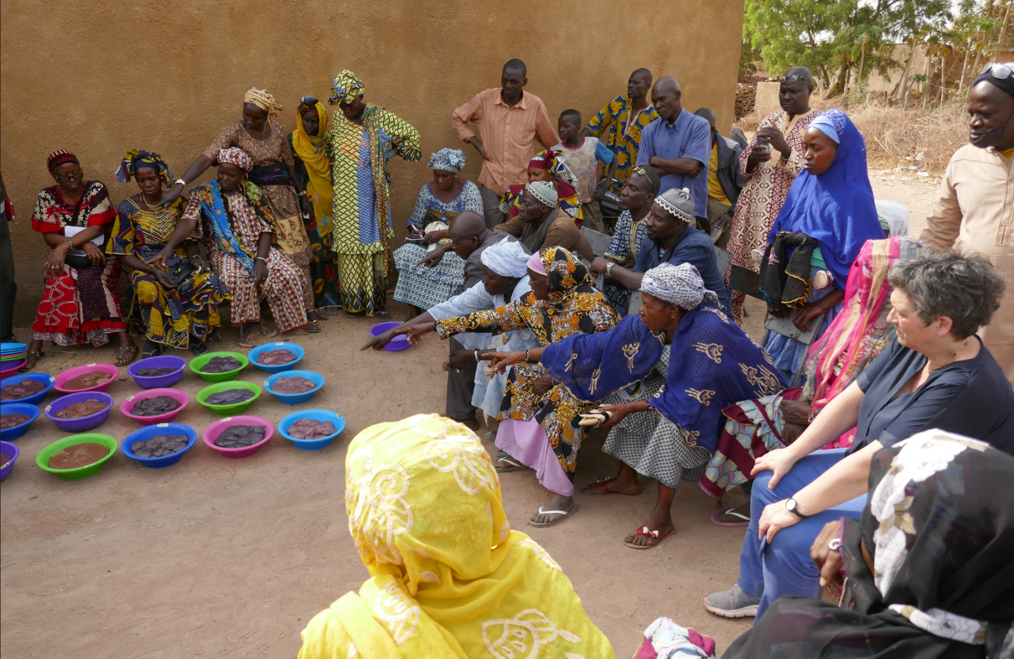
Notes:
Seed FRN / WAf: awesome teamwork. Gender harmony in the decision-making.
At the right, that’s Valerie Verdier of France’s Inst for Research for Development (IRD; she is hosting me for my sabbatical), who was inspired by our visit and interested in applying a similar approach in the collaborative work on rice breeding that she is connected to in Mali.

Slide 23
AE Movilización del conocimiento: co-creación y uso
MIP
Manejo ecológico
de plagas / enfermedades
Agrobio-
diversidad
Salud del suelo
Movilización Social e Institucional
Investigación centrada en el agricultor
Cambio institucional y de políticas hacia AE
Sistemas alimentarios mejorados
Notes:
Thanks, KV – this looks nice. But could you please to visually connect this to the previous (ToC) slide (faded-out circle; arrows)?

Slide 24
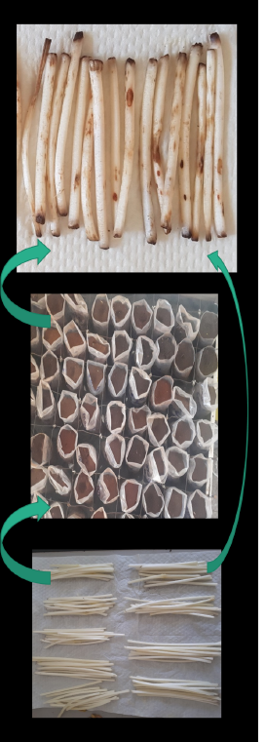
Salud de los Suelos
kit de herramientas
  Desde la creación hasta la utilización / escalado
  CdP del suelo
Moviendo la aguja en SOM
  BBIII: ¡Difícil!
  Mas opciones
      Compost
      Legumbres
      Control de la erosión
      Economía circular para residuos orgánicos
      Bioles
      Plantas perennes
Nematode assay,
Vanek and Medvecky
Notes:
XC1: From creation to utilization / scaling
XC2: Soil CoP
Moving the needle on SOM
BBIII: Not easy!
Expanding options
Compost
Legumes
Erosion control
Circular economy for organic wastes
Bioles
Perennials

Slide 25

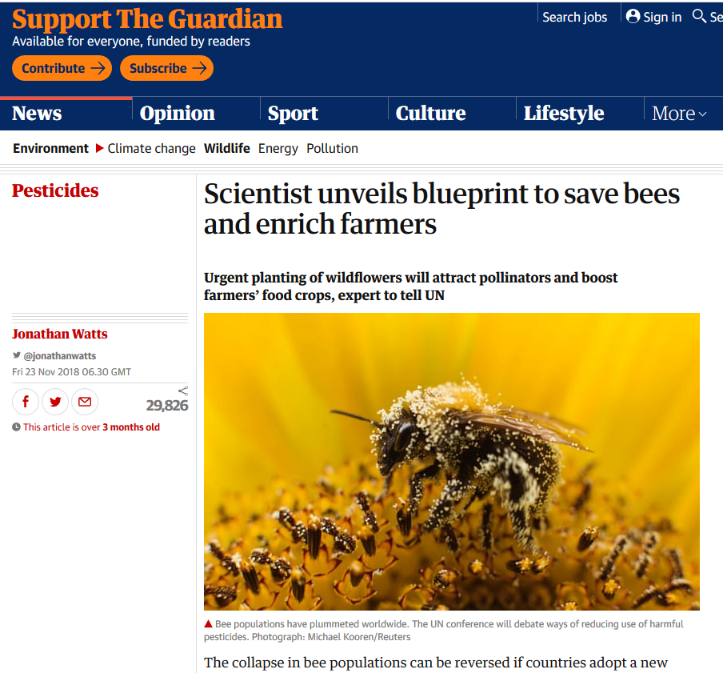
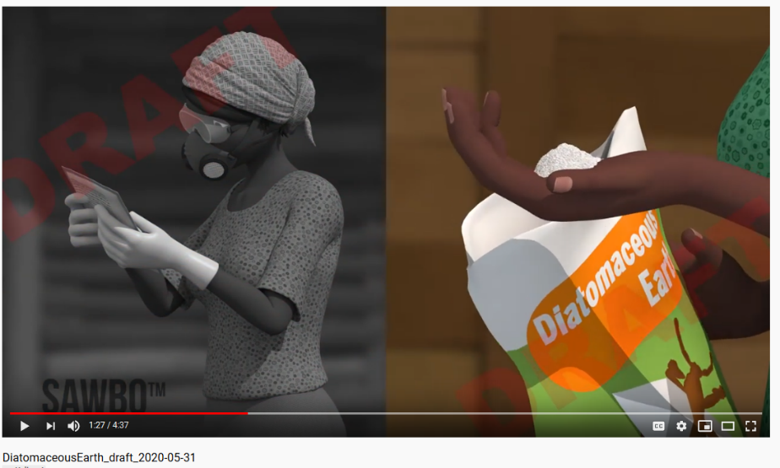
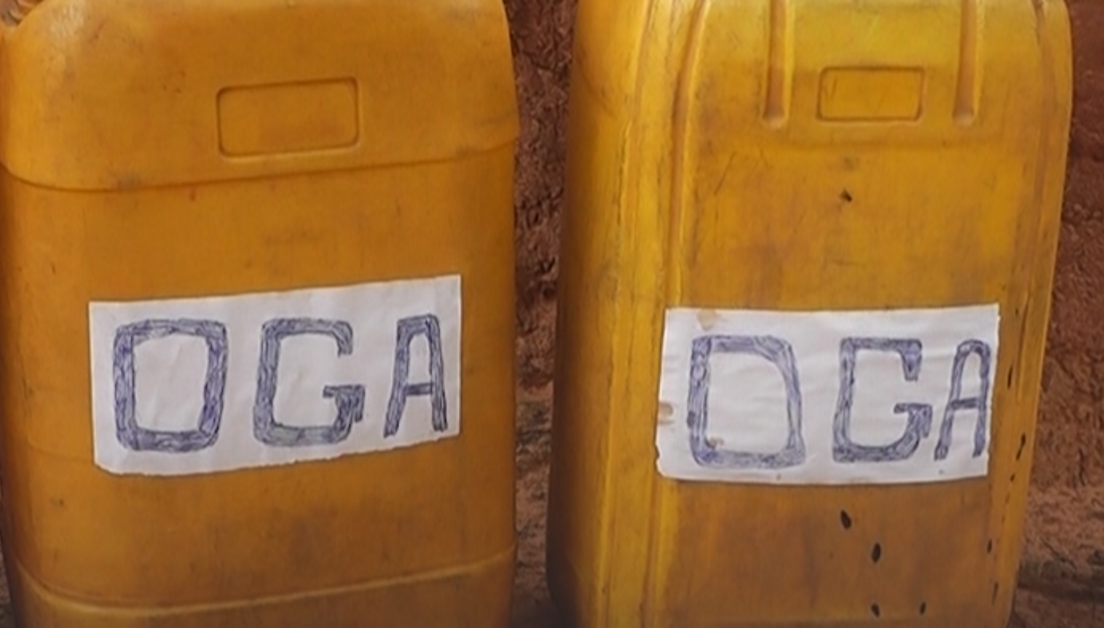
Bioinsumos
Compost – todas las regiones
Bioles – Andes
Oga y economía circular para residuos orgánicos – Waf
Control biológico – Waf
Biopesticidas - ESAf y Waf
Opciones de almacenamiento poscosecha - ESAf

Slide 26
AE Movilización del conocimiento: co-creación y uso
MIP
Manejo ecológico
de plagas / enfermedades
Agrobio-
diversidad
Salud del suelo
Movilización Social e Institucional
Investigación centrada en el agricultor
Cambio institucional y de políticas hacia AE
Sistemas alimentarios mejorados
Notes:
Thanks, KV – this looks nice. But could you please to visually connect this to the previous (ToC) slide (faded-out circle; arrows)?

Slide 27
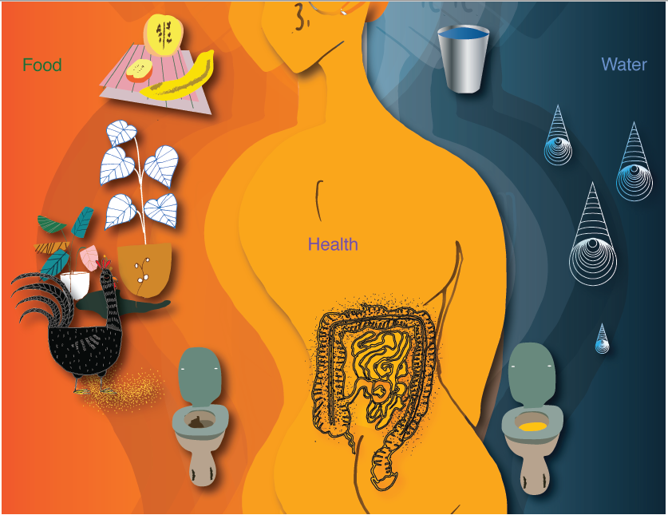
Tejas Sharma and Rebecca Nelson

Slide 28
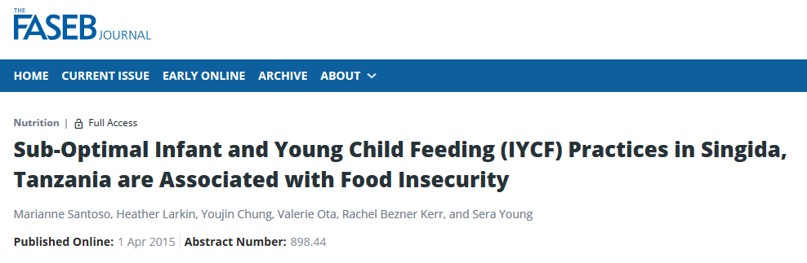
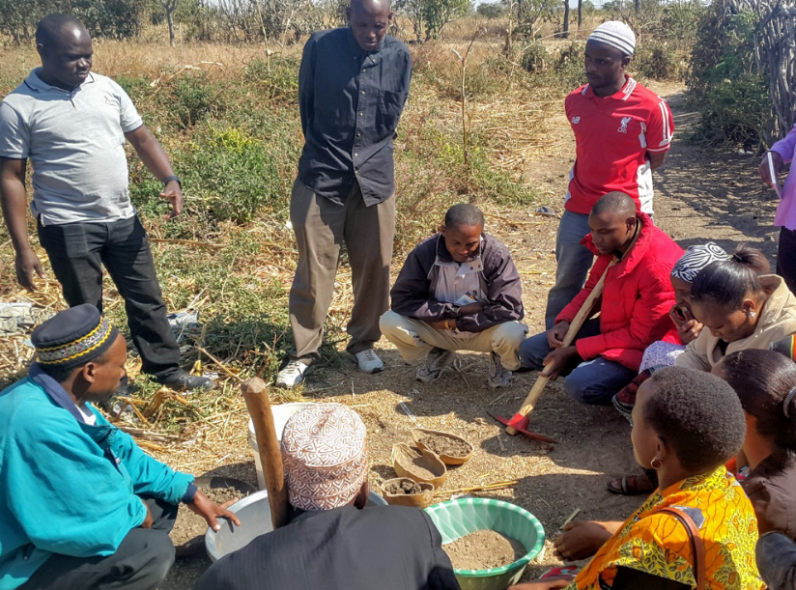
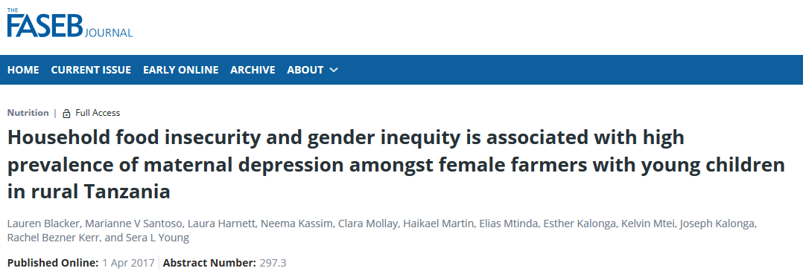


Conseguir impacto en el estado nutricional del niño
Singida Nutrition and Agroecology Project
Integration >> impact
R. Bezner Kerr et al. (since 2005)
Notes:
Agroecology (legumes for diversification+ nutrition education + gender / household

Slide 29
AE Movilización del conocimiento: co-creación y uso
MIP
Manejo ecológico
de plagas / enfermedades
Agrobio-
diversidad
Salud del suelo
Movilización Social e Institucional
Investigación centrada en el agricultor
Cambio institucional y de políticas hacia AE
Sistemas alimentarios mejorados
Notes:
Thanks, KV – this looks nice. But could you please to visually connect this to the previous (ToC) slide (faded-out circle; arrows)?

Slide 30

Red de investigación de agricultores
Grupo 2
de agricultores
Grupo 1
de agricultores
Grupo N
de agricultores
Facilitacion; Plataforma de datos
Grupo 1
de investigadores
Grupo N
de investigadores
Grupo 2
de investigadores

Slide 31

Una federación de mujeres agricultoras de Níger prueba las opciones de AE ​​para encontrar soluciones adecuadas al contexto
Una muestra de pruebas realizadas por FUMA Gaskiya RAE
Seed Balls
Maradi
Hub
Partial Weeding
FUMA Gaskiya
FRN
Data Manager
Oga
Farmer
ID App

Slide 32


RAE De Las Tierras Secas:
Terrazas y diques de arena; esperanza y cultivos
Las transmisiones han regresado
Las mujeres viajan menos para buscar agua para el ganado y los usos domésticos, lo que le da al agricultor más tiempo para realizar otras actividades.
Regeneración de pastos
Mucho progreso en la selección de cultivos
Producción mejorada de cultivos, donde las semillas habían sido barridas después de la siembra.
Las inundaciones recientes no destruyeron sus granjas
Gracias a Alkamoi para los fotos
Notes:
Streams have returned
Women travel less to fetch water for livestock and domestic uses, giving the farmer more time to pursue other activities
Grasses regenerating
Lots of progress in crop selection
Improved crop production, where the seeds had been swept away after planting

Slide 33
Cross-cutting portfolio
Compromiso de los sistemas alimentarios mundiales
  Alianza Global para el Futuro de los Alimentos
  Fondo de Agroecología
  FAO: AKH, TAPE, base de datos de inventario de materia orgánica
Apoyo de los proyectos
  RMS
  Kit de herramientas de suelos
  Soporte de agroecología y base de evidencia - UVM
  Access Agriculture – 100 traducciones de videos
Innovaciones
  Sistema de aprendizaje - IDEO
  Sistema de datos; Bioversity crowd-sourcing
Notes:
Global Food Systems Engagement
Global Alliance for the Future of Food
Agroecology Fund
FAO: AKH, TAPE, organic matter inventory database
Supporting grantees
RMS
Soil toolkit
Agroecology Support and Evidence-Base - UVM
Access Agriculture – 100 video translations
Innovations
FRN learning system - IDEO
FIPS data system
Bioversity crowd-sourcing

Slide 34


