Slide 1
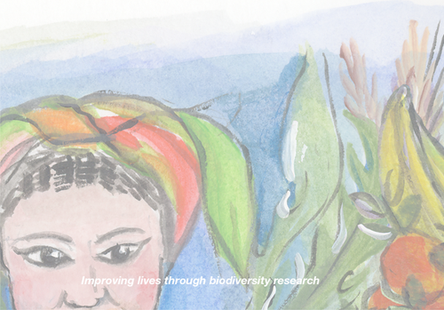

UN MARCO CONCEPTUAL PARA EVALUAR EL ÉXITO DE PROYECTOS DE CONSERVACIÓN EN FINCA CON EVIDENCIA DE 6 CASOS EN LOS ANDES DE ECUADOR, PERÚ Y BOLIVIA
Mauricio R. Bellon and Elisabetta Gotor
Bioversity International
Francesco Caracciolo
Universitá degli Studi di Napoli Federico II

Slide 2
Background
Last 20 years a growing interest in the use and management of agricultural biodiversity in farmers’ fields and in the wild (i.e. on-farm and in situ conservation)
  as a complementary strategy to ex situ conservation
Many projects implemented worldwide to support on farm conservation
However, still a lack of tools that enable donors, practitioners and policy makers to systematically evaluate a project’s success

Slide 3
The project
Project to provide donors, policy-makers and practitioners with the conceptual and methodological tools to assess the success of their projects and the lessons learned, and hence their investments
Focus on the high Andes of South America
Use of case studies and mixed methodologies
Analyzed six projects on on-farm conservation in the region

Slide 4
Projects on on-farm conservation seek to influence three outcomes
Agricultural biodiversity
  the relevant components and their respective levels of biodiversity maintained in an agricultural system
Livelihood benefits
  the private benefits that farmers and their households derive from that agricultural system
Societal benefits
  the public benefits that society derives from the relevant components of biodiversity maintained in an agricultural system

Slide 5
A simple conceptual framework

Slide 6
Agricultural
Biodiversity
Livelihood benefits
(private)

Slide 7
Societal benefits
(public)
Agricultural Biodiversity

Slide 8
Agricultural
Biodiversity
Livelihood benefits
(private)
Societal benefits
(public)
Agricultural Biodiversity

Slide 9
Agricultural
Biodiversity
Livelihood benefits
(private)
Societal benefits
(public)
Agricultural Biodiversity

Slide 10
Agricultural
Biodiversity
Societal benefits
(public)
Livelihood benefits
(private)

Slide 11
Agricultural
Biodiversity
Societal benefits
(public)
Livelihood benefits
(private)

Slide 12
Agricultural
Biodiversity
Expected trend with
economic development
Societal benefits
(public)
Livelihood benefits
(private)

Slide 13
Agricultural
Biodiversity
Expected trend with
economic development
Societal benefits
(public)
Livelihood benefits
(private)

Slide 14
Agricultural
Biodiversity
Agricultural
Biodiversity
Intervention
Societal benefits
(public)
Livelihood benefits
(private)

Slide 15
Agricultural
Biodiversity
Agricultural
Biodiversity
Intervention
Societal benefits
(public)
Livelihood benefits
(private)

Slide 16
Agricultural
Biodiversity
Agricultural
Biodiversity
Ideal situation
Intervention
Societal benefits
(public)
Livelihood benefits
(private)

Slide 17
Assessing success involves answering three questions
Do farmers apply the interventions provided by the project?
If so, does the application of these interventions lead to farmers maintaining higher levels of crop diversity that would have been without them?
Does this higher level of crop diversity lead to increased well-being among farmers who applied the interventions?

Slide 18
Answering positively to these three questions indicates that a project is successful
Societal
Benefits
Project
Interventions
Agricultural
Biodiversity
Livelihood
Benefits
Adoption
SUCCESS

Slide 19
Testable predictions
Farmers who apply project interventions:
  maintain higher levels of crop diversity compared to those who do not apply them
  those farmers who maintain higher levels of crop diversity obtain additional benefits from this diversity compared to those with lower diversity
In addition for sustainability:
  (a) and (b) continue over time

Slide 20
Need measurable indicators for
Agricultural
Biodiversity
Intervention
Societal benefits
(public)
Livelihood benefits
(private)
And correct for confounding factors

Slide 21
Six projects examined
Country | Project | Species | Organization | Donor
Ecuador | Promotion of Andean Crops for Rural Development in Ecuador | Multiple species | UNORCAC | USDA
Ecuador | Sustainable Production Systems to Ensure Food Security in Poor Communities in the Province of Cotopaxi, Ecuador | Quinoa (Chenopodium quinoa) Lupin (Lupinus mutabilis) | INIAP | McKnight Foundation
Peru | Biodiversity of Andean Tubers: strengthening the On-farm Conservation and Food Security of Andean Tubers in the Fragile Ecosystems of the Southern Peruvian Highlands | Oca (Oxalis tuberosa) Ulluco (Ullucus tuberosus) Maswa (Tropaeolum tuberosum) Potatoes (Solanum tuberosum) | CRIBA | McKnight Foundation
Peru | Improved production of native potatoes in the Andean Highlands of Peru | Potatoes (Solanum tuberosum) | ITDG | McKnight Foundation
Bolivia | Enhancing the Contribution of Neglected and Underutilized Crops to Food Security and to Incomes of the Rural Poor | Quinoa (Chenopodium quinoa) Cañahua (Chenopodium pallidicaule) | Bioversity Int. & PROINPA | IFAD
Bolivia | National Genetic Resources System for Food and Agriculture”, Andean Grains | Quinoa (Chenopodium quinoa) Canahua (Chenopodium pallidicaule) | PROINPA | Gov’t of Bolivia

Slide 22
Project Interventions
Activities carried out by a project aimed at changing the way crop diversity is managed, used, consumed and marketed to:
  increase the benefits farmers and their households derive from it (livelihoods) and
  create the incentives for farmers to continue to maintain this diversity on farm (conservation)

Slide 23
Project interventions
92 interventions across six projects
  Ecuador
    INIAP (Cotopaxi): 13
    UNORCAC : 22
  Peru
    CRIBA: 13
    ITDG: 15
  Bolivia
    Bioversity: 16
    SINARGEAA: 13

Slide 24
Interventions had different aims
Knowing and enhancing access to native crop diversity
Improving the agronomic management of the crop
  particularly pest & disease management
Improving the consumption of the crop, storage & processing
Improving marketing to enhance income opportunities
Training and capacity building
Enhancing farmer organization for consumption & marketing
Disseminating information and knowledge
Providing opportunities for income generation through agro-tourism (only one project)

Slide 25
Participation rates versus adoption rates

Slide 26
Participation versus adoption by project
INIAP
UNORCAC
CRIBA
1
.5
0
Rate of adoption
ITDG
Bioversity
SINARGEAA
1
.5
0
0
.5
1
0
.5
1
0
.5
1
Rate of participation

Slide 27
Measurable indicators: Example from Bolivia
ABD: Number of varieties of quinoa and cañahua planted by household
Confounding factors
Language
Age
Education
Sex head household
Landholdings
Wealth
Organizations
Labor availability
Migration
Sources of income
Location
Project
Adoption:
Number of
interventions
applied
Private Benefits: Quantity of quinoa & cañahua produced for self-consumption & for sale or gross revenue from sale
Public Benefits: Location in area of
high genetic diversity

Slide 28
Framework for empirical assessment
The empirical model:
?
?
ADOPTION
ABD
PRIVATE
BENEFITS
u
v
A priori-theoretical structure to test.

Slide 29
Empirical model
Private Benefits_{i} = δ ₀ + δ₁ ABD_{i} + δ ₂ X_{1i} +…+ δ _{1+r} X_{ri} + e_{i}
ABD_{i} = β₀ + β₁ adoption_{i} + β₂ X_{1i} + β₃ X_{2i} +…+ β_{1+r} X_{ri} + u_{i}
Adoption_{i} = γ₀ + γ ₁ Z_{1i} + γ ₂ X_{1i} + γ ₃ X_{2i} +…+ γ _{1+r} X_{ri} + v_{i}
Z₁: ex-ante participant in project
X_{r} : Language, Age, Education, Sex head household, Landholdings, Wealth, Organizations, Labor availability, Migration, Sources of income, Location, Project

Slide 30
Regression results: Bolivia
 | Adoption |  |  |  | Native crop diversity |  |  |  | Household benefits
Variable | Consumption & sale no. interventions applied |  | Gross revenues no. interventions applied |  | Consumption & sale no. varieties of quinoa & cañahua |  | Gross revenues no. varieties of quinoa & cañahua |  | Qty quinoa & cañahua consumption & sale |  | Gross revenues from sale of quinoa & cañahua
ex ante participation | 1.8958 | **** | 1.9417 | ****
adoption |  |  |  |  | 0.0335 | *** | 0.0364 | ****
ABD |  |  |  |  |  |  |  |  | 498.1532 | **** | 1485.8760 | ***
Number of plots |  |  |  |  | 0.0134 | ** | 0.0095
Spanish | 0.0016 |  | 0.0004 |  | -0.0131 |  | -0.0144 |  | 13.6171 |  | 16.9153
Sex household head | 0.0941 |  | 0.0971 |  | -0.0003 |  | 0.0009 |  | -17.4769 |  | -52.1649
Education | -0.0041 |  | -0.0044 |  | -0.0011 |  | -0.0012 |  | 1.4457 | *** | 2.1831
Age | 0.0750 |  | 0.0735 |  | -0.0034 |  | -0.0037 |  | 0.3894 |  | -0.8456
Landholdings | -0.0638 |  | -0.0648 | ** | 0.0032 |  | 0.0026 |  | 8.3493 | ** | 16.5612
Wealth | 0.1805 | ** | 0.1798 | ** | 0.0059 |  | 0.0062 |  | -2.0073 |  | -17.1747
Organizations | 0.3630 | ** | 0.3608 |  | 0.0512 | *** | 0.0493 | **** | -21.9747 | * | -29.1387
Labor | 0.1404 |  | 0.1401 |  | -0.0007 |  | -0.0009 |  | 6.1657 |  | 4.3518
Migration | -0.2099 |  | -0.2085 |  | -0.0097 |  | -0.0088 |  | -0.4288 |  | 24.1266
Sources of income | 0.1311 |  | 0.1347 |  | -0.0076 |  | -0.0069 |  | 19.2785 | ** | 34.5635
Coromata | 0.4966 |  | 0.4979 |  | 0.1658 | **** | 0.1682 | **** | -33.2425 |  | -79.2449
Cachilay | -0.0477 |  | -0.0415 |  | 0.0796 | *** | 0.0773 | ** | 22.2827 |  | 11.5842
Titijone | -0.7447 |  | -0.7374 |  | 0.1052 | *** | 0.1045 | *** | -0.5850 |  | -56.1299
Project | -0.0113 |  | -0.0100 |  | -0.0275 | ** | -0.0254 | * | -7.9192 |  | 5.1685

Slide 31
Regression results: All projects
 | Adoption |  | Native Crop Diversity |  | Household Benefits
 |  |  | UNORCAC
Ex ante participation | 3.34766 | ****
Adoption |  |  | 0.1775699 | ****
Native Crop Diversity |  |  |  |  | 0.609038 | ***
 |  |  | INIAP
Ex ante participation² | 1.23050 | **
Adoption |  |  | 0.0146095
Native Crop Diversity |  |  |  |  | -30.14413
 |  |  | CRIBA
Ex ante participation | 1.734173 | ***
Adoption |  |  | 0.1835637 | *
Native Crop Diversity |  |  |  |  | -1669.148
 |  |  | ITDG
Ex ante participation | 0.95421 | **
Adoption |  |  | 0.2889878 | *
Native Crop Diversity |  |  |  |  | 467.9104
 |  |  | Bolivia¹
Ex ante participation | 1.908434 | ****
Adoption |  |  | 0.0337049 | ****
Native Crop Diversity |  |  |  |  | 497.0055 | ****

Slide 32
Conclusions
Do farmers apply the interventions provided by the project? YES
If so, does the application of these interventions lead to farmers maintaining higher levels of crop diversity that would have been without them? In some cases
Does this higher level of crop diversity lead to increased well-being among farmers who applied the interventions? In some cases
Plausible evidence that at least three on-farm conservation projects a have been successful

Slide 33
Implications
Implement a basket of interventions with different aims
Provide diverse and relevant “options” to the poor that enhance the value of what they already have
Diversity of domesticated plant species and their varieties, and animal breeds: an important entry point
  Identifying, developing and offering new ways of cultivating, consuming, processing and marketing the diversity of crops and animal breeds they have as a way to enhance farmers’ choice and well-being
Enhance capacities
Influence the institutional environment
Interventions that enable choice

Slide 34
Acknowledgements
McKnight Foundation
Vivian Polar, Victor Barrera, Hugo Carrera, Ramiro Ortega, Fernando Alvarez

Slide 35
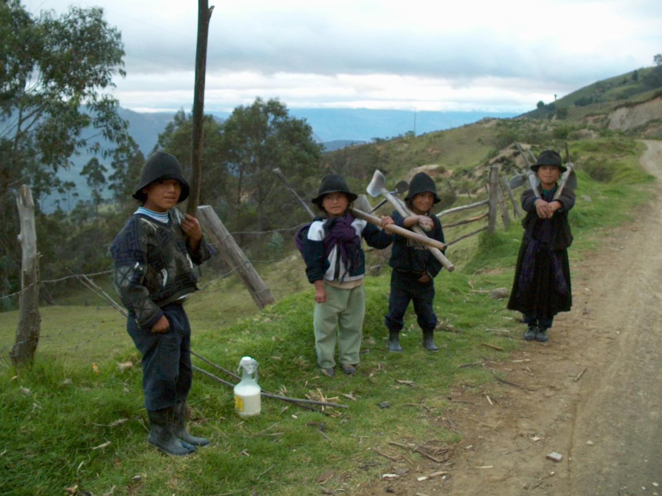
THANK YOU

