Slide 1

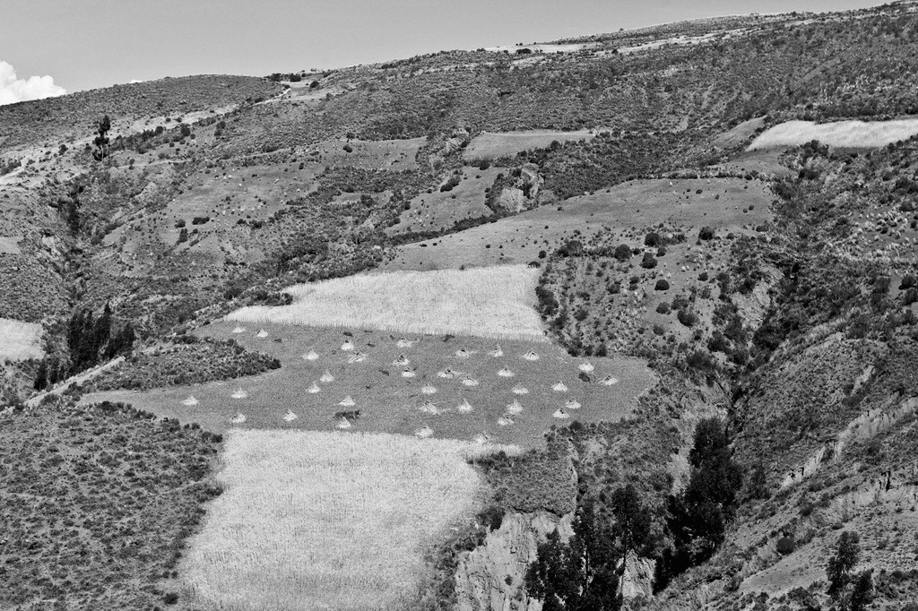
Empoderamiento Geográfico:
Plataforma SIG CdP de los Andes
CCRP
THE McKNIGHT FOUNDATION
Notes:
Grateful and honored to be here –
To enter into discussion with you about the potential of GIS to transform your Business
Presenting a collection of case studies and technologies to benefit:
Agricultural Affairs Sector
Animal Wealth Sector
Control Sector
Examples will also benefit research, development, and strategic performance sectors as well.

Slide 2
Cual es la necesidad de una plataforma SIG?
Da contexto
Agro ecológico
a observaciones
Permite compartir
Aprendizajes, estrategias, datos, resultados, productos geográficos
Mejora las practicas
agrícolas para
optimizar la producción
Permite entender donde
se ejecutan los estudios
Muestra la distribución de: riesgo Climático, cultivos, afectación de plagas y enfermedades,
seguridad alimentaria, ecosistemas
Aumenta
Conocimiento, interacción y conectividad
Permite entender porque
se observa resultados y patrones
Notes:
Esto es el ‘Por que plataforma geografica’

Slide 3
Que es una plataforma SIG ?
Gran Potencial
Analítica
Plataforma CCRP
Gob. Data
Imágenes
Open Data
Content
CONECTIVIDAD
Análisis
Servidor
Grupos
Templa
Desktop
Mobile
Notes:
Problemas de desktop:
Problemas de servidor:
… llega la nube …
Plataforma permite:
imagenes,
Contenido
Analsis
Groupos
Plantillas

Slide 4
CdP de los Andes:
Inventario de Resultados
Notes:
Discussion to break down the elements (DNA)
Which deliver business value across the industry

Slide 5
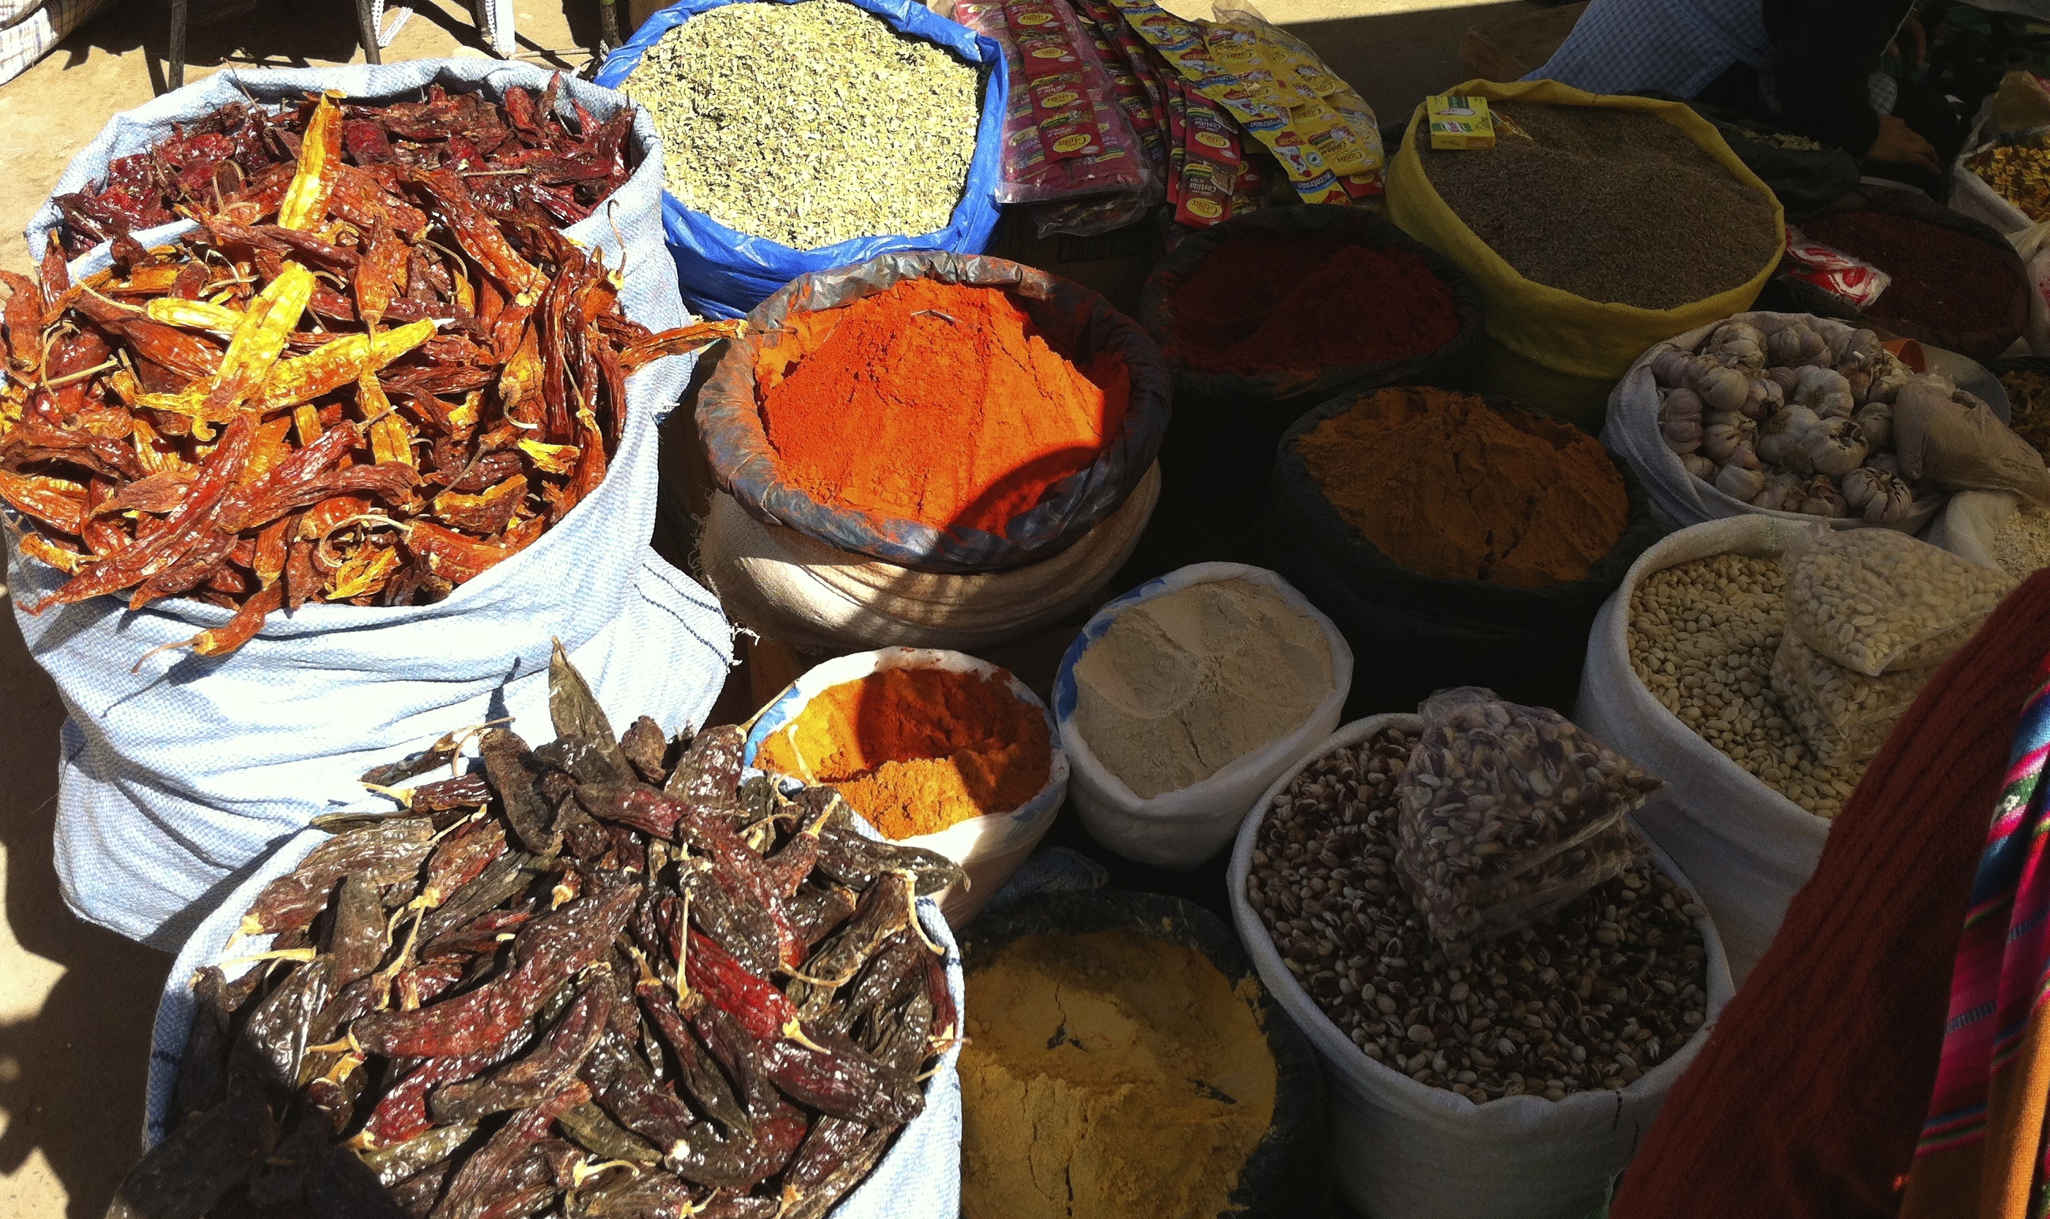
Grupos Creados
16
Notes:
Numero de projectos:

Slide 6
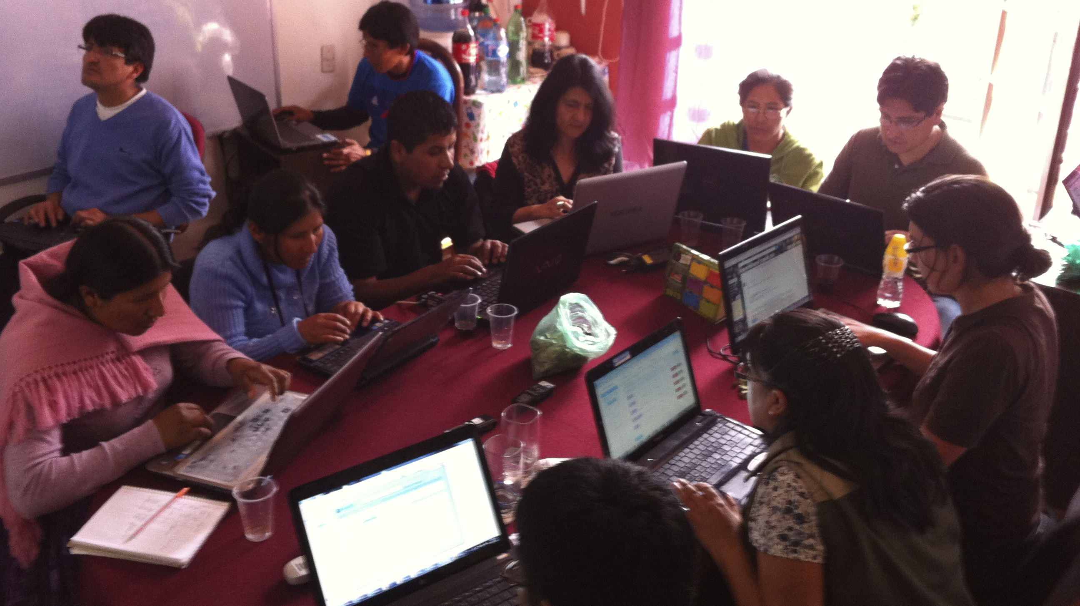
Técnicos Capacitados
119
Notes:
Tecnicos capacitados: 99

Slide 7

Productos geográficos que ustedes han creado
1017 capas
335 mapas
19 aplicaciones
Notes:
Capas subidas: 806

Slide 8
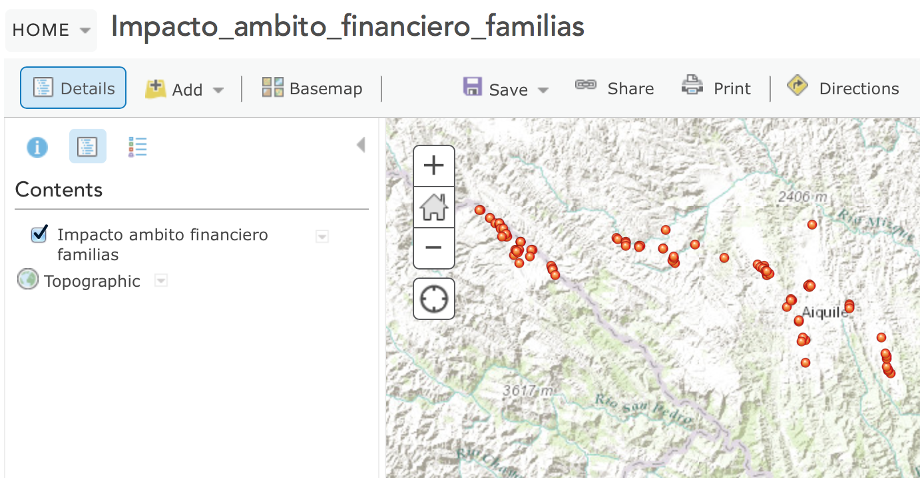
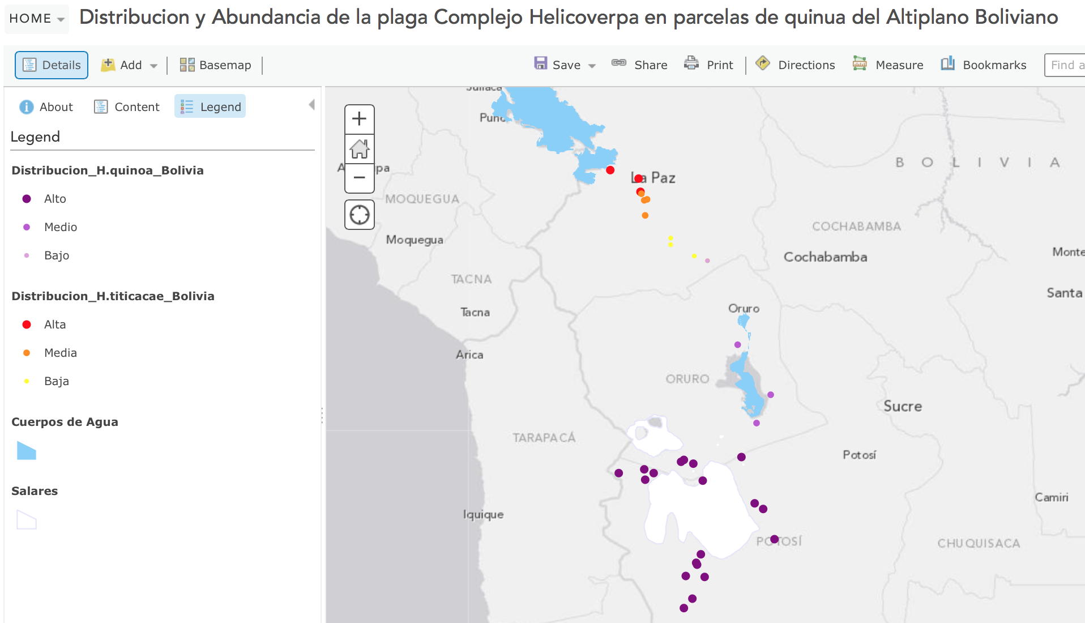
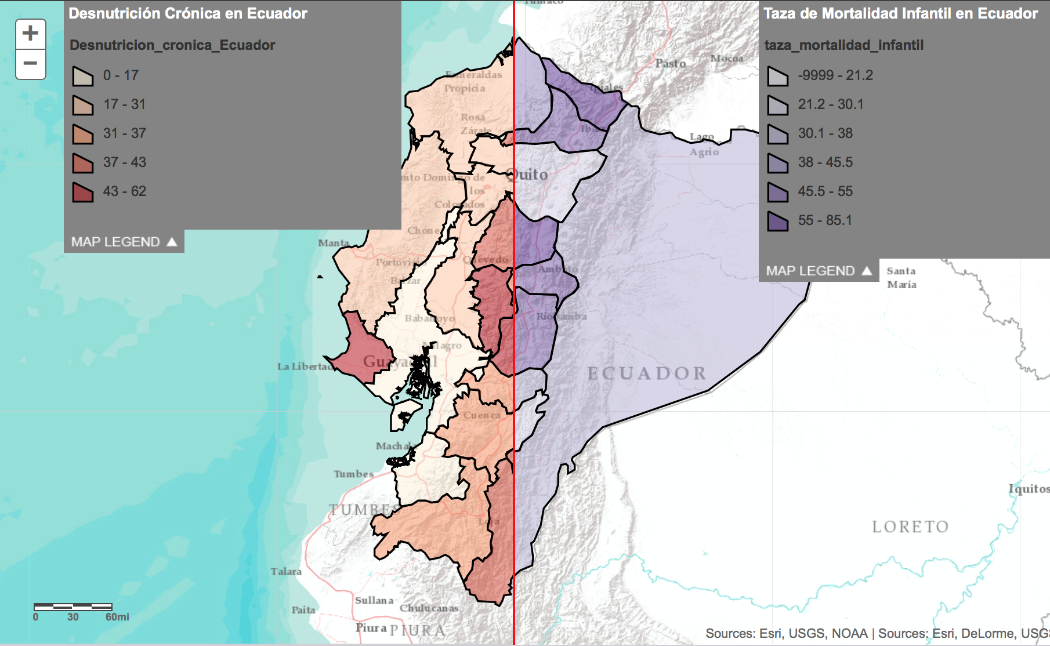
Productos de Información Subidos
capas
mapas
aplicaciones
Notes:
Capas individuas de datos
Mapas – con varias capas, simbolijia
Applicaciones – mapas con algun funcion.

Slide 9
Que se aprendió?
Buscar información geográfica a través de la plataforma
Compartir con grupos, organización y open data
Crear meta data
Manejar atributos
Simbolizar, filtrar y analizar capas
Crear puntos, líneas y polígonos
Geo-referenciar Datos; manejar coordenadas geográficas, UTM y cartografía básica
Estandarizar Tablas para mapeo
Notes:
Estandizar tablas
Subir capas
Crear puntos, polyganos
Dar attributos
Crear metadata
Compartir con grupo

Slide 10
Contenido de la plataforma geográfica CCRP
Producción
Mercado
Ecosistemas
Agricultura Orgánica, limpia
Especies Nativas
Innovaciones tecnológicas
Y Agrícolas Sostenibles
Agricultura de Conservación
Yapuchiris
Barbechos y Forrajes
Ferias y Mercados
Información de Precios Locales
Acceso a los Mercados
Canastas Comunitarias
Tiempo de Viaje
Áreas Pobladas
Seguridad Hidrológica
Clima
Suelos
Zonas Agro Ecológicas
Biodiversidad
Uso del Suelo
Elevación
Riesgos
Atlas Vivo
AGOL
Clima
Plagas y enfermedades
Amenazas de sequia
Conflictos
Desastres Naturales
Riesgos por Cambio Climático
Degeneración de Semillas
Población
Demografía
Estaciones Meteorológicas
Ayllus, Markas, Comunidades
División Política
Seguridad Alimentaria y Nutrición
Predicción del tiempo
Herramientas de Mapeo
Imágenes de Alta Resolución
Imágenes Híper espectrales
Aplicaciones
Open Data
Conectividad

Slide 11
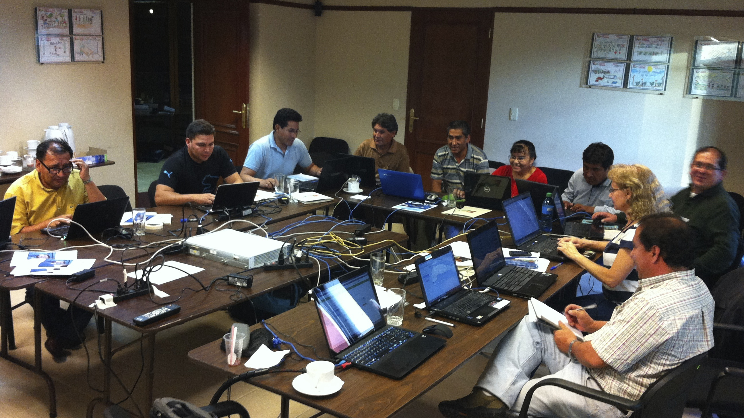
Fundación Valles Normalizando Tablas
Notes:
Estandizar tablas
Subir capas
Crear puntos, polyganos
Dar attributos
Crear metadata
Compartir con grupo

Slide 12
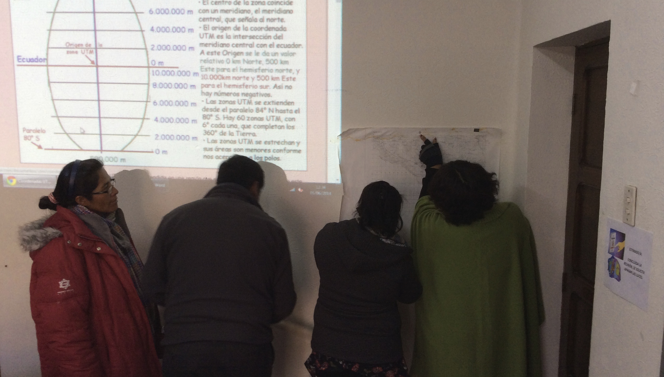
PROSUCO Trabajando Coordenadas Geográficas y UTM
Notes:
Estandizar tablas
Subir capas
Crear puntos, polyganos
Dar attributos
Crear metadata
Compartir con grupo

Slide 13
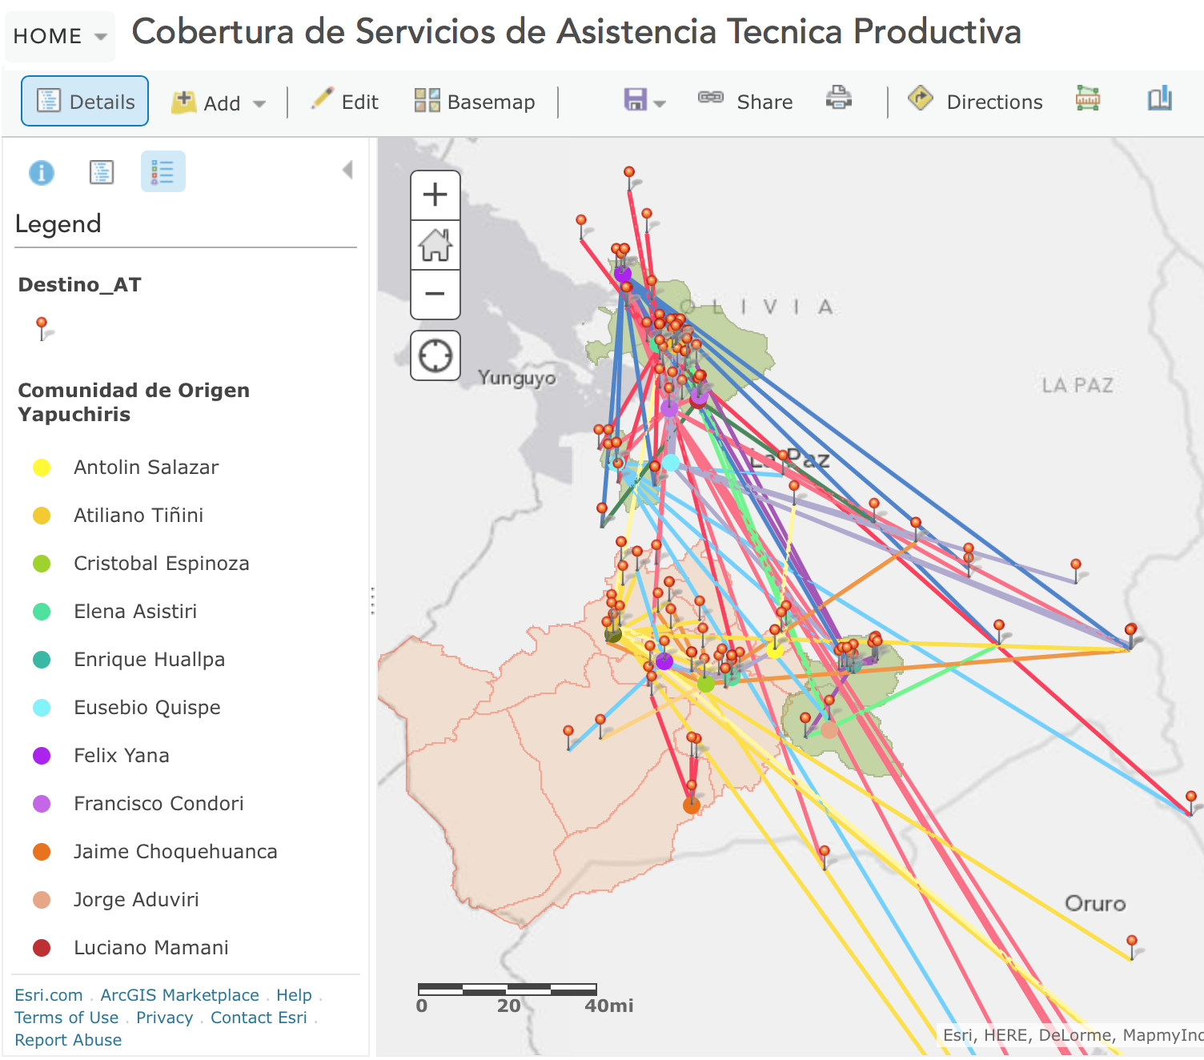
“Ya subí mi mapita. Y ahora Que?”
Que el mapa … Cause … Acción
Al entender patrones de distribución de servicios, se pueda optimizar a travez de dimensiones geográficas:
Donde?
A que distancia?
Cuan factible es?
Notes:
Esto es el ‘Por que plataforma geografica’ ..
Mapas llevan a mejor entedimiento …
Pero el punto de este ejercisio es que atravez de los mapas de llega a hacer decisiones mas informadas, gracias al considerar dimensiones geográficas:
Donde esta?
Cerca de que?
A que distancia?
Cual es el distribición de servicios óptimos?
Cuales son las areas mas factibles?

Slide 14

Para recorrer …

Slide 15

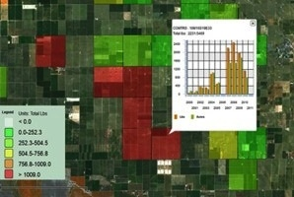
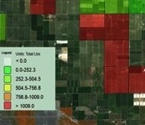
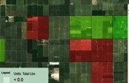
‘’’
Nuevos conceptos en SIG
Aplicación
producción
Mapa
Web map
Variables
Crear
Productos de
Información
Capas
Datos
Observaciones
Mediciones
Cultivos
Que inspiran Acción
De Ahí sale el valor
Notes:
(framework of the future)
Innovations in GIS have led to increased business value –
Layers –
Maps – Aggregate layers, give context and extent
Apps – Provide functionality, serve a purpose, become ‘Information Products’, create value
To Whom?
Roles within an organization
Business value comes from:
Equipping the right person with the right information product
Therefore – the principle limitation lies not with the technology, but with our creativity in aggregating layers into maps, into functional applications to deliver knowledge to individuals who fulfill Roles.
These items (layers, maps, and apps) are the delivery mechanisms of a successful GIS to an organization (enterprise)
__________
El punto de las capas, mapas, y applicacion es crear productos de informacion que inspiran accion!
Mejores decisiones

Slide 16
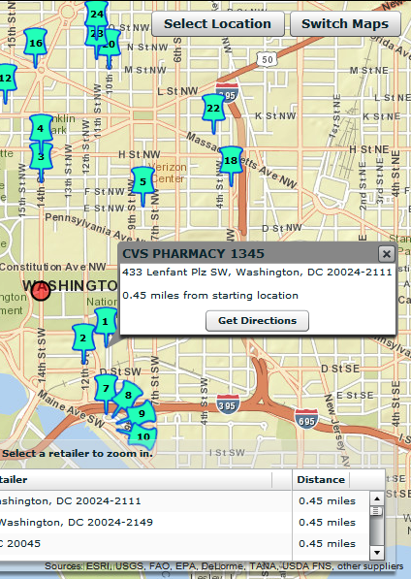
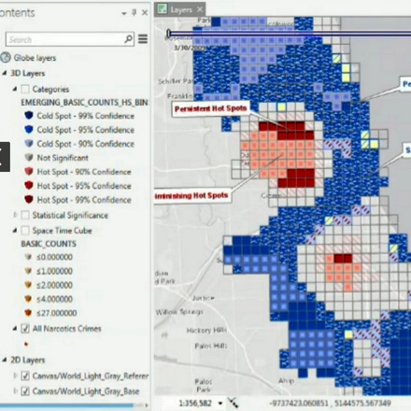
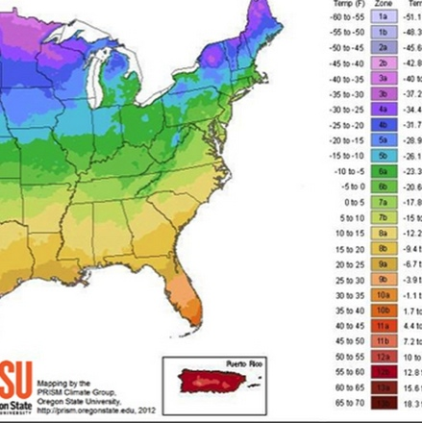
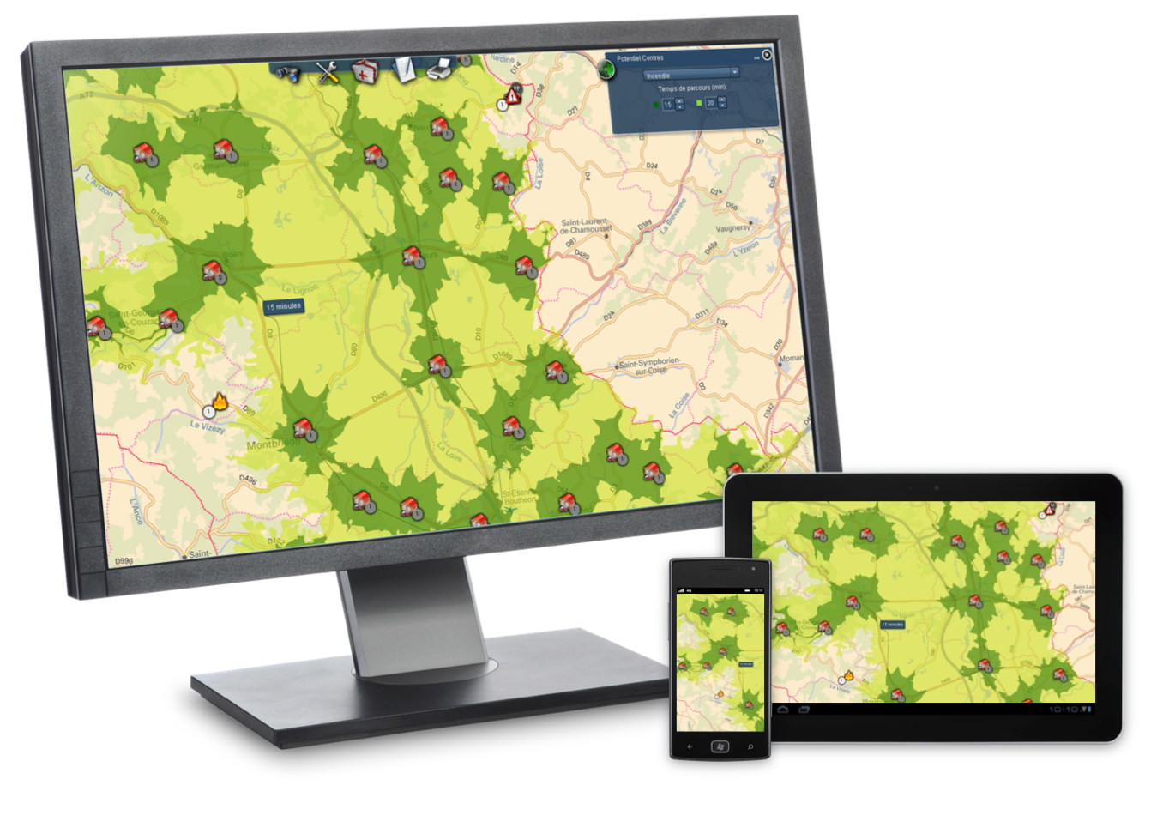
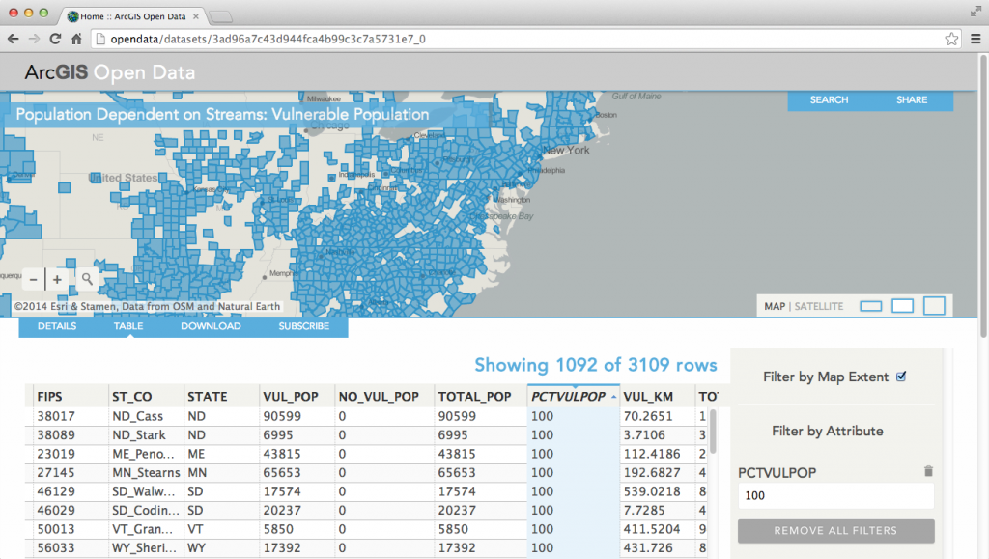
Agregar, Analizar, Contextualizar, y Aplicar
Agregar capas entre grupos
Compartir capas a grupos temáticos
Agregar datos entre todos los proyectos
Análisis
Análisis estadístico
‘Hotspots’
Pestes emergentes
Tipo de suelo vs producción
Contenido para dar contexto
Suelos
Zonas agro ecológicas
Datos climáticos
Nutrición
Plagas
Acceso al agua
Saberes ancestrales
Permite análisis
Aplicaciones
Combinan capas hacia alguna funcionalidad
  ‘Repórtame’
  ‘Encuéntrame’
  ‘Sugiérame’
CCRP Open Data Portal
Datos abiertos
Se descubre a travez de otros grupos
Notes:
USDA Applications – Mostly to connect customers to services…
Very little externally facing applications ---
Few externally – facing services --
Food, Services, ERS, Supply Chain, Food Control

Slide 17
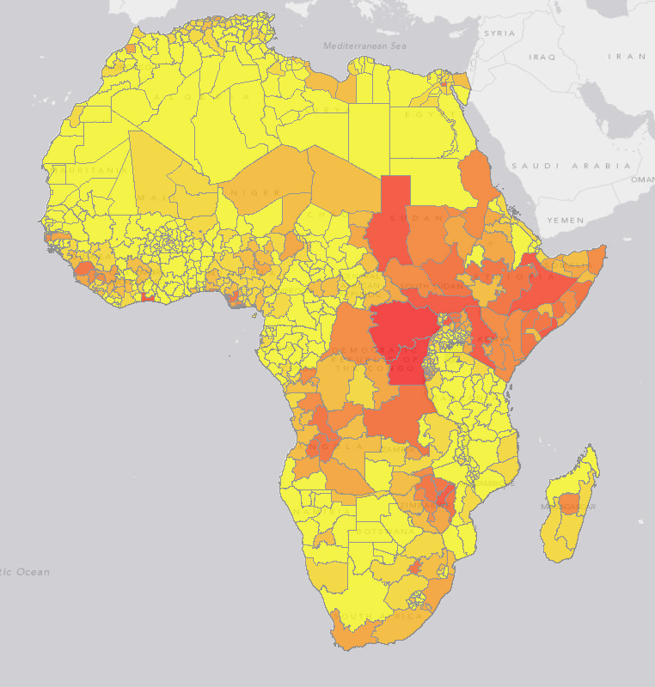
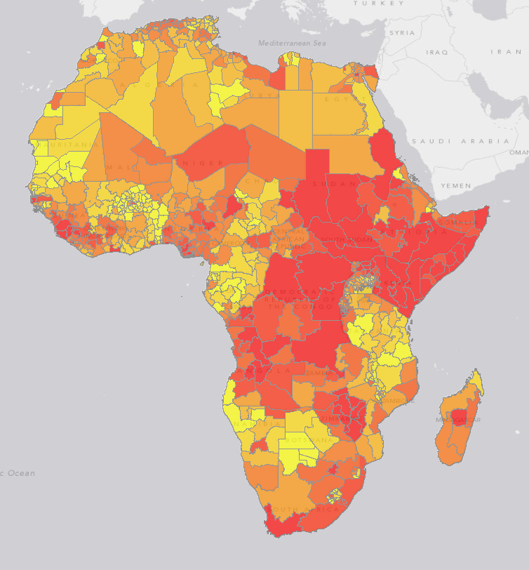
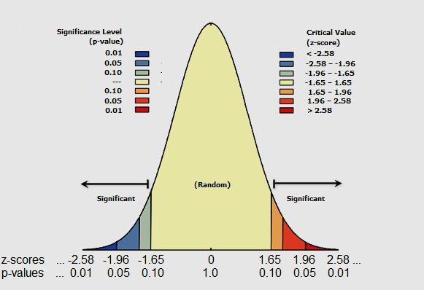
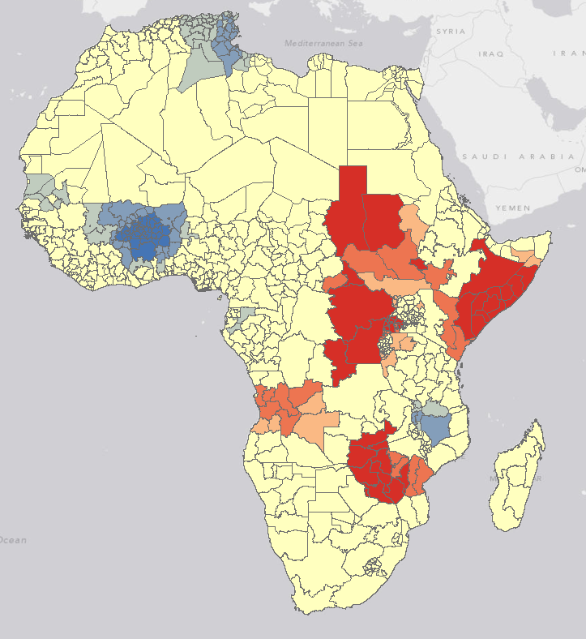
Análisis : Estadísticas espaciales
Donde están los puntos calientes?
Donde están las variaciones?
La subjetividad del análisis del patrón visual
Notes:
Running a hotspot analysis – simple way to explore if the features’ spatial variation is statistically significant.
The spatial pattern analysis tools show us how likely it is the our pattern reflects a random pattern using p-values and z-scores. Those p-values and z-scores are what’s used to determine what’s red in our map, and what’s blue.
So, those areas that are RED and BLUE, that are statistically significant, are areas where there is a very small chance that the clustering we’re seeing reflects a random spatial pattern.
Inferential statistics use probability theory to tell you how likely it is that the pattern you are looking at is the result of random processes. These tools return both a p-value and a z-score.
People usually find it easier to understand p-values… p-values are just probabilities. When the p-value is very small (near zero), we say the probability that we are looking at a random pattern is also really small <in other words, it is not very likely that the distribution of features or values on this map is the result of random processes>.
But z-scores aren’t really difficult to understand either … they are just standard deviations! Both p-values and z-scores can be mapped against a normal distribution. Notice that p-values get small in both tails of the distribution… at the mean, in the center of the distribution, the p-value is 1… that’s as large as it can ever get. Z-scores are exactly the opposite… at the mean, near the center, z-scores are always 0. They get bigger and positive to the right of the mean and they get smaller and negative to the left of the mean. A small p-value tells us we can reject the null hypothesis… the pattern is not random… the z-score tells us WHY we can reject the null hypothesis: if the z-score is positive we reject the null hypothesis because the pattern is more clustered than we would expect if the processes creating the pattern were truly random… if the z-score is negative, we reject the null hypothesis because the pattern is more dispersed than we would expect from random processes.
So we are no longer guessing about whether the pattern is clustered or not… if the p-value is small and statistically significant, we reject the null hypothesis… if the z-score is positive, we say… yep, it’s clustered.

Slide 18

Acción
Servicio vivo de imágenes
Servicios web vivos
Contenido revisado
Contenido acreditado
Contenido descubrible
Acceso abierto
Análisis web
Aplicaciones abiertas
Integra
calibra
analiza
comparte
Notes:
Call to Action - contribute to landscape
Challenge that will transform ADFCA – and transform

Slide 19













Comunidad internacional en Agricultura
Mas de un millón de usuarios
1500 organizaciones participantes
350,000 organizaciones usuarias

Slide 20

Gracias
Pablo Cabrera
Consultor SIG
pablocabreragis@gmail.com
Notes:
Discussion to break down the elements (DNA)
Which deliver business value across the industry
ADFCA is unique and there is no other organization that takes on so much –
So very difficult to find subject matter expert that covers all –
Agriculure – Food – Livestock.
GIS will transform the business -

Slide 21
Demo
Notes:
ArcGIS Online → Map Ph, Run Hotspot Analysis, Make an App to compare, Annotate, Update.
Visualizing yield through time
http://psstldemo3.esri.com/apps/yieldthroughtime/

Slide 22
Casos de Estudio

Slide 23
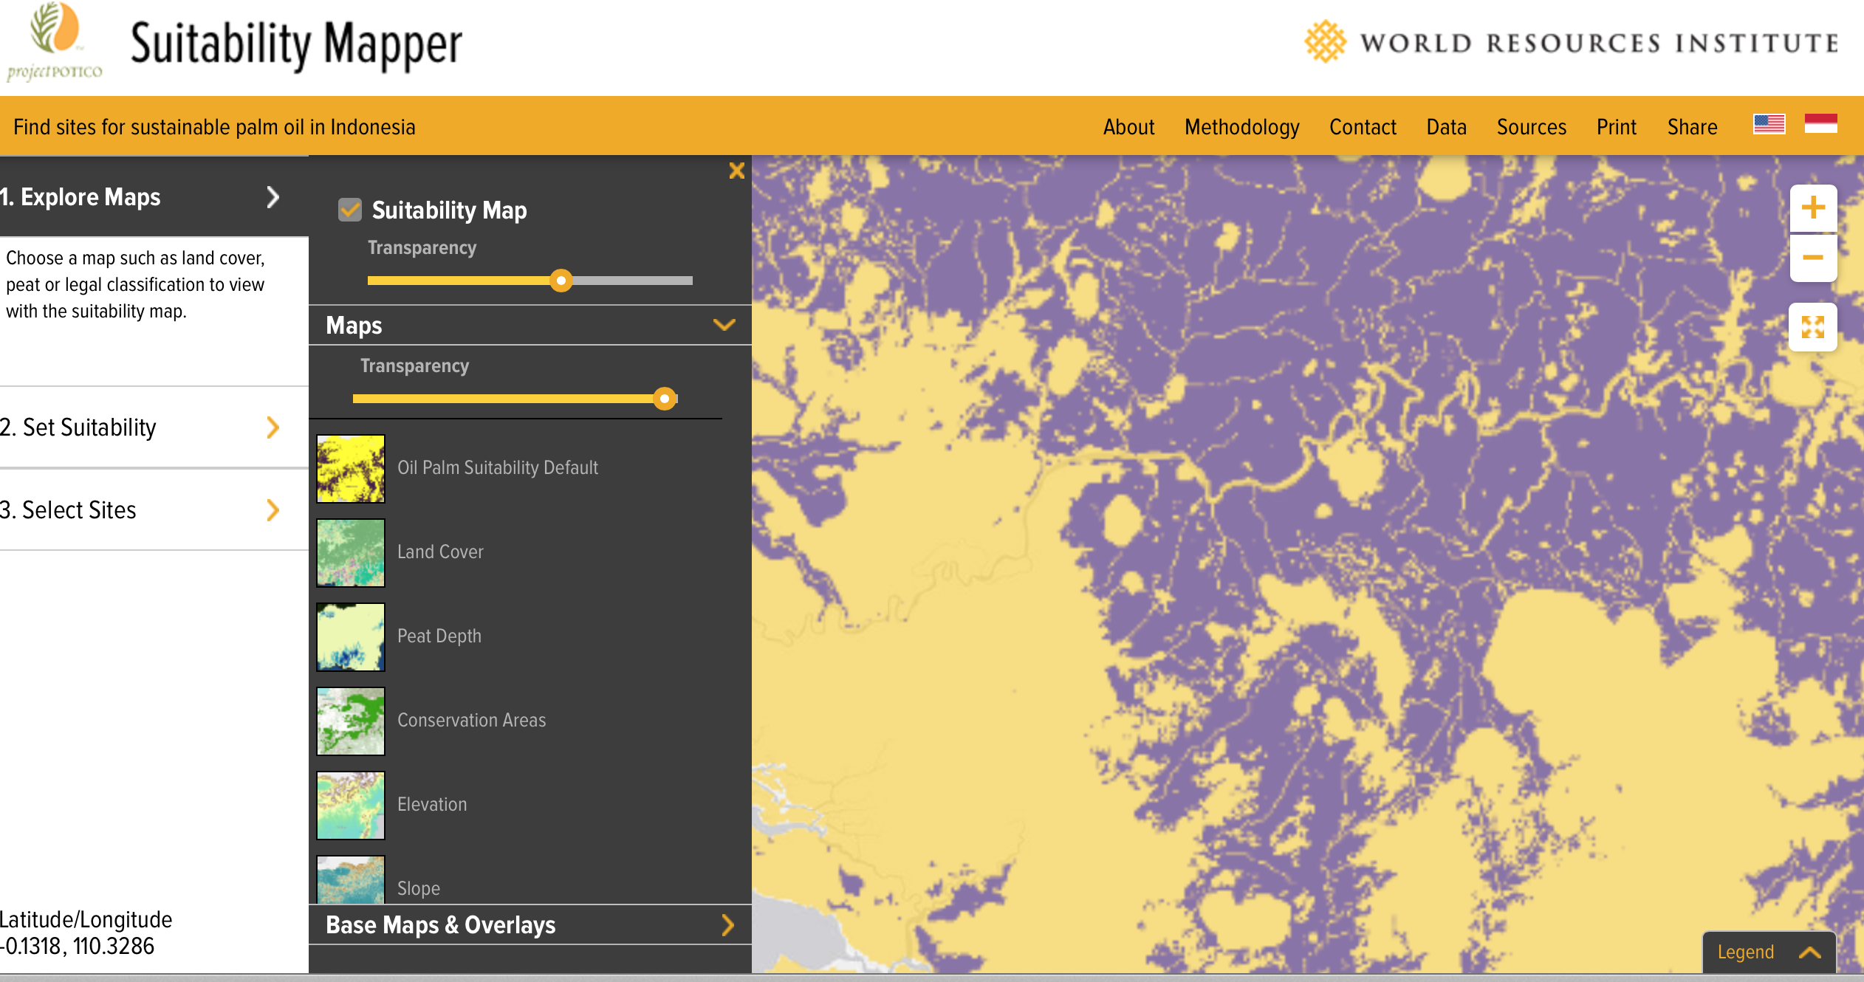
Suitability Analysis: Raster Chain Functions
Notes:
Raster chain function – weighted overlay to explore suitability
http://www.wri.org/applications/maps/suitability-mapper/index.html
Ocean Modeler
http://geoss.esri.com/oceanmodeler/#
Landscape Modeler
http://landscapemodeler.arcgis.com/#
Think of the application for global Supply Chain…

Slide 24
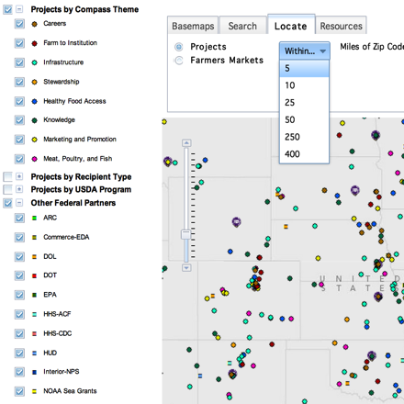

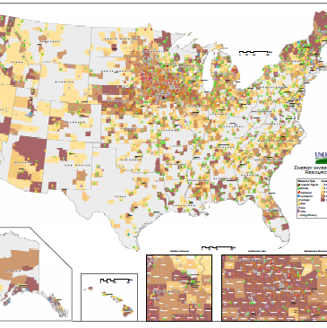
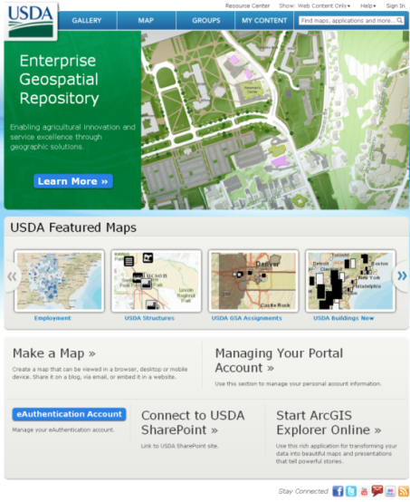
USDA GIS Applications
SNAP Retail Locator
Connects customers to places providing food assistence
Know Your Farmer Know Your Food Compass
Maps projects and programs provided by all USDA departments
Infrastructure
  Meat processor facilities
  Food hubs
  Farmer’s markets
Supports the farm to market value chain
Plant Hardiness Zone Map
Does one thing, and one thing well
Provides suitable domains for certain activities
[Could be any domain – market sheds, vetrenary service providers]
USDA Common Land Unit (CLU) Database
Authoritative source of parcel, cadastral land management
USDA GEO Portal
Data discovery and sharing
Notes:
USDA Applications – Mostly to connect customers to services…
Very little externally facing applications ---
Few externally – facing services --
Food, Services, ERS, Supply Chain, Food Control

Slide 25
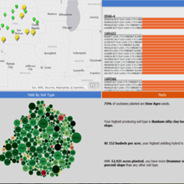
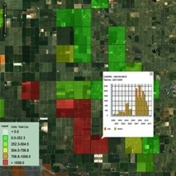
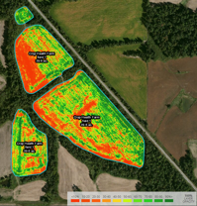
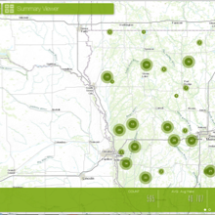
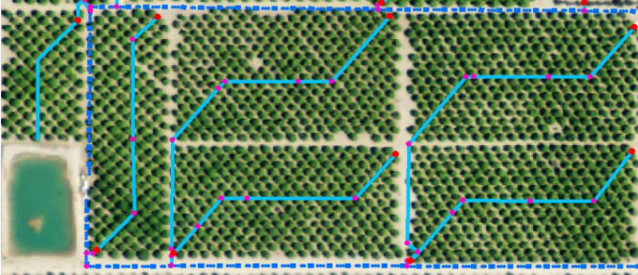
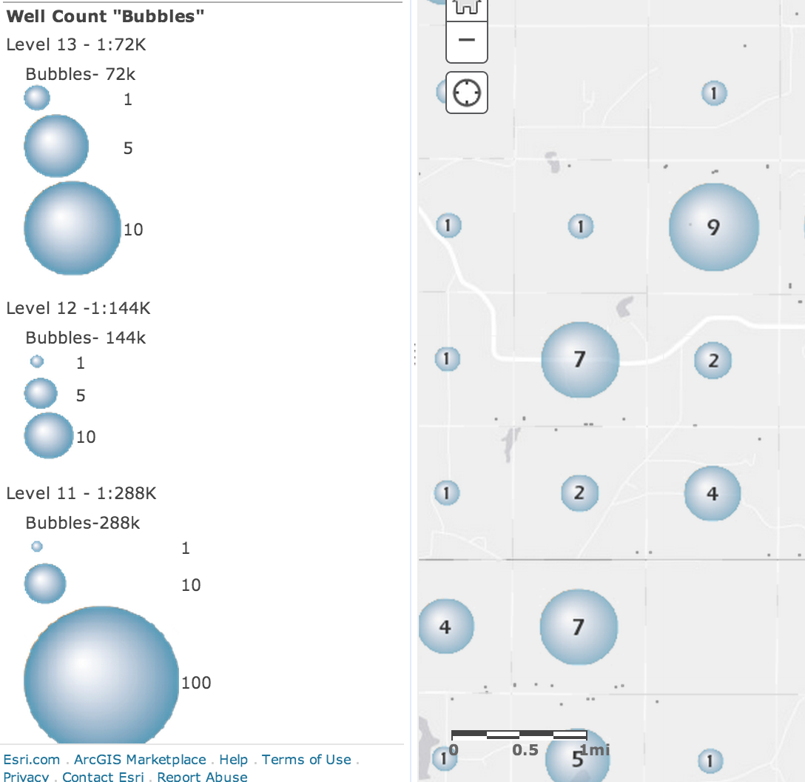
Information Products for ADFCA to realize its Primary Mandates
Agriculture
Production
Dashboard
Pest
Monitor
Crop health
Asset
Tracker
Irrigation Optimizer
Service
Provider
Locator
Emerging Disease
Monitor
Livestock
Irrigation Optimizer
Food Control
Notes:
Productive and mature GIS –
Provide External stakeholders – geoenabled e – services
Integrated to main business processes – and providing e-services to end customers:
Livestock producers
Agriculture producers
Food establishments
When information products are leveraged across / between roles in an organization for DECISION – MAKING, Design, Changing behavior -
Information Products Let People Track Metrics:
Tons per acre
Pests per field
Inputs per acre
Soil nutrients
Location of assets
Performance
Safety
Number of labor hours
Location of people
Acres in production
Look at what ADFCA already has:
These products and more will be hydrated by existing streams of information:
Wells Data
Support Data
Control Data
R&D Data
S&A Data
Facilities
ADFCA is well positioned to ‘turn on’ a dial-tone of streaming information to hydrate info products:
Information Products facilitate the flow of data from measurements, to knowledge / understanding
But … it doesn’t stop there. Business value doesn’t come from understanding alone, it comes from informing ACTION which results in changes in BEHAVIOR.
For Example… Assigning Permits to dig wells
Environmental Department – issues permits to dig wells.
Unless, there is water deficiency…
Factors leading to water deficiency …
Geology
Salinity
Depth to water table
Lack of Rain
[Landscape Analyst Demo]
Knowing before hand the suitable sites for new wells, saves times and money.
Changes behavior by discouraging the public to call and apply for permits they won’t get
Saves both public and government officials time and money.

