Slide 1
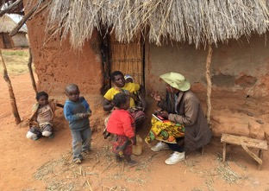
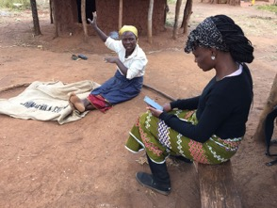
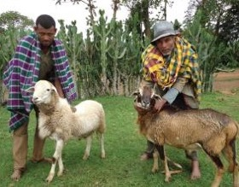



A RHoMIS update: activities of the last year
Mark van Wijk, James Hammond, Mark Caulfield
McKnight annual meeting
10th of July 2020

Slide 2
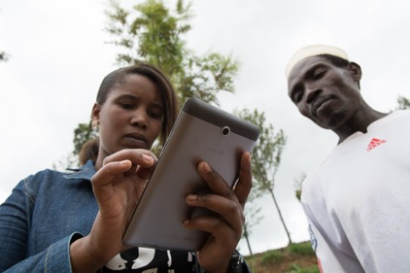
What is RHoMIS?
Rural Household Multi-Indicator Survey
  A system for designing farm household surveys and compiling the data
  To reduce burden of survey design and reporting in Ag4Dev
  To produce standardised and harmonised data
  Flexible whilst standardised: can be tailored to local context and research needs
  RHoMIS Consists of:
    questionnaire modules
    data processing and analysis code
    digital infrastructure
Hammond et al Ag Sys 2017

Slide 3

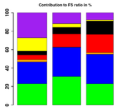
How does it work?
Survey design phase
Modules & translation
Partitioned and Global databases
Written in R
Database
Website
Library of analysis code
Survey template
Completed surveys
Reporting of results
ODK software
Interview farmer

Slide 4
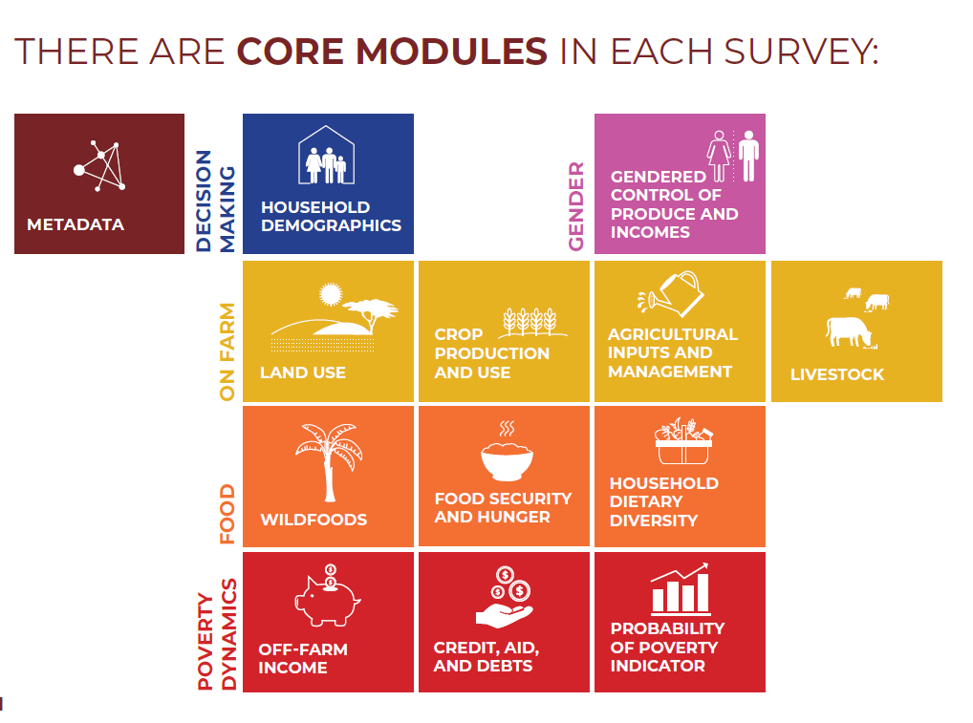
Survey Content: Core Modules

Slide 5
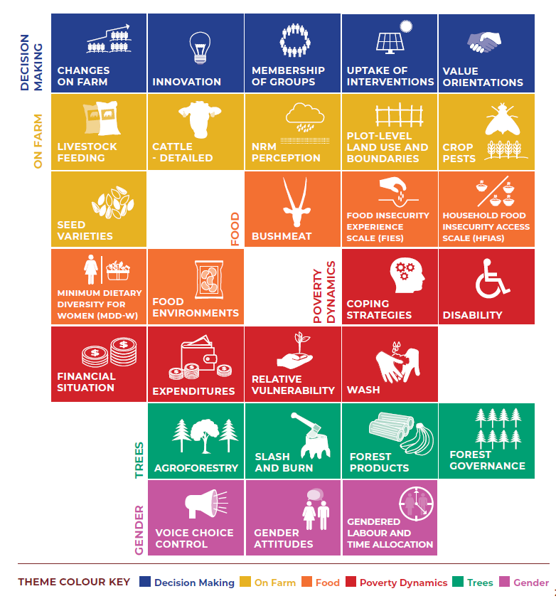
Survey Content: Optional Modules
+ Bespoke user-defined questions and indicators

Slide 6
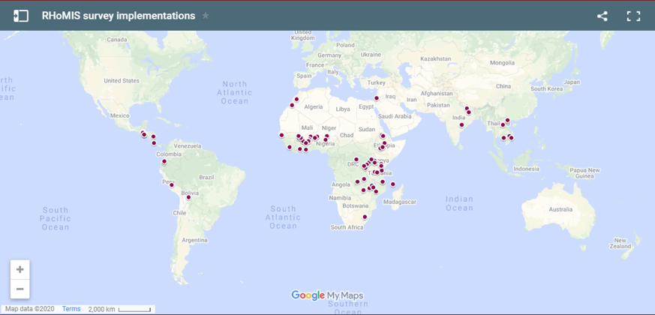
Uptake since 2015 and the RHoMIS Database
www.rhomis.org
More than 32,000 interviews in 33 countries
Used by Research Organisations, Major Donors, and NGOs

Slide 7
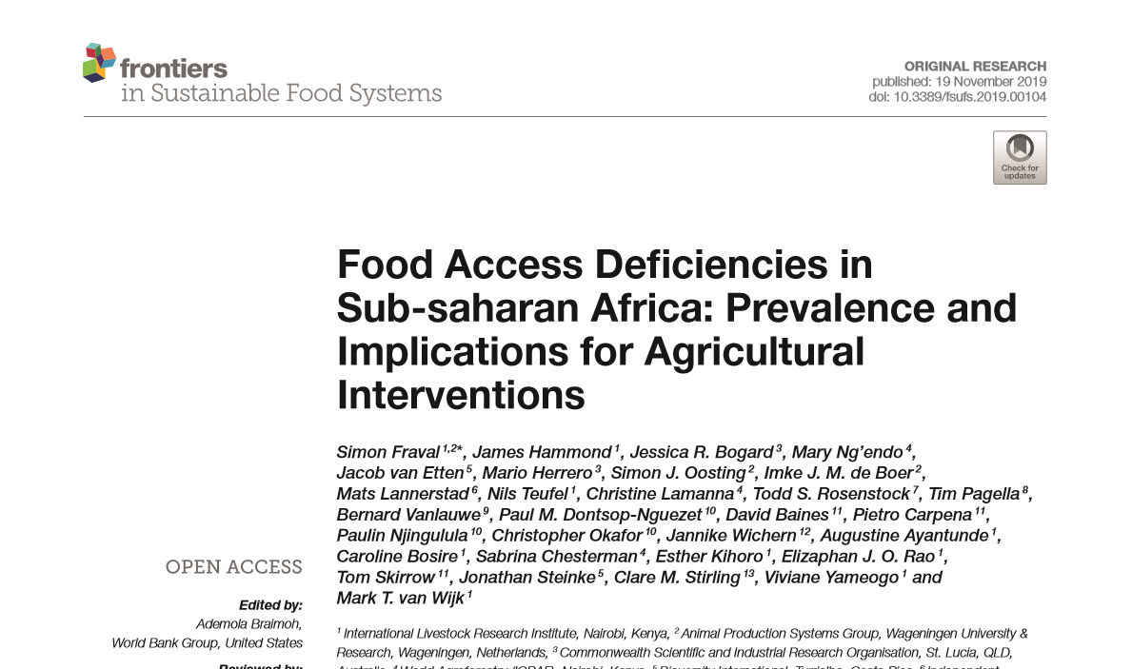
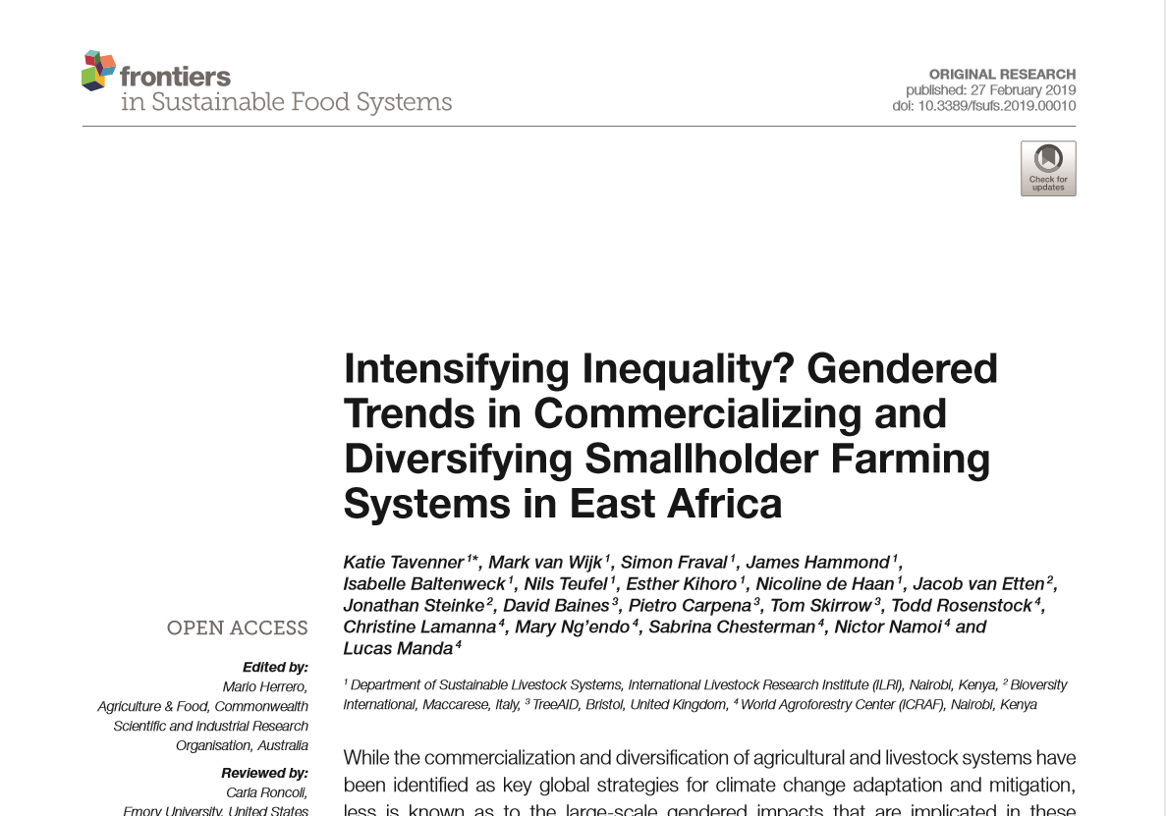
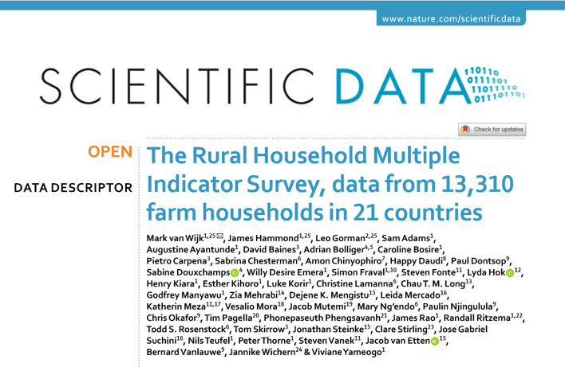
Key overall outputs, besides a series of more locally focused studies:

Slide 8
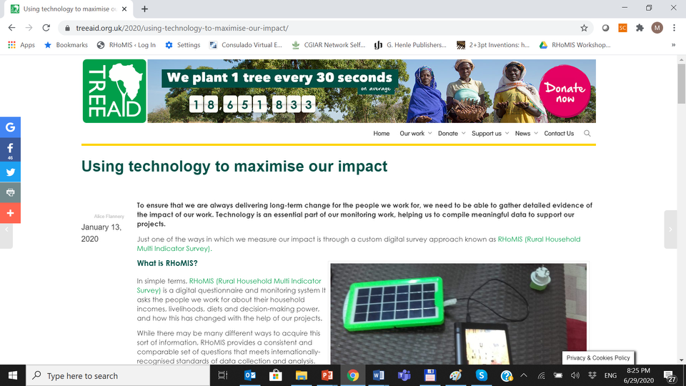
Trabajando juntos con ONGs

Slide 9
Biggest change in 2020: from RHoMIS to a RHoMIS family of tools
Rural Household Multi-Indicator Survey
  mini-RHoMIS: much shorted than the normal RHoMIS, but data fit seamlessly in the same system
  RHoMIS-COVID module: currently applied in 8 different countries
  RHoMIS-SIAF: integral multi-indicator evaluation
  RHoMIS-DIY: hace tu mismo!
  With S4D (Statistics for Development) and the University of Bristol we have explored options for a Graphical User Interface (GUI) for building RHoMIS surveys and linking to the database and data processing procedures.

Slide 10
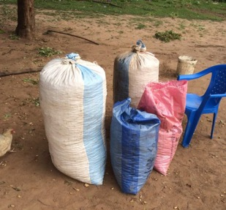
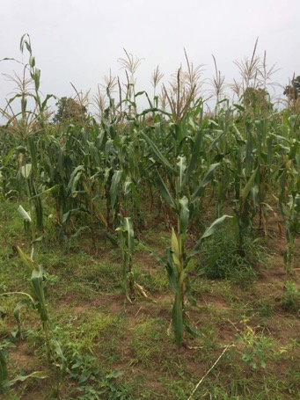
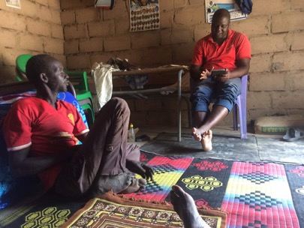
Making Use of the Data:
A few highlights

Slide 11
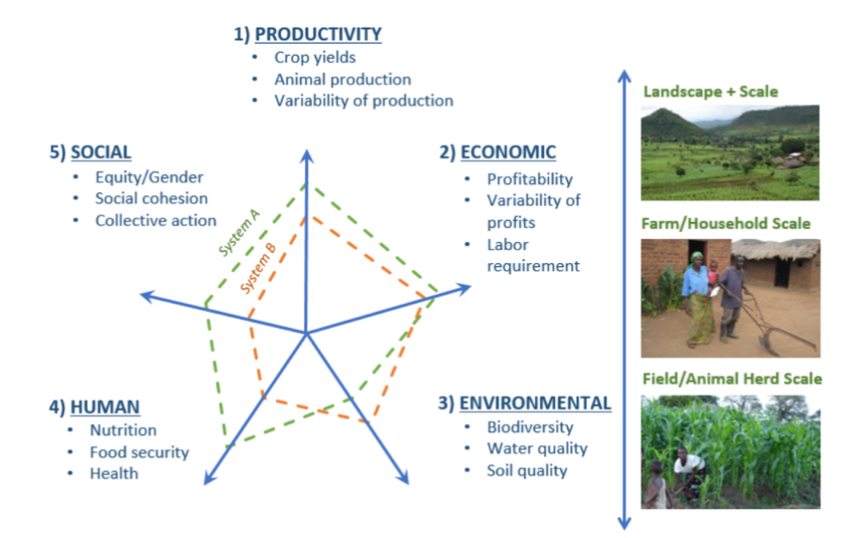
RHoMIS – SIAF link

Slide 12
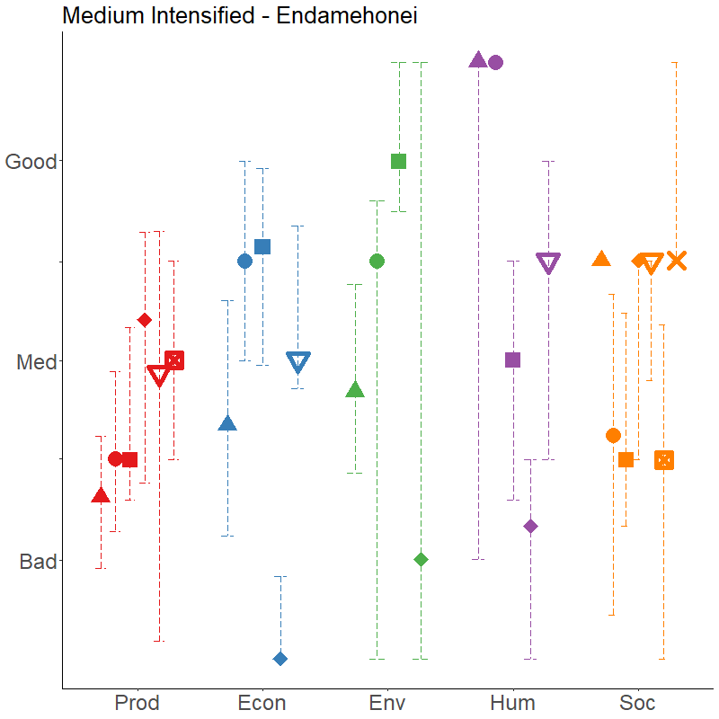
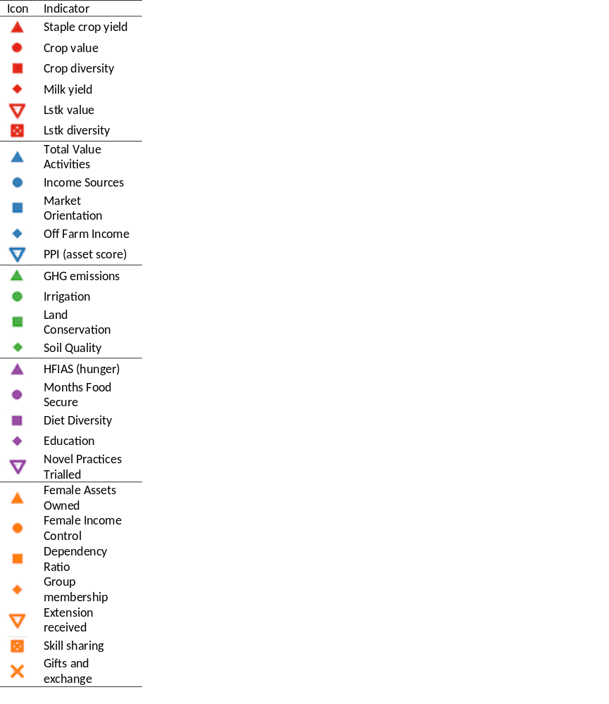
Indicators of Sustainable Intensification
27 indicators quantified across 5 sustainability domains from 880 household interviews
Indicators re-scaled according to locally defined thresholds
Medians and IQRs plotted, allowing for disaggregated analysis (see figure)
Indicators can be aggregated across domains
Households can be aggregated, for example along a spectrum of agricultural intensification (production per unit of land and per unit of livestock)
Agricultural Production
Economics
Environment
Human Welfare
Social and Society

Slide 13
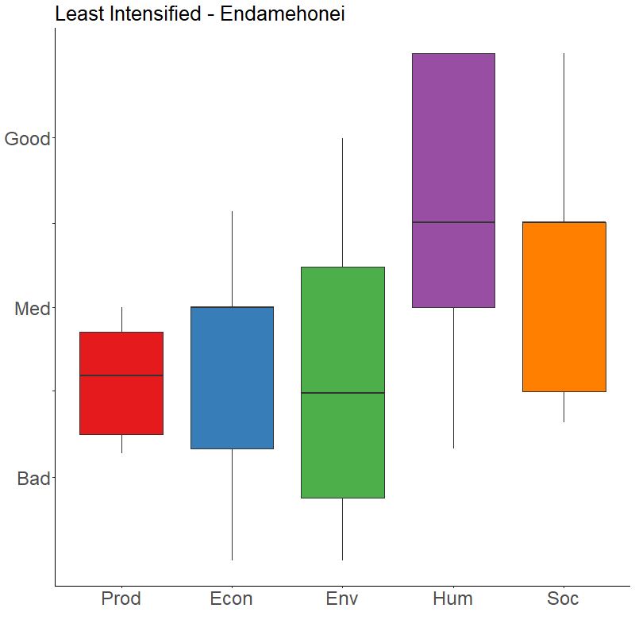
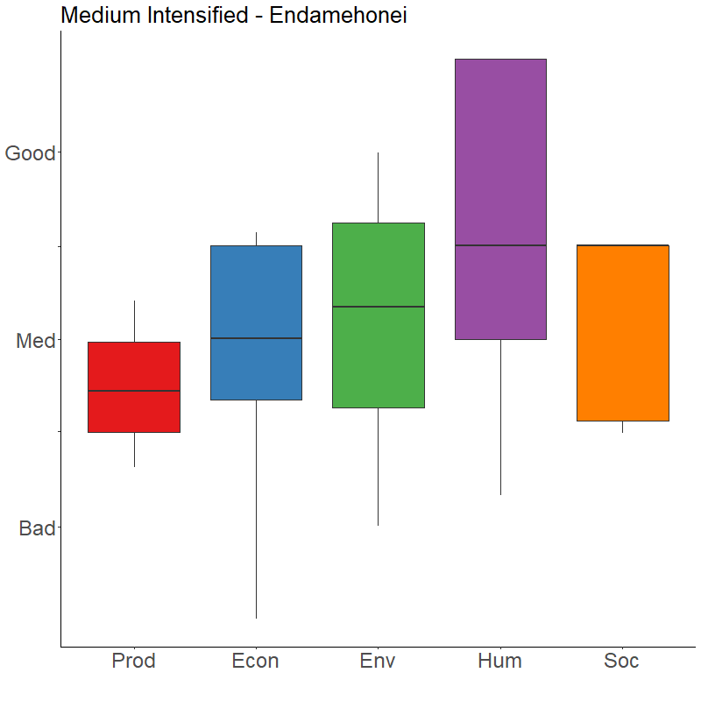
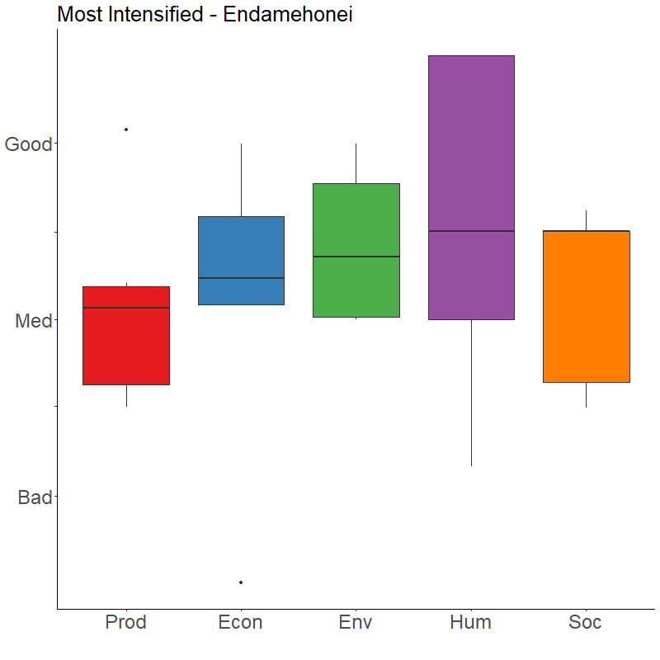
Indicators along an Intensification Gradient
Mean number of introduced technologies still in use:
2.3 2.5 3.0
Most popular technologies (and % of households using them):
Improved crop varieties (58%)
Fodder trees (55%)
Cultivated Forage (35%)
Improved crop varieties (70%)
Fodder trees (68%)
Cultivated Forage (52%)
Improved crop varieties (75%)
Fodder trees (59%)
Cultivated Forage (46%)

Slide 14
Aplicaciones en McKnight CCRP - Andes
1. Peru (lead: Steve Vanek/Fonte)
2. Ecuador (lead: Israel Navarrette)
3. Bolivia (lead Miguel Florido/Walter Fuentes).
4. Ecuador (lead Aida Imbaquingo)

Slide 15
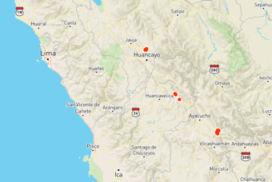
Aplicaciones en McKnight CCRP - Andes
1. Peru (lead: Steve Vanek & Steve Fonte)
171 hogares

Slide 16
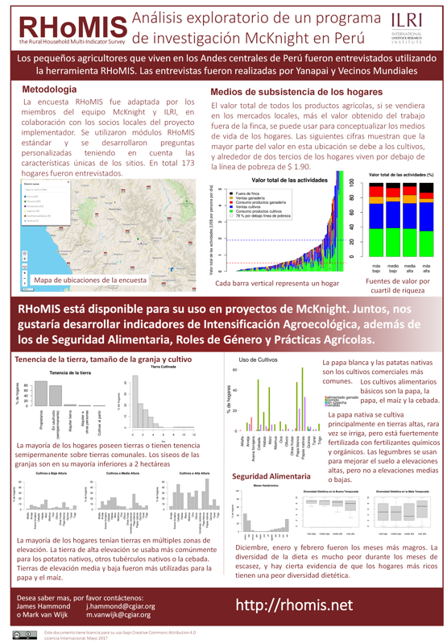

Slide 17
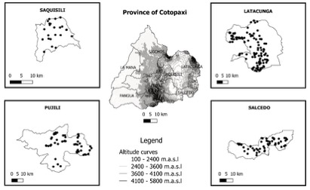
Aplicaciones en McKnight CCRP - Andes
2. Ecuador (lead: Israel Navarrette)
266 hogares

Slide 18
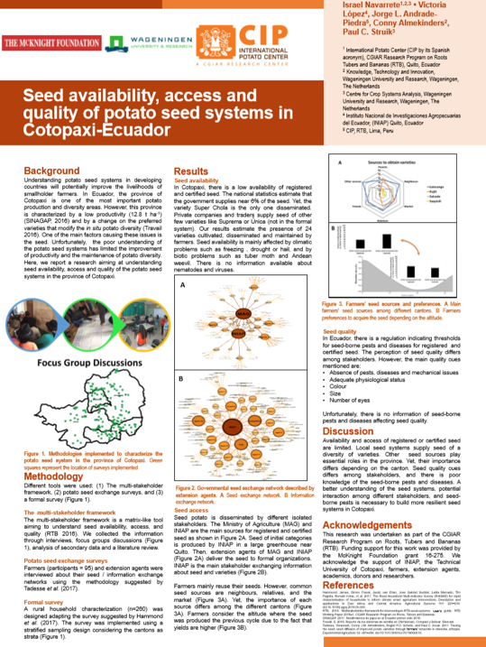

Slide 19
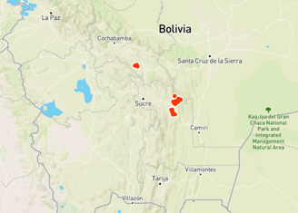
Aplicaciones en McKnight CCRP - Andes
3. Bolivia (lead Miguel Florido/Walter Fuentes).
134 hogares

Slide 20
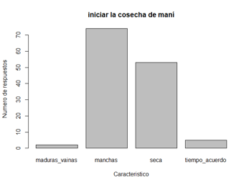
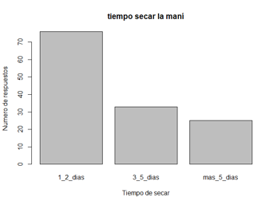
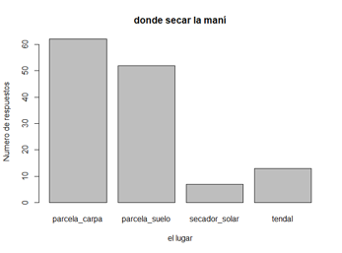
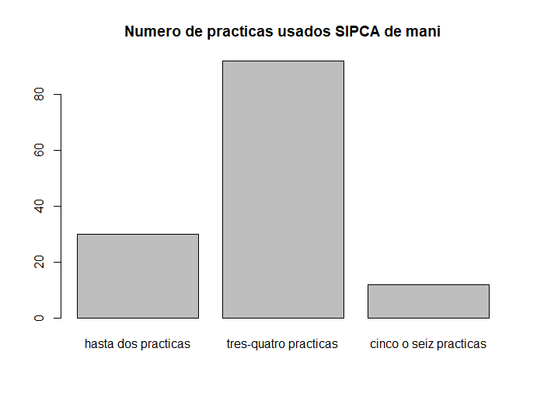
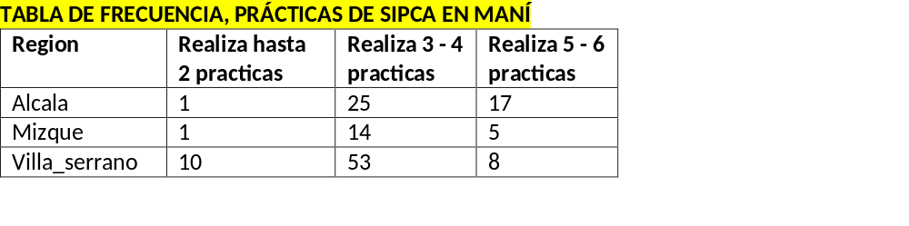
Aplicaciones en McKnight CCRP – Andes
Aflatoxines en mani

Slide 21
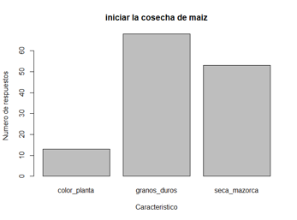
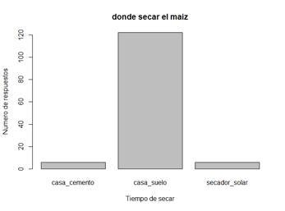
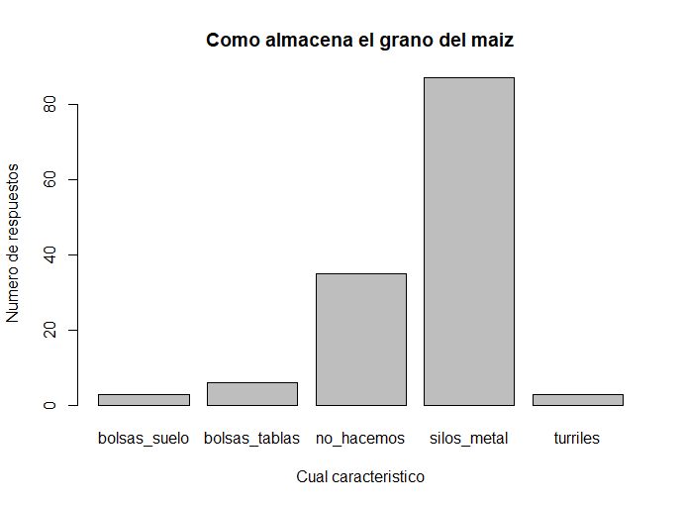
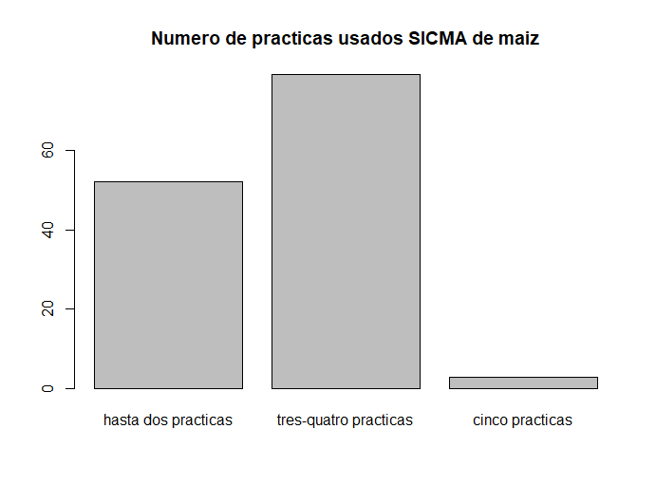
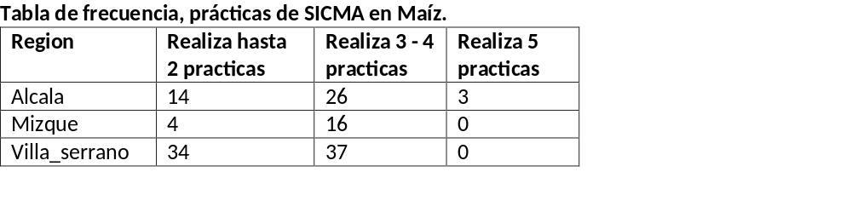
Aplicaciones en McKnight CCRP – Andes
Mycotoxinas en maiz

Slide 22
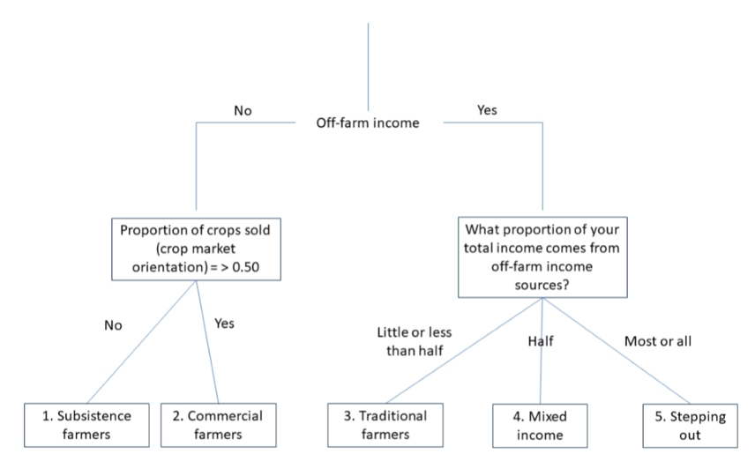
Rural household characteristics and livelihood strategies interact to influence farm intensification patterns in the rural Andes
Mark Caulfield, James Hammond, Steven Fonte, Miguel Angel Florido, Walter Fuentes, Katherin Paola Meza Retamozo, Israel Navarette, Steven Vanek, Mark van Wijk

Slide 23
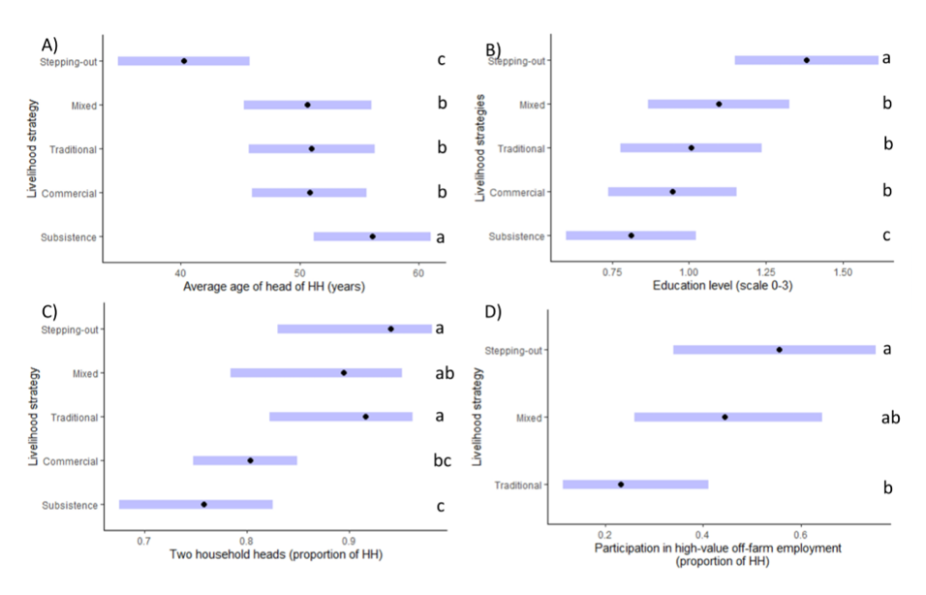

Slide 24
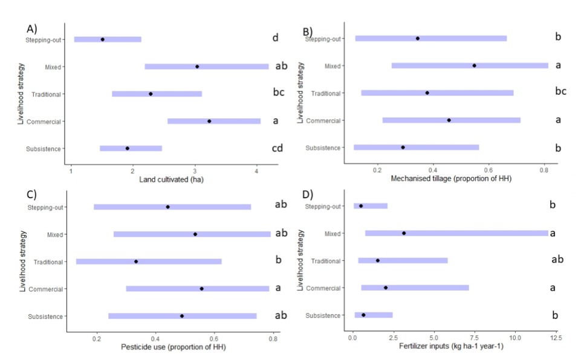

Slide 25
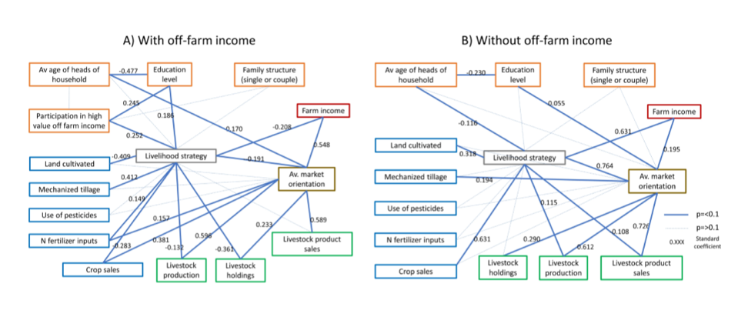

Slide 26
Phase II?
Objective 1. Embed the RHoMIS-SIAF work into the indicator thinking for AEI, and evaluate similarities and differences with FAO’s TAPE approach.
Objective 2. Apply the updated RHoMIS-SIAF work, to be called RHoMIS-AEIA (AEI Assessment), to the RHoMIS data collected over the last 2 years in Bolivia, Peru and Ecuador.
Objective 3. Evaluate AEI interventions promoted in the different projects in Bolivia, Peru and Ecuador that have used the RHoMIS approach.
Objective 4. Special focus of the evaluation described in Objective 3 will be on pathways towards food security and diverse diets, and how AEI can contribute to improving the diets of the rural poor in Andean production systems.
Objective 5. Using the results of the previous objectives we will critically evaluate the framework developed, and contrast it with other multiple-indicator assessment frameworks available, and specifically FAO’s TAPE approach.

