Slide 1

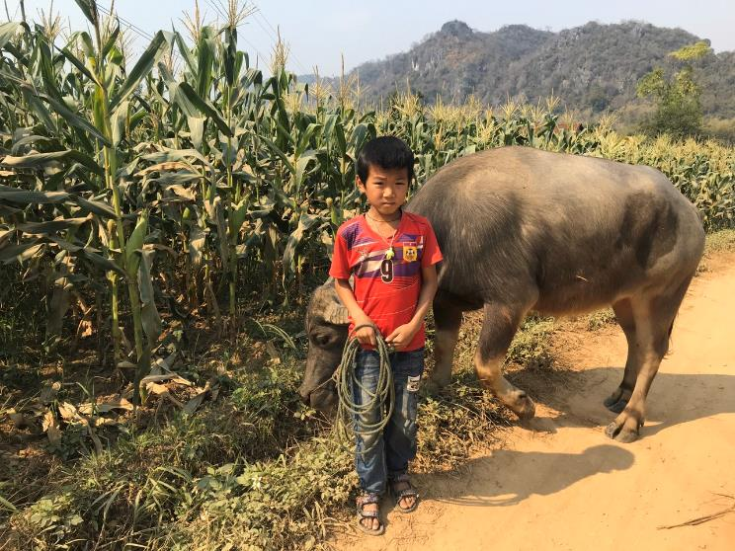
The Rural Household Multi Indicator Survey (RHoMIS)
Better lives through livestock
Mark van Wijk, Jim Hammond, Mark Caulfield
April 2022
m.vanwijk@cgiar.org
Notes:
Greet, introduce, thank for listening.
I hope that this talk will give you some ideas on how we may be able to collaborate over the next few years.
Its nice to be given such an open title. I’ve decided to interpret the title as “What’s the big idea? Why are you doing all this “farming systems analysis”?

Slide 2
Que es RHoMIS?
Una encuesta modular y armonizada para hogares agrícolas
Una infraestructura de procesamiento de datos
Una base de datos de encuestas armonizadas
Notes:
FSA data allow us to
(i) identify general rules or system behaviours
(ii) Mine dataset for location of farm - specific findings as and when needed
User friendly tools:
Probably familiar with RHoMIS - a tool for data collection
May not be so familiar with my work on innovation and adoption - typology–decision tree with 1AF
Or my work on developing a scalable approach to assessing sustainable intensification of farming systems
Why develop tools? It means the work – the research and the findings – can be scaled up. Can be repeated by numerous parties operating in different contexts. There is also a chance that through developing tools a contribution to procedural knowledge will be achieved, and whoever develops the next tools will do it a little bit better.
Collabs:
Scaling, agility, and implementation along the “impact pathway”.
Scaling of RHoMIS was primarily through CG colleagues (mainly Mark van Wijk’s contacts). And of course analysis, scientific writing, sometimes funds, ideas…
Universities - honorary position at Bristol, (access to different funding opportunities – e.g. PhD funding for Léo, GCRF bid for covid monitoring work. Now they are recruiting a data scientist whose remit will be on rural development issues, and have asked me to assist with the recruitment procedure.
Also I’ve developed networks outside the CG, E.g. NGOs - tree aid, 1AF, and some other shorter term collabs….

Slide 3
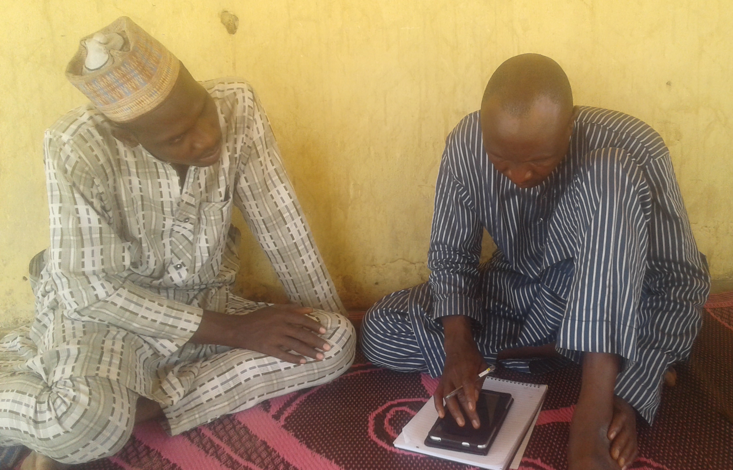
Porque RHoMIS?
  Facilitar mejores prácticas en las encuestas a pequeños agricultores
    Producir datos e indicadores armonizados
    Facilite la reutilización de datos, más beneficio por entrevista
    Encuesta lista para usar, bien probada, eficiente
  Cobertura holística a nivel de finca-hogar
  Suficientemente flexible para ser utilizado en muchos lugares y proyectos
  Código de informes y procesamiento de datos existente
Notes:
FSA data allow us to
(i) identify general rules or system behaviours
(ii) Mine dataset for location of farm - specific findings as and when needed
User friendly tools:
Probably familiar with RHoMIS - a tool for data collection
May not be so familiar with my work on innovation and adoption - typology–decision tree with 1AF
Or my work on developing a scalable approach to assessing sustainable intensification of farming systems
Why develop tools? It means the work – the research and the findings – can be scaled up. Can be repeated by numerous parties operating in different contexts. There is also a chance that through developing tools a contribution to procedural knowledge will be achieved, and whoever develops the next tools will do it a little bit better.
Collabs:
Scaling, agility, and implementation along the “impact pathway”.
Scaling of RHoMIS was primarily through CG colleagues (mainly Mark van Wijk’s contacts). And of course analysis, scientific writing, sometimes funds, ideas…
Universities - honorary position at Bristol, (access to different funding opportunities – e.g. PhD funding for Léo, GCRF bid for covid monitoring work. Now they are recruiting a data scientist whose remit will be on rural development issues, and have asked me to assist with the recruitment procedure.
Also I’ve developed networks outside the CG, E.g. NGOs - tree aid, 1AF, and some other shorter term collabs….

Slide 4
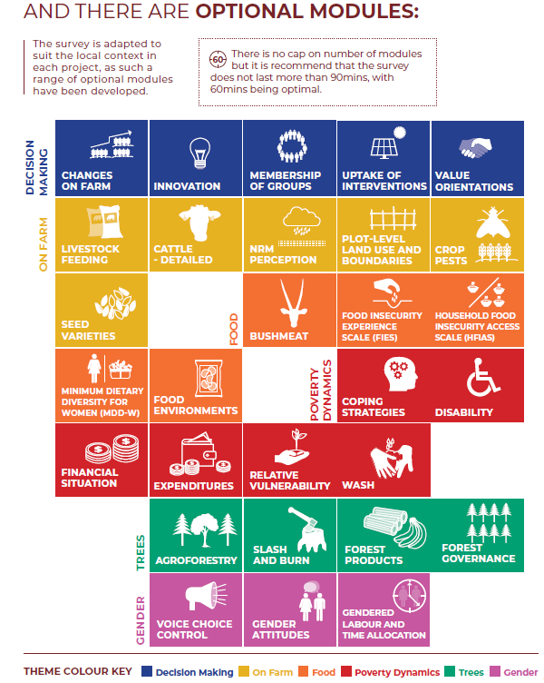
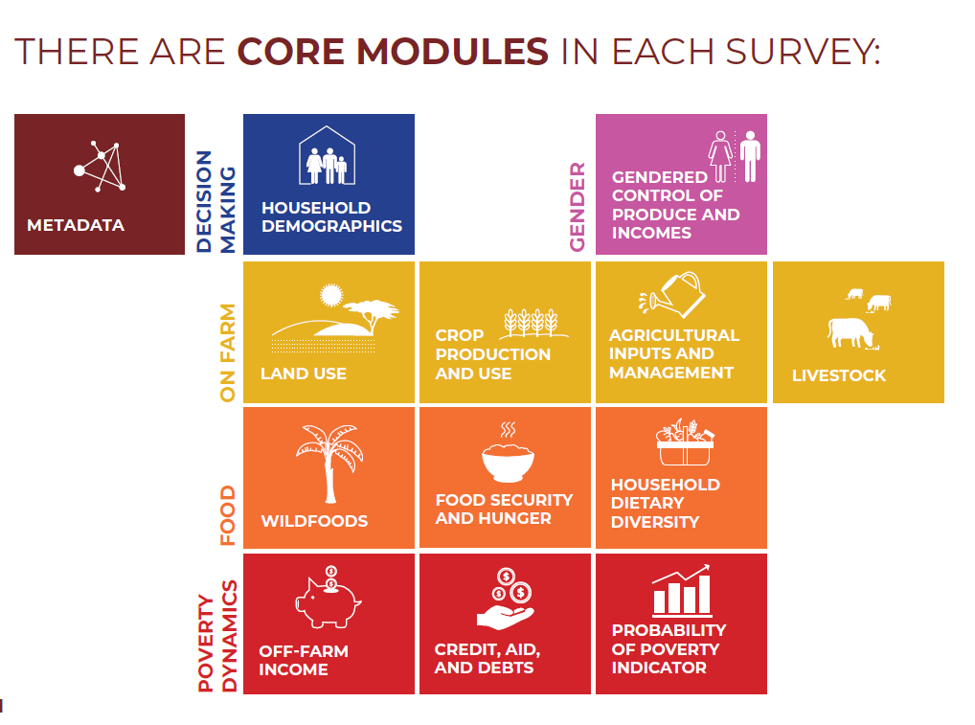
Modular Approach to Building Survey
+ Bespoke user-defined questions and indicators
Note: Environmental indicators are generated from the “on-farm” modules
Notes:
FSA data allow us to
(i) identify general rules or system behaviours
(ii) Mine dataset for location of farm - specific findings as and when needed
User friendly tools:
Probably familiar with RHoMIS - a tool for data collection
May not be so familiar with my work on innovation and adoption - typology–decision tree with 1AF
Or my work on developing a scalable approach to assessing sustainable intensification of farming systems
Why develop tools? It means the work – the research and the findings – can be scaled up. Can be repeated by numerous parties operating in different contexts. There is also a chance that through developing tools a contribution to procedural knowledge will be achieved, and whoever develops the next tools will do it a little bit better.
Collabs:
Scaling, agility, and implementation along the “impact pathway”.
Scaling of RHoMIS was primarily through CG colleagues (mainly Mark van Wijk’s contacts). And of course analysis, scientific writing, sometimes funds, ideas…
Universities - honorary position at Bristol, (access to different funding opportunities – e.g. PhD funding for Léo, GCRF bid for covid monitoring work. Now they are recruiting a data scientist whose remit will be on rural development issues, and have asked me to assist with the recruitment procedure.
Also I’ve developed networks outside the CG, E.g. NGOs - tree aid, 1AF, and some other shorter term collabs….

Slide 5

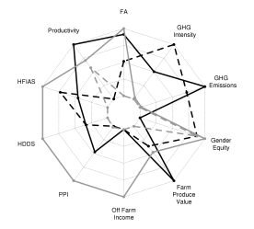
Setup
ODK survey definition
Database
R data analysis code (automatically linked to database labels)
Data
server
Visualization of results
ODK
survey
Survey
results
Interview farmer

Slide 6
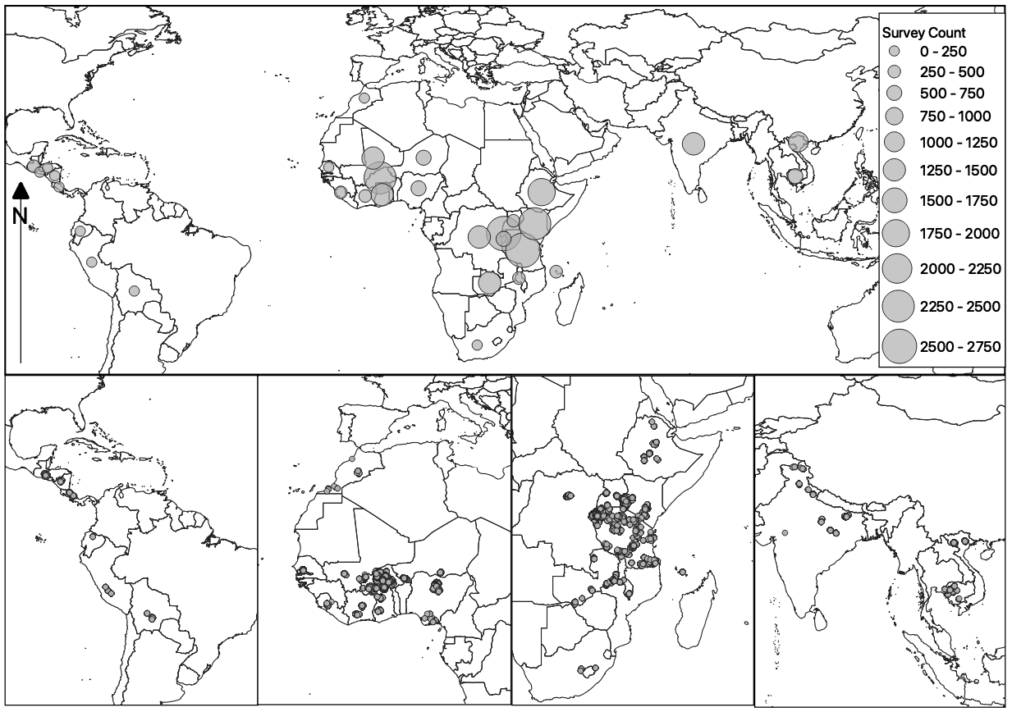
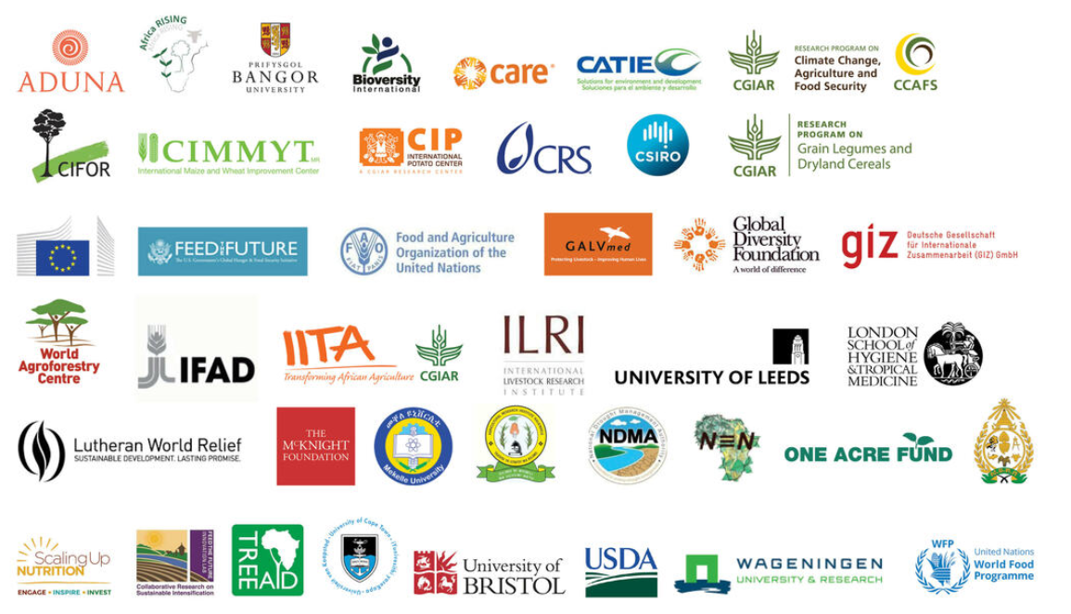

The Global Database
More than 45,000 household interviews in 33 countries – link here
Partner organisations include CGIAR, research institutes, universities and NGOS
www.rhomis.org

Slide 7
Basis for a coherent portfolio of analyses
Modeling and Projections
Characterisation
Agro-ecological characterization
Vulnerability assessment
Scaling potential
Scaling-up geographic representation of analyses
Climate and other threats foresight
Farm typologies
Positive deviants
Farming Systems Analysis
Integrated multi-variate assessment
Quantification of system dynamics
Segmentation/ targeting
Adoptability
Adoption & dissemination
Ex-ante impact assessment
Trade offs and synergies
Monitoring
Prioritisation

Slide 8
Posicion de RHoMIS en medir transiciones de AE
Trabajo junto con AES, RMS y RHoMIS
Juntar diferentes elementos: la vision sobre los cambios que queremos lograr, como caracterizar, como medir, elementos cualitativos & quantitativos, etc.
El dispositivo de Carlos B
Notes:
FSA data allow us to
(i) identify general rules or system behaviours
(ii) Mine dataset for location of farm - specific findings as and when needed
User friendly tools:
Probably familiar with RHoMIS - a tool for data collection
May not be so familiar with my work on innovation and adoption - typology–decision tree with 1AF
Or my work on developing a scalable approach to assessing sustainable intensification of farming systems
Why develop tools? It means the work – the research and the findings – can be scaled up. Can be repeated by numerous parties operating in different contexts. There is also a chance that through developing tools a contribution to procedural knowledge will be achieved, and whoever develops the next tools will do it a little bit better.
Collabs:
Scaling, agility, and implementation along the “impact pathway”.
Scaling of RHoMIS was primarily through CG colleagues (mainly Mark van Wijk’s contacts). And of course analysis, scientific writing, sometimes funds, ideas…
Universities - honorary position at Bristol, (access to different funding opportunities – e.g. PhD funding for Léo, GCRF bid for covid monitoring work. Now they are recruiting a data scientist whose remit will be on rural development issues, and have asked me to assist with the recruitment procedure.
Also I’ve developed networks outside the CG, E.g. NGOs - tree aid, 1AF, and some other shorter term collabs….

Slide 9
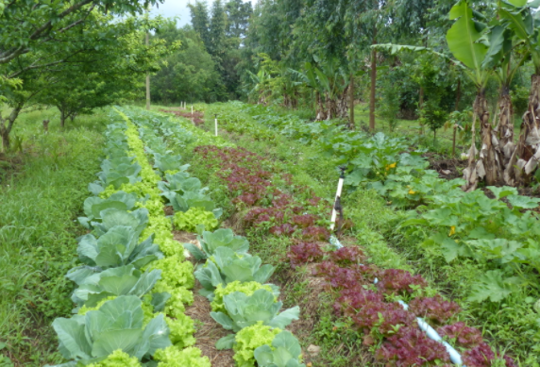
Set the vision
Involve the agents of change
Monitoring progress
Move from wide and shallow evaluations to in depth following of key indicators
Is the system changing?
Take stock of changes to the system from time to time
Select and affect strategic entry points
Identify the level for the transition
Use harmonised tools that can be contextualised
Moving from documenting practices to monitoring agroecological performance
Provide information that is useful to the agents of change
Learn from multiple experiences and share the learning

Slide 10
Un ejemplo avancado es el trabajo de los Steves, Katharina & Mark Caulfield en su proyecto
Quien esta interesado en participar y cambiar su systema de producir?
Notes:
FSA data allow us to
(i) identify general rules or system behaviours
(ii) Mine dataset for location of farm - specific findings as and when needed
User friendly tools:
Probably familiar with RHoMIS - a tool for data collection
May not be so familiar with my work on innovation and adoption - typology–decision tree with 1AF
Or my work on developing a scalable approach to assessing sustainable intensification of farming systems
Why develop tools? It means the work – the research and the findings – can be scaled up. Can be repeated by numerous parties operating in different contexts. There is also a chance that through developing tools a contribution to procedural knowledge will be achieved, and whoever develops the next tools will do it a little bit better.
Collabs:
Scaling, agility, and implementation along the “impact pathway”.
Scaling of RHoMIS was primarily through CG colleagues (mainly Mark van Wijk’s contacts). And of course analysis, scientific writing, sometimes funds, ideas…
Universities - honorary position at Bristol, (access to different funding opportunities – e.g. PhD funding for Léo, GCRF bid for covid monitoring work. Now they are recruiting a data scientist whose remit will be on rural development issues, and have asked me to assist with the recruitment procedure.
Also I’ve developed networks outside the CG, E.g. NGOs - tree aid, 1AF, and some other shorter term collabs….

Slide 11

Iterative mixed methods approach
Qualitative interviews
Analysis of
RHoMIS data

Slide 12
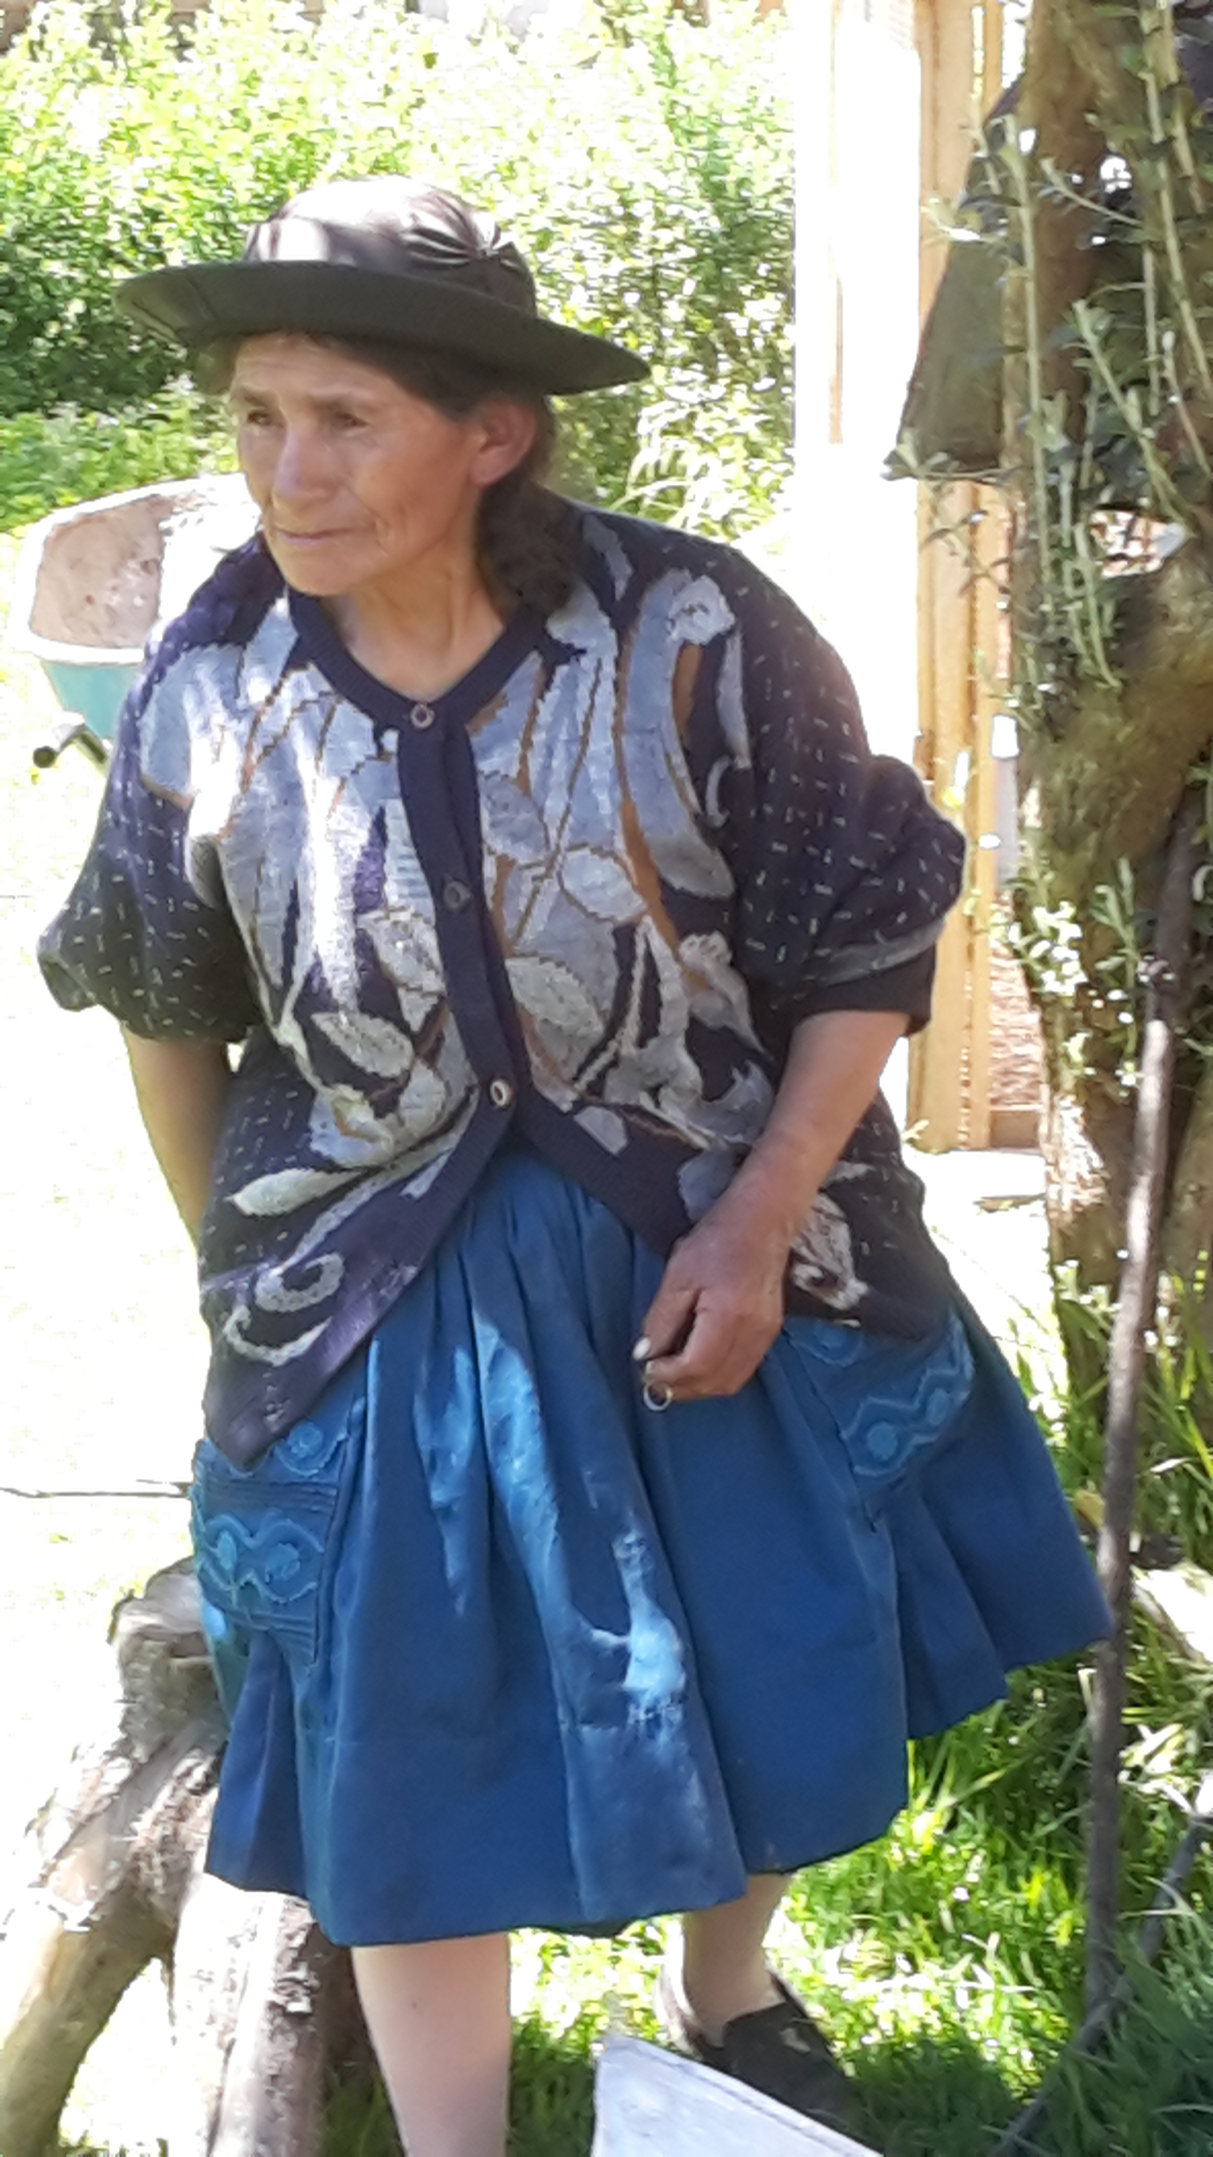
A road to better understanding participatory research
171 RHoMIS surveys were collected from the 8 communities in February and March 2018.
Households surveyed were randomly selected from each of the communities.
Households were subsequently categorized into four groups: 1) Full Participants; 2) Dropped-Out; 3) Only Meetings; and 4) Non-Participants.
Qualitative interviews were conducted on HHs from the RHoMIS survey – 2 from each group in each of the communities to help interpret the survey data.

Slide 13
Variable | p-value | Household type
 | p-value | Full Participants | Dropped-Out | Only Meetings | Non Participants
HH members (persons) | <0.01 | 4.77 (0.44)a | 4.81 (0.71)a | 3.90 (0.48)ab | 3.24 (0.51)b
HH head age (years) | <0.01 | 44.3 (1.88)b | 51.1 (3.84)ab | 51.6 (2.14)a | 55.0 (2.48)a
Farm income ($ year⁻¹) | <0.10 | 897 (263)a | 1687 (558)ab | 719 (299)ab | 581 (365)b
Value farm produce ($ year⁻¹) | <0.10 | 1631 (511)ab | 3537 (1084)a | 1467 (582)ab | 1158 (710)b
Total income ($ year⁻¹) | 0.08 | 1161 (330)a | 1944 (650)a | 898 (372)ab | 755 (436)b
Broad characterisation of the household types:
Compared to non-participants, participating HHs are resource endowed – younger, larger households with greater financial resources

Slide 14
Interpretacion qualitativa: las historias de ‘porque si’ o ‘porque no’
1) The farm lifecycle and a “wait and see” approach
“In the case [where the household is comprised] of an old couple, and that don’t have any children in the community, participation is more difficult.”
“While less resource endowed neighbours are not participating in the research, they are closely following the progress of the [experimental] plots”.
“[I do not have] enough time to participate directly in the research, [but am] waiting with interest to understand the results of the project and the final evaluations... I want to see the productivity of these [improved] fallows.”
“The fact of having small children at home requires more work... however, children over 10 years old are more independent which allows not only the husband to attend community meetings [about the participatory research], but the wife too. For households [comprised of] an older couple, active participation in the project and communal activities becomes difficult.”

Slide 15
Gracias!!

