Slide 1
CdP-12 Andes
10 Julio 2016

Slide 2

Agradacimientos
Thanks for being here
Thanks to our organizers
Notes:
Welcome Julio Postigo

Slide 3
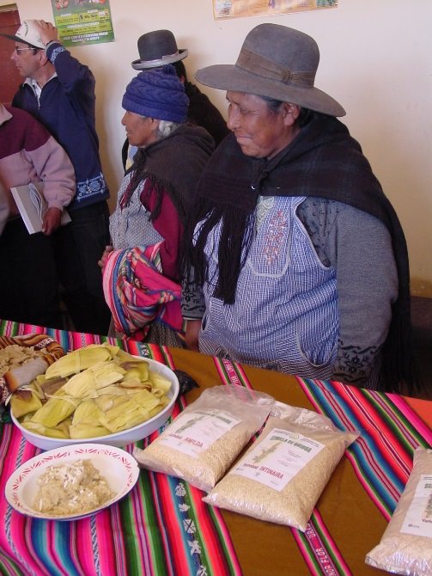
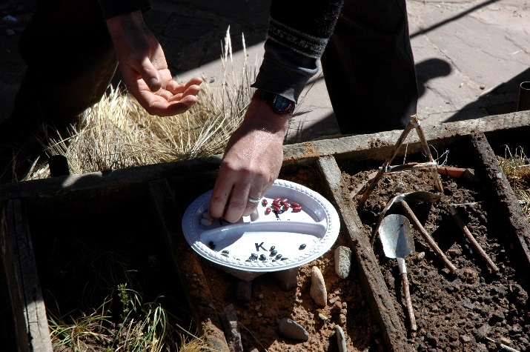
Algunos reconocimientos…
Notes:
The people, culture, beauty of the Andes
The collective strength and creativity of the Andes CoP
The new and old ideas that we are working with to maintain and improve what people value about the Andean agroecosystems
→ System: Andean agriculture interacting with the social and technical innovations fueled by the CoP

Slide 4
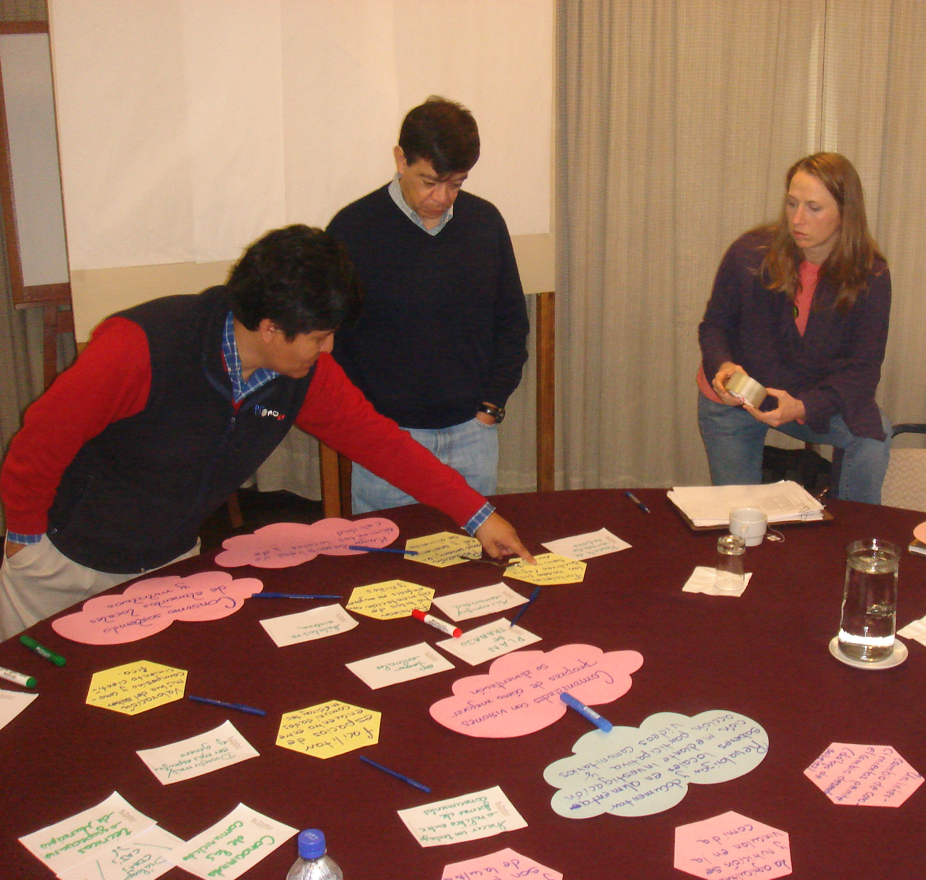

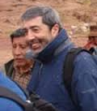

Equipo regional
Notes:
People are a key component of the program system. Note all these changes for the Andes RT… Carlos P. passing, Julio K. moving up and out, Julio P. joining, Carlos B. getting thinner…
In the Claire photo, the RT is working with Sergio on a systems analysis (ToC) of one of the projects.

Slide 5
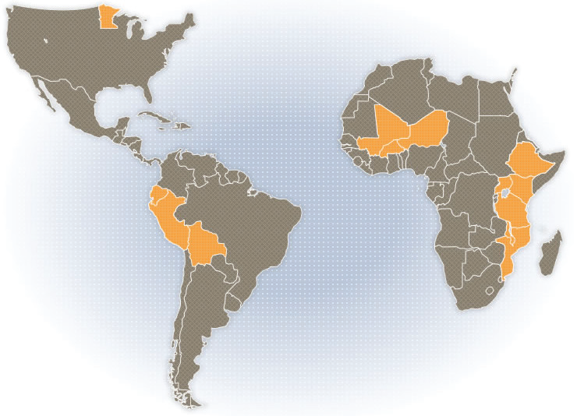
CdP-11 Andes
McKnight, program updates
Towards AEI
Towards innovative R+D systems
Notes:
Andes CoP as a part of the larger CCRP system. The whole program learns from your experiments and advances and we’d like to share some developments from the rest of the CCRP with you too.

Slide 6
Systems Perspective (see Strategic Framework -www.mcknight.org)
Adaptive Action and Emergent Learning
Impact Investing to align investments with grantmaking

Slide 7
Donor ecology
Agriculture
R + D
system
Donors
Notes:
What are others doing? What’s special about MF/CCRP?

Slide 8
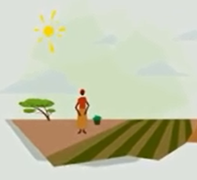
Diferentes ideas sobre el camino a seguir
Más de lo que queremos con lo que tenemos
Mejorar la eficiencia del uso des insumos
La intensificación sostenible
Utilizar los procesos naturales en lugar de los combustibles fósiles , pesticidas, etc.
Deshacerse de los pequeños productores; vamos con fincas grandes
La transformación agrícola
La intensificación agroecológico
Revolución Verde
Levar entradas (de petróleo) a los pequeños productores
Notes:
2-4

Slide 9
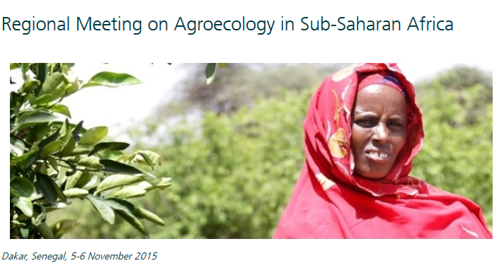
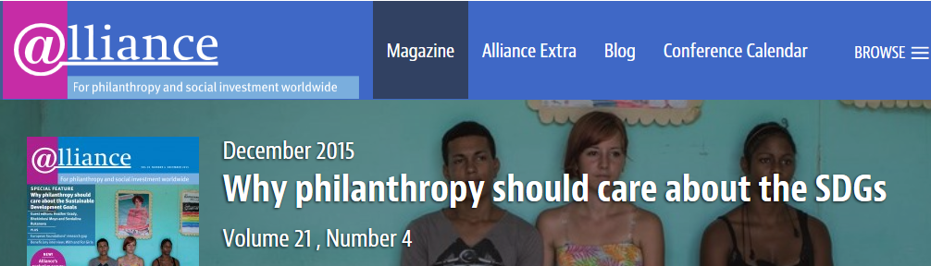
Agroecología : una creciente atención mundial
Cambios en el exterior
Reuniones regionales de la FAO
Objetivos de desarrollo sostenible (SDGs)
Contabilidad verdadero del costo de la agricultura
El interés en FRN
Notes:
Screen grab of philanthropy doc re: SDGs
How and the what imporatn

Slide 10

CCRP External Contributions
FAO Agroecology Knowledge Hub
TEEB/Food Tank
Global Alliance for the Future of Food
Sustainable Development Solutions Network
Notes:
Leadership and Grants – What do we want to do if anything around SDGs? SDSN is one option.

Slide 11

Notes:
A lot of the SDGs (most or all?) have implications for food, food systems and agricultural development. The list of n=17 doesn’t really make that very clear, though…

Slide 12
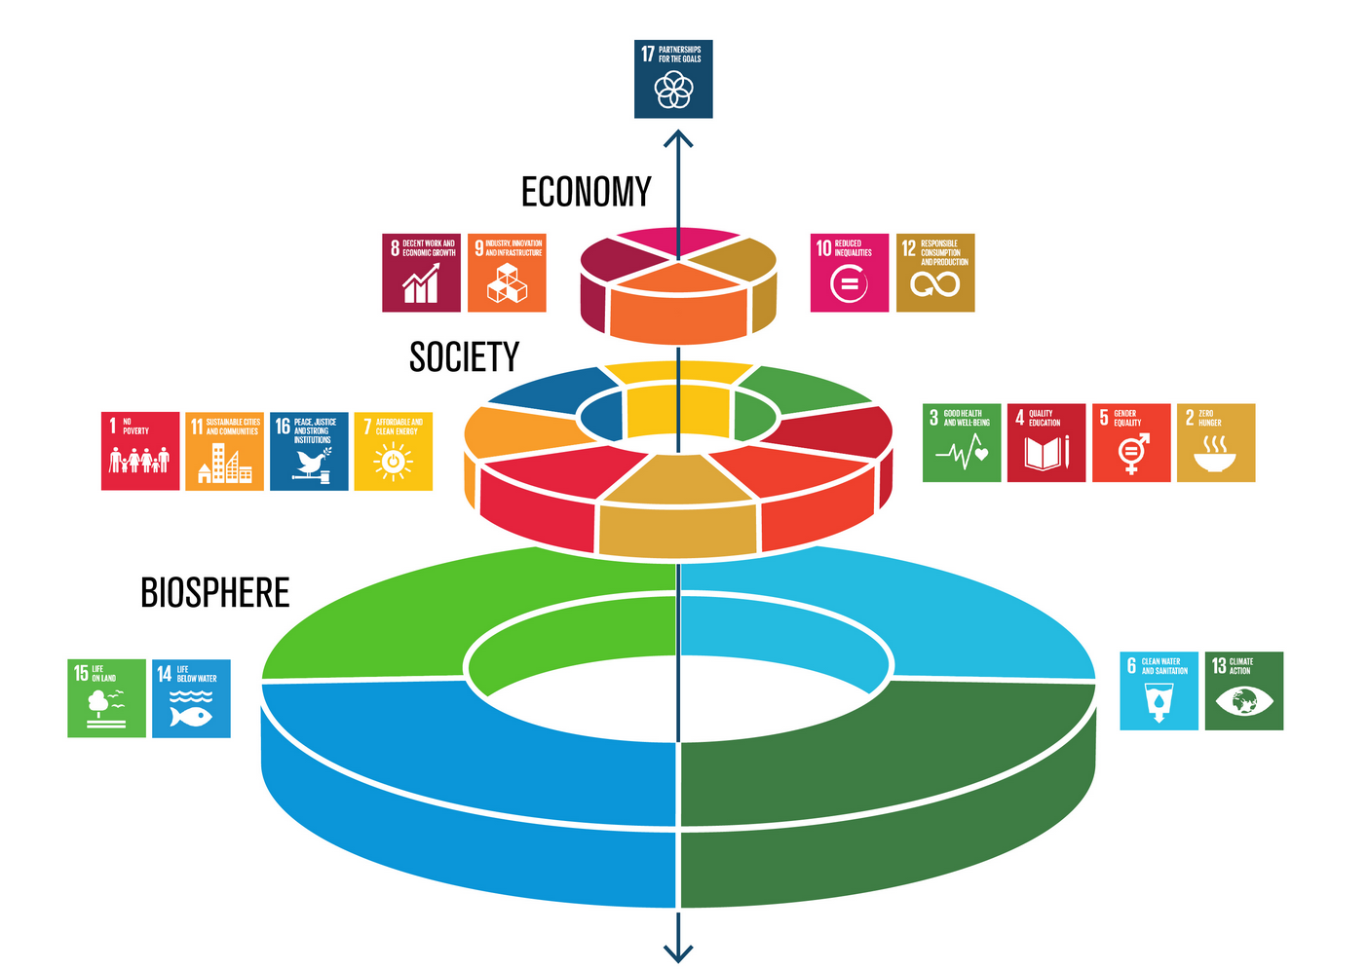
http://www.stockholmresilience.org/images/18.36c25848153d54bdba33ec9b/1465905797608/sdgs-food-azote.jpg
Notes:
It’s more helpful to think of how the pieces fit together. Here’s Rockstrom’s take.

Slide 13
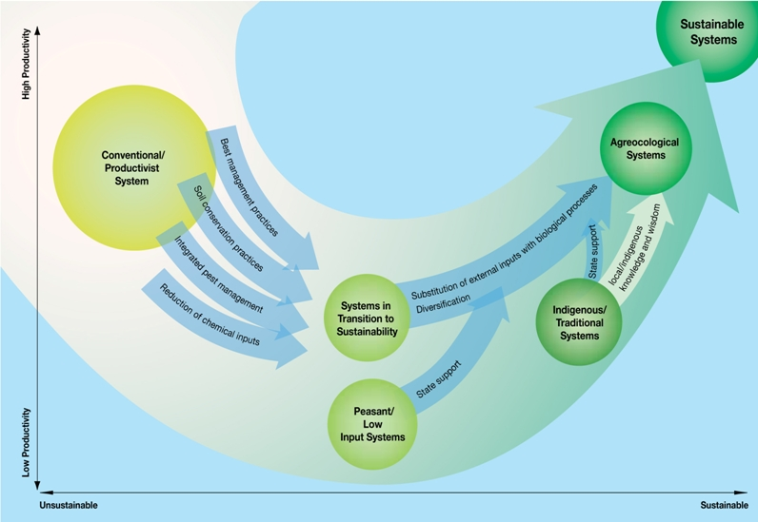
Pathways to sustainability
Source: IAASTD Latin America and Caribbean Summary for Decision Makers.
Building soil carbon
Increasing nutrient cycling
Crop diversification
Crop-livestock integration
Ecological approaches to pests and diseases
Landscape-level management

Slide 14
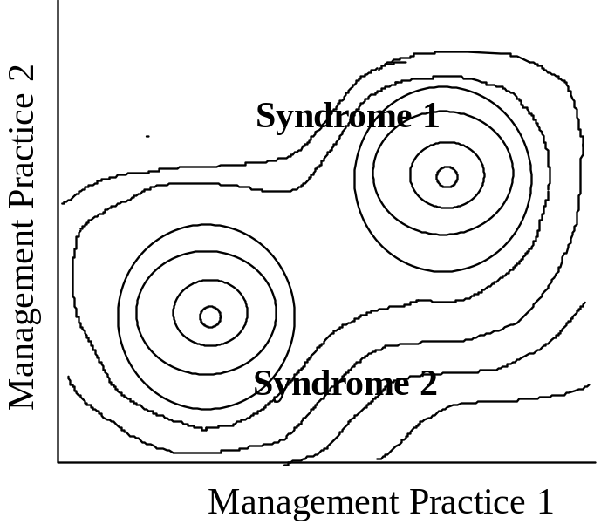
Intensificación agroecológica
AEI progress
  What are we doing?
  How and why?
  So what? Now what?
Building innovative R+D systems
Notes:
Define AEI, with a focus on the concept of “intensification” – improving the performance of farms and farming systems through the integration of AE principles… performance being defined subjectively – not just productivity, but nutrition, ecosystems services, cultural services, livelihoods, equity, etc etc. Syndrome shift from degerative → regenerative (both socially and biophysically)

Slide 15
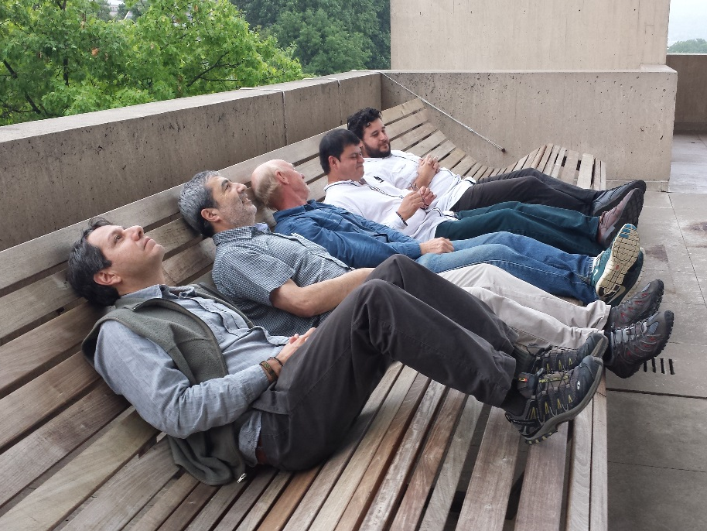
Fronteras del CCRP
AEI: Stepping it up
Coherence: fitting the pieces together
Research quality: rigor and participation

Slide 16


Productivity
Nutrition
Livelihoods
Sustainability
Equity
CoP
Crop impr
P&D
Diversi-
fication
AEI
FRN
Markets
Orgs
Notes:
Similarly, CCRP grantees are diverse and work on a lot of things. What’s the logic? How do the pieces fit together? How can they synergize to affect positive change for people and environments? That’s why we come together in regional CoPs. The Andes CoP is now in its 2nd decade and brings us a lot or pride and great ideas.

Slide 17
AE “Intensification” = using AE to build wealth
DFID’s Sustainable Livelihoods Framework
Ford Foundation’s Rural Wealth Creation Framework
Financial
Physical
Human
Social
Natural
Individual
Cultural
Financial
Natural
Social
Intellectual
Political
Built
Notes:
While some tend to look solely at productivity or economic benefits, many are finding it makes more sense to consider a wider range of assets that can be used for development, as well as assets that should be valued as outcomes of development. Include “methodological capital” as an input asset for researchers (formal or farmer)?

Slide 18
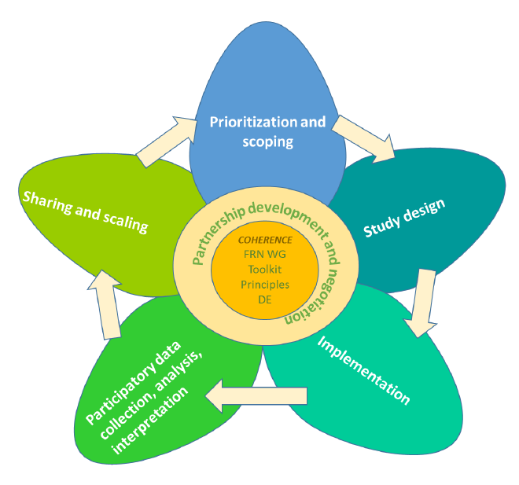
Farmer Research Networks
Peanut aflatoxin (Andes)
FRN-NGO (Kenya, EAf)
Drylands FRN (Kenya, EAf)
Ethiopia FRN (Ethiopia, EAf)
Best bets (SAf)
Pigeonpea FRN (SAf)
Seed systems (WAf)
Women’s plots/farmer org (WAf)
Notes:
FRN is an idea from the program that is getting a lot of interest both within and outside of CCRP.
Here’s a sample of projects. We are tracking their development conceptually and practically. Monitoring and refining their potential for impact.

Slide 19
Institutional innovation
Program update
AEI progress
Building innovative R+D systems
  Relevance
  Credibility
  Equity
Tools and methods
  Skills to use them
Leadership capacity
Facilities
Farmer engagement, including FRN
Community of practice
  Brings it together
  All come together to create a sustainable, adaptive R+D system
Notes:
Jane - Appreciations
CCRP 2015-6
About LM9
Internal Updates
Progress
Priorities

Slide 20
Cross-cutting grants
Global
Food Tank
FAO’s Agroecology Knowledge Hub
PhotoSynQ (SoilSpeQ, GrainSpeQ)
Support
Innovation
Soils
Regional CoP grants
Research Methods Support
GIS
Leadership
Local (CCRP)

Slide 21
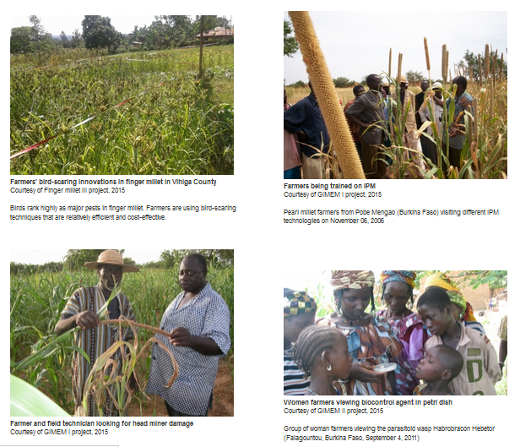
Program communications
Thanks to all
who have helped with this
Check it out!
Improve your Web page
CCRP.org
  FRN, IMEP, RMS pages
  Competitions for photos, Web pages
Book and gallery exhibit
Quarterly Newsletter
Meetings >> virtual
Take a photo tour of CCRP!
Notes:
Na, Molly

Slide 22
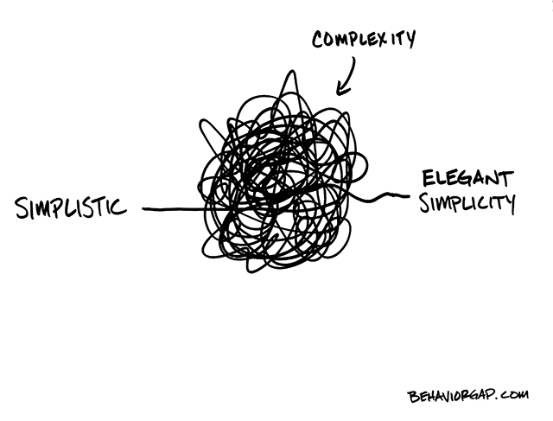
Synthesis: making meaning of complexity
Identify patterns
  Similarities, differences, etc
Learning from each other
Models: conceptual and dynamic
  How the world works
  How change happens

